Slide 1

Congratulations on being approved for a Section 8
Housing Choice Voucher!
Notes:
Hello and welcome ☺

Slide 2
SECTION 8 HOUSING CHOICE VOUCHER BRIEFING
CDA-City of Madison
215 Martin Luther King Jr. Blvd. Ste 161
Madison, WI 53703
Phone: (608) 266-4675
Fax: (608) 264-9291
Website: https://www.cityofmadison.com/dpced/housing

Slide 3
GOALS FOR TODAY:
To learn how the Section 8 Program (also known as “Housing Choice Voucher” program) functions
To take the information learned today to successfully use your voucher and fulfill your responsibilities as a voucher holder
To review, initial, sign and date my Responsibility Agreement and Briefing Certificate – and submit copies to CDA by my assigned due date
Notes:
Understanding and having success with the Section 8 program

Slide 4
RESPONSIBILITY AGREEMENT
  EACH NUMBERED ITEM WILL BE REVIEWED
  PLEASE WRITE DOWN ANY QUESTIONS YOU MAY HAVE FOR YOUR ASSIGNED HOUSING SPECIALIST TO REVIEW WITH THEM AFTER RECEIVING YOUR VOUCHER
  PLEASE INITIAL EACH NUMBERED ITEM AS REVIEWED – all items must be initialed (Only the head-of-household needs to initial)
  SIGN AND DATE FORM (ALL ADULTS in the household)
    ALL ADULTS IN THE HOUSEHOLD ARE RESPONSIBLE TO UNDERSTAND AND ABIDE BY THE INFORMATION SET FORTH ON THE VOUCHER AND RESPONSIBILITY AGREEMENT
  A COPY OF THIS FORM MUST BE RETURNED TO CDA BY THE ASSIGNED DUE DATE ON YOUR VOUCHER BRIEFING LETTER IN ORDER TO RECEIVE YOUR ACTUAL VOUCHER PAPERWORK.

Slide 5
1. I must abide by all of the family obligations listed on the voucher. Violation of any family obligation can be cause for termination from the program.

Slide 6
2. I must provide only true and complete information to the CDA.

Slide 7
3. I must receive written approval from CDA and the landlord before anyone can move in with me. I will not allow anyone not on my voucher/lease to use my address for any purpose.

Slide 8
4. I must notify CDA in writing within 10 days of the birth, adoption or court awarded custody of a child and/or if any household member leaves the unit.

Slide 9
5. In order to remove a household member who has income, I must provide CDA with verification of where that person now resides.

Slide 10
6. I must notify CDA in writing within 10 days of ALL changes in household income, including income of minor children and full-time students.

Slide 11
7. If I report a decrease to my household income, I will need to provide verification of the decrease to CDA. I understand that it may take up to 60 days for CDA to process the change (after receiving the verification), and the change may be processed retroactively to the first of the month after it was reported.

Slide 12
8. If I do not properly report an increase to household income, I will be required to pay back the CDA any excess monies paid to the landlord. I may also be removed from the Section 8 program.

Slide 13
9. If the amount of housing subsidy provided by CDA is reduced to zero, I understand that my participation in the voucher program will automatically be terminated 180 days after the last subsidy payment.

Slide 14
10. If I have out-of-pocket child-care expenses for children in my household under the age of 13 due to employment, seeking employment or attending school, I must report and provide verification in order to receive a reduction in my rent.

Slide 15
11. I will sign a lease agreement with the landlord, and I am obligated to live by ALL the rules and conditions of the lease (ie: paying rent on time, no unauthorized people living in my unit, paying utilities, etc.)

Slide 16
12. I can be terminated from the Section 8 program for serious or repeated violations of the lease agreement with the landlord.

Slide 17
13. I will provide CDA with copies of any lease violation or eviction notices and any eviction related court documentation.

Slide 18
14. If evicted in court, I may be terminated from the Section 8 program.

Slide 19
15. I may be terminated from the Section 8 program if I move out of my assisted unit without prior approval by CDA

Slide 20
16. I must obtain approval from CDA before signing any leases/renewals with the landlord.

Slide 21
17. I must obtain CDA approval for ANY additional money paid to the landlord beyond CDA approved rent and utilities. CDA must approve the landlord providing me with a rent credit for work done on property.

Slide 22
18. I cannot sublease the assisted unit or any part of the assisted unit.

Slide 23
19. Upon moving to a new unit, I will not be permitted to move within the initial lease term in the lease agreement. CDA will not approve a lease agreement rescission between myself and the landlord during this initial term.

Slide 24
20. I must notify CDA in writing of my intention to move at least 60 days before my intended vacate date.

Slide 25
21. I will not be issued a moving voucher until BOTH of the following occur:
1) It is confirmed that I provided proper notice to my landlord
2) I have provided CDA with all necessary paperwork and income/asset/expense verification.

Slide 26
22. I am responsible for my household members and guests of all ages. If any participate in any illegal drug or violent criminal activity, my entire household can be terminated from the Section 8 program.

Slide 27
23. If I or any household members/guests threaten, verbally abuse or commit actual violence to any CDA staff, termination of my participation in the Section 8 program will begin.

Slide 28
24. I understand I have the right to an informal meeting/hearing when there is a disagreement between the CDA and myself over these rules, or if CDA begins termination of my Section 8 participation.

Slide 29
*Elderly and disabled Households only*
25. If I have out-of-pocket medical expenses that I would like to be counted as a deduction to my rent calculation, I will provide verification of the medical expenses to the CDA.

Slide 30
I HAVE READ, INITIALED, SIGNED AND DATED THIS AGREEMENT.
I understand I can reach out to my future assigned Section 8 Housing Specialist with any questions regarding this agreement.

Slide 31
After completing this briefing and submitting your documentation, your CDA Housing Specialist will send you the following documents to begin your housing search:
VOUCHER
REQUEST FOR TEANANCY APPROVAL (RFTA)
GROSS RENT VOUCHER LIMIT CALCULATION
UTILITY ALLOWANCE WORKSHEETS

Slide 32
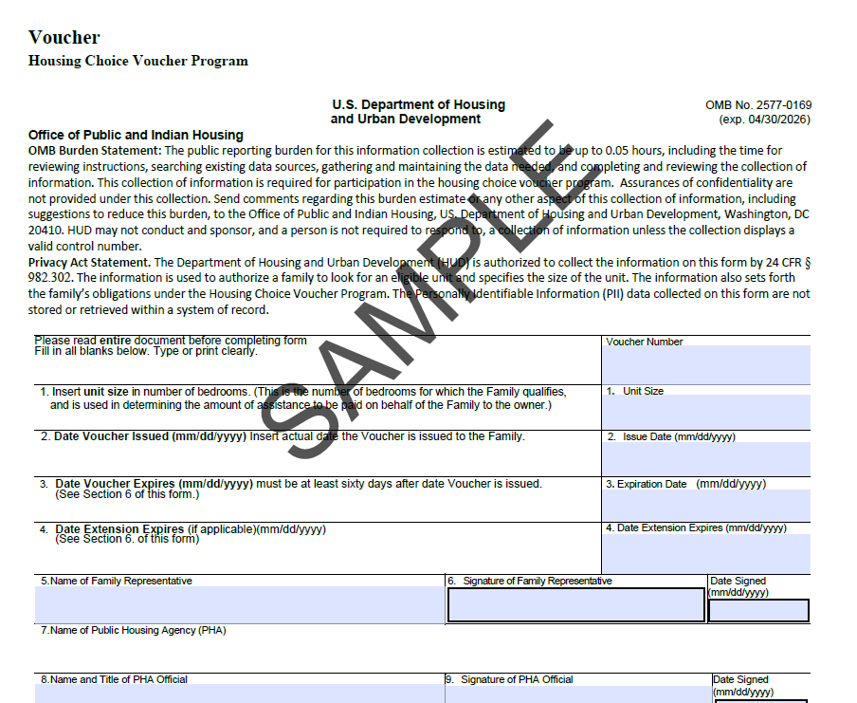
VOUCHER
(form HUD-52646)
Your assigned voucher size
Date your voucher is issued
60 days from date of issuance
If you are approved for a voucher extension, it will be listed here in the future
Name of the Head of household
Signature/date of Head of household
CDA-City of Madison
Name of your assigned CDA Housing Specialist
Signature and date of your CDA Housing Specialist
Notes:
When applying for a unit, it is up to you to disclose that you have a housing voucher. If you do disclose that you have a housing voucher, the housing provider will most likely want to see the voucher and make a copy for your application- this is an acceptable practice.

Slide 33
VOUCHER EXTENSION REQUESTS
Must be submitted in writing
Must be submitted before the voucher expires
Up to 2 additional 30-day extensions may be approved for a total voucher search time of 120 days
If additional time is still needed, approval will need to be processed through a reasonable accommodation request
The voucher expiration date is the due date for submission of the Request for Tenancy Approval (RFTA) form and one-year, unsigned lease
The unit does not need to be inspected by the expiration date
The lease does not need to begin before the expiration date
Once you submit the RFTA/lease, the time on the voucher “clock” stops; if the unit does not work out, you will be provided with an extension for the number of days that remained on your voucher when the paperwork was submitted

Slide 34
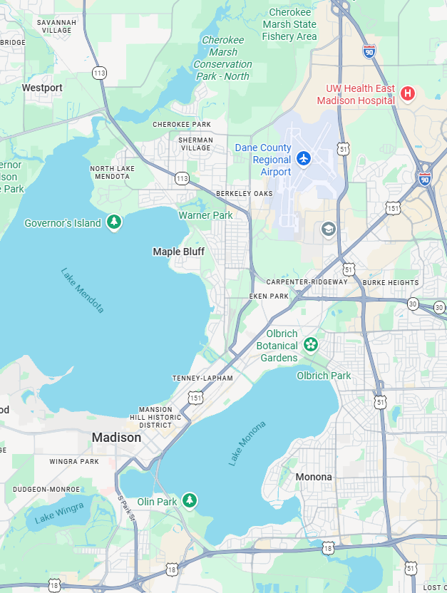
Where can I use my voucher?
The CDA-City of Madison’s jurisdiction includes units that are found within the City of Madison limits only!
To check if a unit is within the City limits you can search for an address at: https://www.cityofmadison.com/assessor
If the search provides property details → the unit IS within the CDA jurisdiction.
If the search states “no property information was found based on your search→ the unit IS NOT within the CDA jurisdiction*
*You might be able to transfer your voucher to the Dane County Housing authority to lease up in their jurisdiction

Slide 35
PORTABILITY: ability to transfer housing voucher assistance from one housing authority jurisdiction to another with a housing voucher program
Portability at admission
Portability after initial lease-up
Each housing authority determines in their Administrative Plan if an applicant voucher holder is able to port their voucher at admission
CDA’s Administrative Plan states:
“If neither the head of household nor the spouse/co-head of an applicant family had a domicile (legal residence) in the CDA’s jurisdiction at the time of submission of the family’s full application (not at the time of the family’s entry into the lottery), the family must live in the CDA’s jurisdiction with voucher assistance for at least 12 months before requesting portability”
At your annual recertification and coming up to completing your lease term, you can request a moving-voucher
You can request to port this voucher to another housing authority jurisdiction

Slide 36
Things to remember about Portability:
Your voucher size will be determined by the housing authority that is receiving you and your voucher (it could be smaller!)
Your voucher limit will be determined by the housing authority that is receiving you and your voucher (it could be more or less depending on their payment standards and the voucher size issued to you)
Portability takes time! You may be required to complete a portability application, attend a briefing in person, etc. In addition to that…
You will still need to find a unit, apply and get approved for it, have the housing provider complete and submit the paperwork and the unit needs to pass inspection/rent be approved before you can be moving in

Slide 37
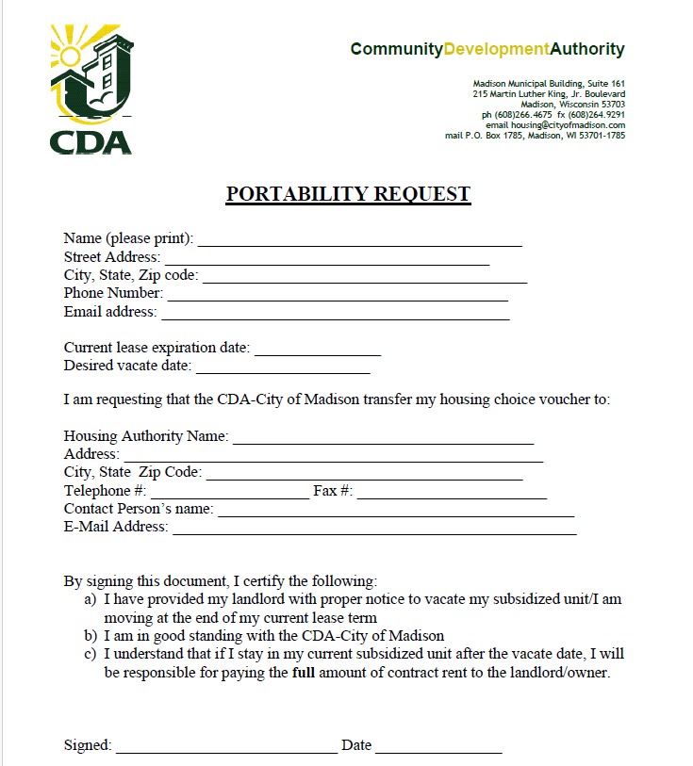
Portability Request form
To be completed and submitted to your housing specialist to let us know where you would like CDA to send your paperwork

Slide 38
VOUCHER SIZES
  1 bedroom on the voucher will be provided for each two persons within the household
  Exception: Persons of different generations and opposite sex (other than spouses and children under age 6) will be provided 1 bedroom each on the voucher
    HOH= Head of Household
  Example 1: HOH and One child → 2-bedroom
  Example 2: HOH and 2 female siblings → 2-bedroom
  Example 3: HOH, 1 male (8 y/o), 1 female (4 y/o) → 3 bedroom
  Example 4: HOH, 1 male (3 y/o), 1 female (4 y/o) → 2 bedroom
  Example 5: Married couple → 1- bedroom
  Example 6: HOH, other adult of different sex, 2 males (8 y/o), 1 female (4 y/o) → 4- bedroom
Exceptions to your assigned voucher size must be requested in writing to your housing specialist and will be processed as a reasonable accommodation as to accommodate a disabled household members disability, medical or health condition
The CDA Reasonable Accommodation Specialist must be able to make a connection between the need for an additional room and the disability

Slide 39
CDA-City of Madison Payment Standards
As of 07/01/2026
Voucher Size | Payment Standard [City/Downtown (53715 & 53703) ] Voucher limit if at $0 income
1 | $1,600 / $1,800
2 | $1,850 / $2,100
3 | $2,400 / $2,700
4 | $2,700 / $3,000
5 | $3,100 / $3,750
6 | $3,500 / $4,850

Slide 40
Gross Rent
Gross rent = contract rent + utility allowance for unit
If the housing provider has any non-negotiable fees that are charged separately from the rent, we will add these fees to the contract rent to get the gross rent (ie: pest control, trash, amenity fees, etc.)

Slide 41
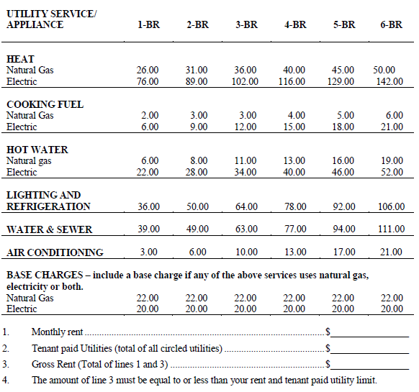
UTILITY ALLOWANCE WORKSHEETS
3 Different types of unit types/worksheets:
MULTI-UNIT STRUCTURES
DUPLEX, TOWNHOUSE/ROWHOUSE
DETACHED UNITS
**Make sure to utilize the worksheet that matches with the unit type you are looking to rent**
What bedroom size utility should be used?
  The bedroom size utility is usually equal to voucher size… however,
  If you are looking at a unit smaller than your voucher size, use the actual unit size
  If you are looking at a unit larger than your voucher size, use your voucher size
Circle the utilities that the tenant is required to pay. The total of these is the unit Utility Allowance or “Tenant Paid Utilities”.

Slide 42
Gross Rent Voucher Limit Calculations
The Gross Rent Voucher Limit for each voucher family varies!
Your voucher limit is determined by:
Payment standard of issued voucher size
+
10% of the household monthly
adjusted income
Example
Voucher size issued: 3 bedroom
Payment standard for 3 bedroom: $2400
10% of monthly adjusted income: $100
Gross Rent Voucher Limit → $2500
**This means that the contract rent + the utility allowance for the unit cannot total more than $2500**

Slide 43
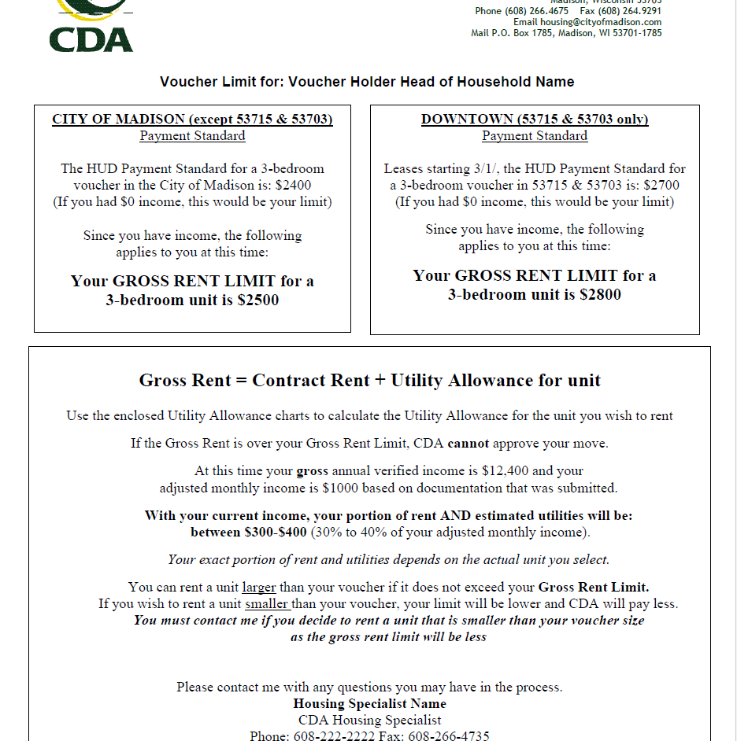
Gross Rent Voucher Limit Calculation
You will be provided with 2 different voucher limits:
For units within the general City of Madison area (box on the left)
For units in the 53715 & 53703 zip codes ONLY (box on the right)
The rest of the document will provide:
An overview of your household income
30%-40% of your monthly adjusted income amounts
Information on renting a unit larger or smaller than your assigned voucher size
Contact information of your CDA Housing Specialist

Slide 44
Things to Keep In Mind…
If the gross rent of the assisted unit is at or below the payment standard of the voucher size, the family will contribute 30% of their monthly adjusted income toward rent + estimated tenant-paid utilities
  This is the minimum a family will contribute (unless at the $50 minimum tenant contribution)
When a voucher holder has income and moves into a new approved unit, the maximum they can contribute is 40% of their monthly adjusted income toward rent + estimated tenant-paid utilities
  If a unit would require more than 40%, the unit will NOT be inspected or further processed by CDA
After a family has been in a unit and their circumstances change (ie: income decreases, voucher size decreases, contract rent increases), they could end up contributing more than 40%.
  If a family’s income goes down to $0, this does NOT guarantee that their rent + estimated tenant-paid utilities will decrease to $0.

Slide 45
Minimum Rent Hardship Exemption
If 30% of the monthly adjusted income of a family is less than $50, CDA has a minimum monthly tenant (voucher holder) contribution of $50.
In the event that the family is not able to contribute the $50 minimum due to one of the situations below, they may be exempt from contributing the $50 for a certain time period until their financial situation changes:
1) They lost ability for or are awaiting eligibility for a federal, state or local assistance program (ie: Social Security, Unemployment, etc.)
2) The family’s income has decreased because of changed family circumstances (ie: lost job, unemployment/child support ended)
3) A death has occurred in the assisted family household
4) The family would be evicted because it is unable to pay the minimum-rent (ie: has received a 5-day notice)
5) The family has experienced other circumstances determined by CDA
**The family must submit a Minimum Rent Hardship Exemption form along with supporting documentation for processing and potential approval.

Slide 46
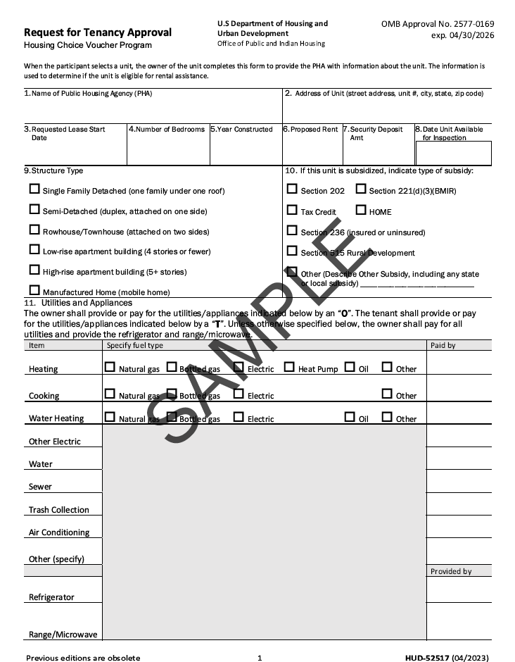
Request for Tenancy Approval
(form HUD-52517)
**To be completed by the Housing Provider**
CDA will be listed along with the name/email/telephone of your assigned CDA housing specialist
Address of proposed unit
Start date of the proposed lease
Number of bedrooms in the unit
The year the unit was built
The proposed amount of the contract rent
The amount of security deposit listed on the lease
The date the unit will be ready to be inspected
Notes:
Must be filled in completely and submitted with a filled in unsigned 12 month lease
Incomplete forms will not be processed and will cause a delay in moving to the next step

Slide 47
Request for Tenancy Approval
(form HUD-52517)
***To be completed by the Housing Provider***
The type of structure the unit is in needs to be identified
If applicable, any type of subsidy needs to be disclosed
All utility related information needs to be identified: type of energy used (usually natural gas or electric) and who is responsible to pay for each utility/appliance (the tenant or owner)
Notes:
Must be filled in completely and submitted with a filled in unsigned 12 month lease
Incomplete forms will not be processed and will cause a delay in moving to the next step

Slide 48
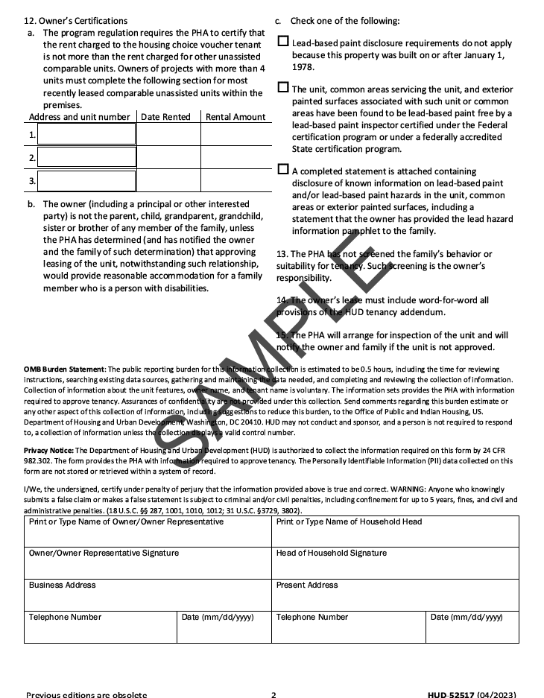
Request for Tenancy Approval
(form HUD-52517) part 2
**To be completed by the Housing Provider**
12. Owner’s Certifications
The owner may provide information about other rental units rent amounts
Owner reads/acknowledges
Owner must complete regarding Lead-Based Paint and the unit
13.-15. Owner reads/acknowledges
*Owner completes bottom left-hand corner information
---------------------------------------------------
You must complete, sign and date the bottom right-hand corner information and return the form along with a copy of the proposed one-year, unsigned lease

Slide 49
Things to remember about your Request for Tenancy Approval (RFTA) form:
Only provide your RFTA to a housing provider after you know the unit fits within your limit, you have been fully approved by the housing provider and you are confident this is where you want to use your voucher (if multiple RFTA forms are received by CDA we will process the first one that is received)
We will not process a RFTA until it is completed (all the information from the housing provider and you have completed/signed/dated your section on page 2) AND we have a copy of the proposed one-year, unsigned lease
  If you are currently in the middle of a lease and your current unit: 1) is within the City of Madison; 2) fits within your voucher limit; 3) will pass our HUD inspection and 4) you would like to use your voucher there- you can submit your current lease with the completed RFTA and “lease-in-place” with your voucher until the end of your current lease. It will be up to you at the end of your lease to request a moving voucher and move or stay in your current unit.
If the gross rent of the unit is more than your gross rent voucher limit, we will NOT be able to process the paperwork. We will let the housing provider know the amount it is over and see if they are able to decrease the contract rent to make it fit within your voucher limit. If they are not able/willing to do so, we will not be able to process the unit and you must look elsewhere*
*See Reasonable Accommodations for possible exceptions to this HUD regulation

Slide 50
I turned in my RFTA and lease, what happens now?
After the Housing Specialist determines all paperwork is complete and the unit fits within your voucher limit, the unit information will be sent to the CDA Housing Inspector
  The inspector will reach out to the housing provider to set up the unit inspection
    If you are leasing-in-place, the inspector will be notified and will reach out to you directly to set up an inspection date and time
  Once the unit has passed inspection, you will be notified by CDA by email or telephone with approval to sign the residential lease
  A copy of the signed lease must be sent to CDA
  After receipt of the signed lease, the Housing Specialist will draft the Housing Assistance Payments (HAP) contract to be sent to the housing provider for signature
  Once the housing provider returns the HAP contract with signature, CDA can submit for payment to be sent on our next payment disbursement
    Payments are disbursed around the 1st and 15th of each month

Slide 51
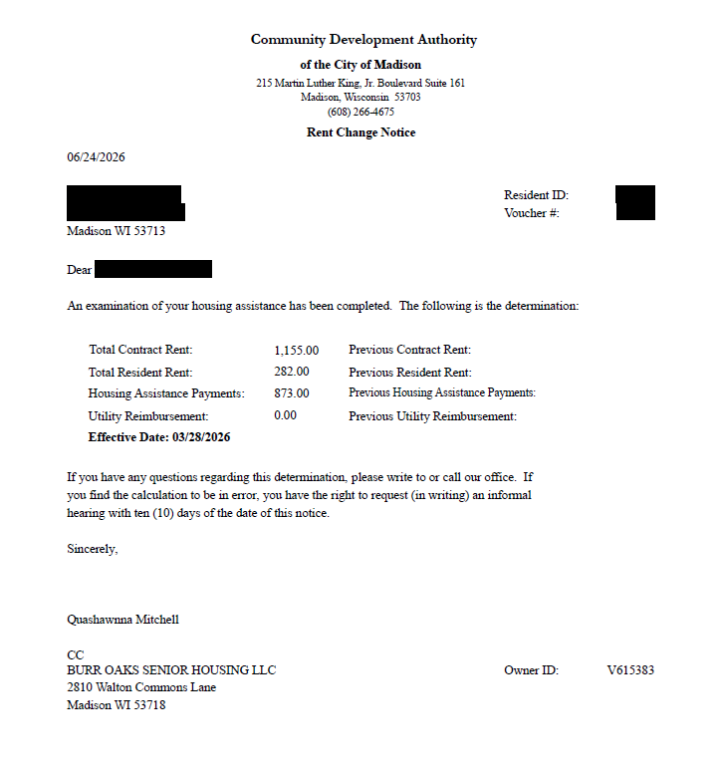
How much is my rent portion?
When your unit paperwork is sent to the inspector, your housing specialist will contact you and your landlord with an estimated breakdown rent
Once the HAP contract is sent to the housing provider for signature, a Rent Change Notice will be sent to you with the official rent breakdown
Tenant rent portion is to be paid directly to the housing provider in the manner(s) set forth in the rental lease agreement

Slide 52
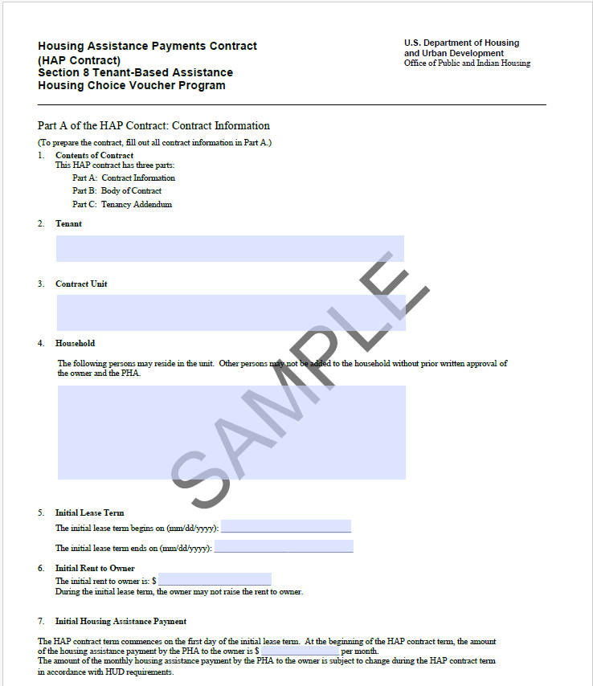
Housing Assistance Payments (HAP) Contract
This is the contract that is signed between the CDA and the housing provider.
CDA cannot release payment to your housing provider until this contract is returned to CDA with signature
Part A: Contract Information
Part B: Body of Contract
Part C: Tenancy Addendum

Slide 53
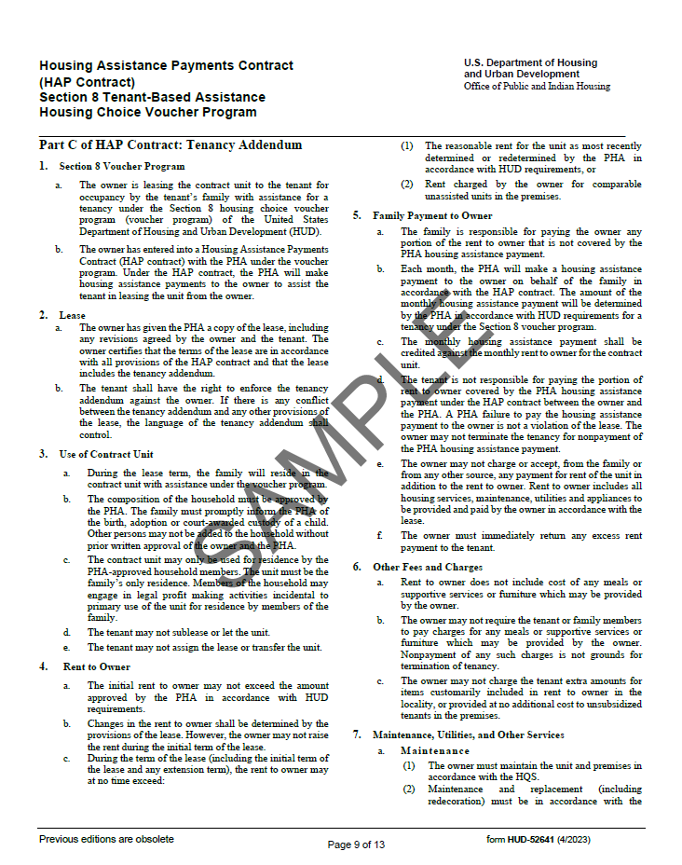
HAP Contract:
Tenancy Addendum
The tenancy addendum is to be attached to the residential lease between the tenant and housing provider and becomes an addendum to that lease.

Slide 54
Reasonable Accommodation
If an applicant or participant indicates that an exception, change or adjustment to a rule, policy, practice, or service is needed because of a disability, HUD requires that CDA treat the information as a request for a Reasonable Accommodation.
The applicant or participant family must explain what type of accommodation is needed to provide the person with the disability full access to the CDA’s programs and services
Examples of Reasonable Accommodations
Additional search time on voucher
Approval for Live-In-Aide
Approval for additional/separate bedroom
Exception (higher) payment standard

Slide 55
Additional BRIEFING PACKET INFORMATION
A Good Place to Live
Lead-based Paint Booklet
Violence Against Women Act (VAWA)
HUD Discrimination complaint information
Notes:
This is all the information that is part of the briefing packet

Slide 56
Things to keep in mind…
CDA does not assist with application fees nor security deposits
Do NOT sign the lease until CDA informs you that that the unit has passed inspection and the rent is determined to be reasonable
Make sure to complete your unit check-in form and return to your landlord

Slide 57
Additional things to keep in mind…
You will be required to recertify your income/assets/expenses on a yearly basis and failure to comply can result in termination of your assistance
Your unit will be scheduled for a HUD inspection at least once every 2 years and must be in compliance for housing assistance payments to continue
Notes:
When you first lease up and anytime you move your portion of the rent cannot exceed 40% of your adjusted income
If you remain in the same unit for a number of years – your portion of the rent could end up exceeding the 40%

Slide 58
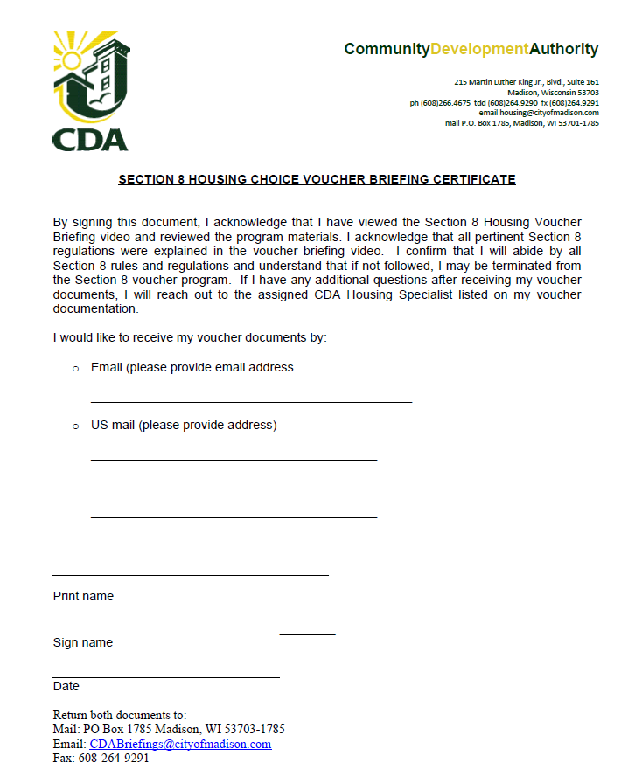
Voucher Briefing Certificate
To be completed by the voucher holder:
Indicate how you would like to receive your voucher documents and provide email address or mailing address
Print full name
Sign full name
Date document

Slide 59
NEXT STEPS
Submit your completed documentation to the CDA office by the
deadline listed on your briefing letter
RESPONSIBILITY AGREEMENT
BRIEFING CERTIFICATE
Documents can be submitted by email, fax, US mail or dropped off at our office:
Email: CDABriefings@cityofmadison.com
CDA-City of Madison
215 Martin Luther King Jr. Blvd. Ste 161
Madison, WI 53703
Fax: 608-264-9291
  Office Hours: Monday- Thursday, 8:00 am- 4:30 pm
  Office suite drop box hours: Monday-Friday, 8:00 am- 4:30 pm

Slide 60
Once CDA has received your documentation, your Housing Specialist will send the following documents within 10 business days by the manner you indicated on your briefing certificate:
1) VOUCHER- You must sign, date and submit a copy to your assigned housing specialist
2) REQUEST FOR TEANANCY APPROVAL (RFTA) FORM- This form needs to be completed by the housing provider/landlord and returned to CDA along with a copy of the proposed, unsigned 12-month lease for the unit you wish to rent. This form must also be signed by the voucher holder in order for CDA to proceed with processing the unit upon receipt.
3) GROSS RENT VOUCHER LIMIT CALCULATION- This shows your voucher bedroom size, gross rent (contract rent + unit utility allowance) voucher limit and the calculations of 30% and 40% of your monthly adjusted income
4) UTILITY ALLOWANCE WORKSHEETS- Make sure to utilize the worksheet that matches with the unit type you are looking to rent. If you are looking at a unit smaller than your voucher size, use the actual unit size. If you are looking at a unit larger than your voucher size, use your actual voucher size

Slide 61
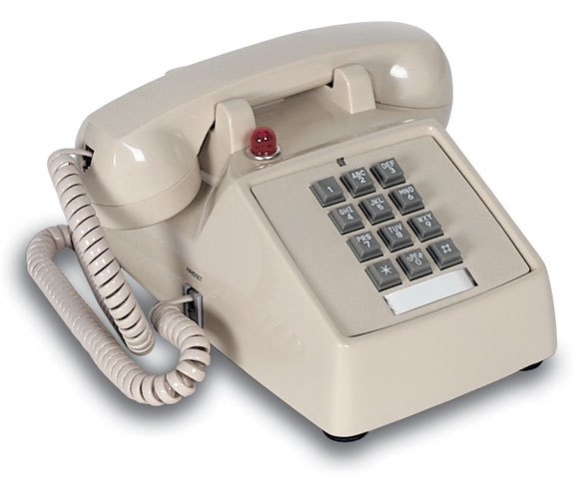

Section 8 staff contact information

Slide 62
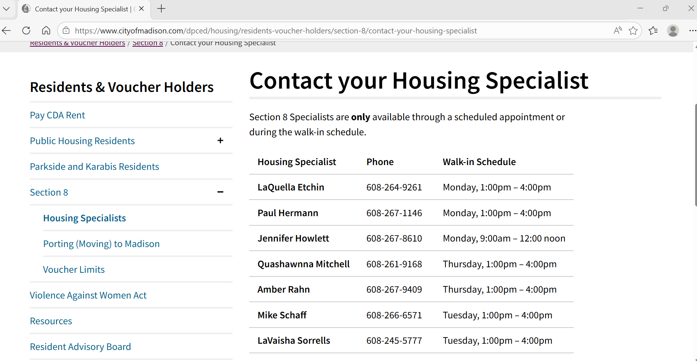
https://www.cityofmadison.com/dpced/housing/residents-voucher-holders/section-8/contact-your-housing-specialist
Notes:
HS meet with clients by appointment only
Each HS has walk in hours
Call or e-mail once and wait for a reply
E-mail is best

Slide 63
GOALS FOR TODAY:
To learn how the Section 8 Program (also known as “Housing Choice Voucher” program) functions
To take the information learned today to successfully use your voucher and fulfill your responsibilities as a voucher holder
To review, initial, sign and date my Responsibility Agreement and Briefing Certificate – and submit copies to CDA by my assigned due date

Slide 64
Thank you!

