Slide 1
Welcome!
We will begin shortly…
Virtual Meeting Schedule
6:00 – 6:10 | Welcome
6:10 – 6:45 | Presentation
6:45 – 7:00 | Presentation Q & A (General)
7:00 – 7:45 | Zoom Breakout Rooms
7:45 – 8:00 | Come Back Together/Wrap-Up

Slide 2

City of Madison Engineering Division
Date
Public Information Meeting Title
Please Note: This meeting is being recorded. It is a public record subject to disclosure.
By continuing to be in the meeting, you are consenting to being recorded and consenting to this record being released to public record requestors.

Slide 3
Meeting Technical Housekeeping
This meeting will be recorded and posted to the project page.
All attendees should be muted to keep background noise to a minimum.
Use the “Q and A” button for technical issues with meeting to troubleshoot with staff to assist.
Use the “Q and A” button to type questions about presentation. Questions will be answered live after the presentation.
Inappropriate questions may be dismissed.
Use the “raise your hand” button to verbally ask your question. You will be prompted to unmute when it is your turn.

Slide 4
This meeting is being recorded.
It is a public record subject to disclosure.
By continuing to be in the meeting, you are consenting to being recorded and consenting to this record being released to public record requestors.

Slide 5
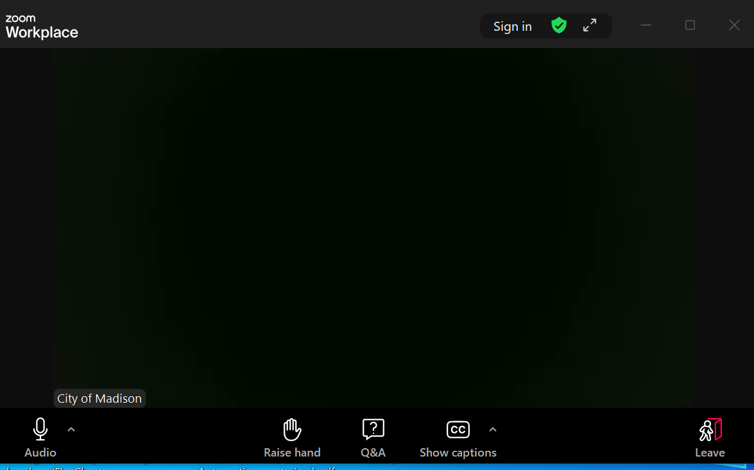
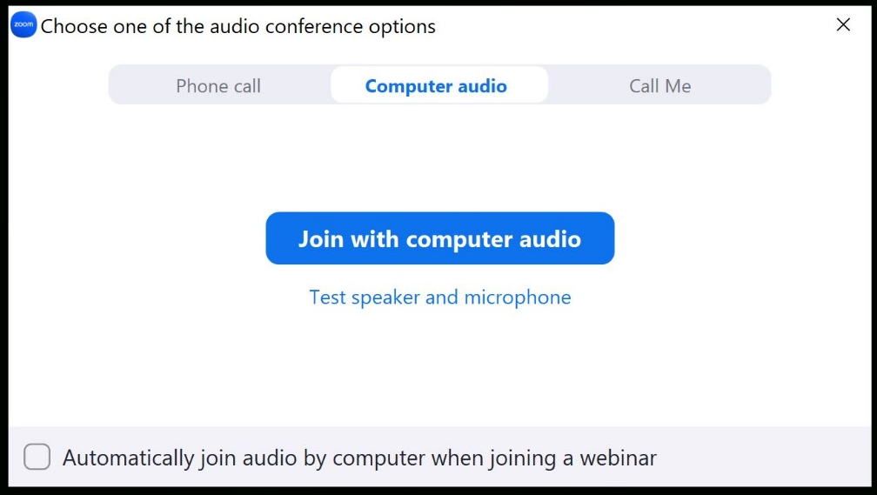
How to Participate
Make sure to
join audio

Slide 6
How to Participate
Raise your hand to be unmuted
For comments or ask additional questions.

Slide 7
How to Participate
Use Q&A button if you have technical issues
or a question for the panelists.

Slide 8
How to Participate
Use Q&A button for all other questions.
We will answer after the presentation.

Slide 9
How to Participate
To leave the meeting, click leave.

Slide 10
How to Participate
If you’d like to enable closed captioning, click “show closed captions” button on the bottom of the screen.
This may already be enabled. If this is not enabled, click the button to allow closed captioning.

Slide 11
Project Contact Introductions
PM Information
City Staff Information
Alder Information

Slide 12
Evening Overview
Welcome (Hannah Mohelnitzky, City of Madison)
Presentation (Project Manager)
Q&A (facilitated by Hannah Mohelnitzky, City of Madison)
  Submit questions through Zoom “Q and A”
  Questions answered at the end of the Presentation
Wrap Up (Hannah Mohelnitzky, City of Madison)
Breakout Groups (_____ and City of Madison staff)
  An option to join breakout groups will appear on your screen

Slide 13
Presentation Outline
Definitions of commonly used terms
Study location
Watershed study schedule
Flood mitigation targets
Inundation mapping
Proposed solutions development process
Proposed solutions
  a. Standalone projects
  b. Local storm sewer
Implementation and cost
Why aren’t all flood targets met?
Next steps

Slide 14
Board of Public Works (BPW) Meeting
Members of the public can watch, register support/opposition, speak (3 minutes), and/or submit written comments.
Subscribe to the email list on project webpage to get notification when BPW meeting registration opens.
If you register to speak, make sure the name you display in Zoom matches the name you registered under so staff know who to unmute when it’s your turn.
BPW meetings start at 4:30 PM but the public hearings for public works projects don’t start until 5:30 PM (or when the item under discussion at 5:30 PM finishes). You can join at any time.
If you have any questions about registering for the BPW meeting, email boardofpublicworks@cityofmadison.com.

Slide 15

Contact Information & Resources
Project Manager: Matt Allie, mallie@cityofmadison.com
Public Information Officer: Hannah Mohelnitzky, hmohelnitzky@cityofmadison.com
Project Webpage: https://www.cityofmadison.com/engineering/projects/greentree-mckenna-watershed-study
  Sign-up for project email updates on the website
  Report flooding, past or current on the Report Flooding form
  Learn ways to protect your property from flooding with on-site fixes
New Flooding Website: www.cityofmadison.com/flooding
Everyday Engineering Podcast
Instagram: @MadisonEngr
Facebook – City of Madison Engineering
X – @MadisonEngr
Provide your feedback! https://www.cityofmadison.com/news/survey-open-city-engineering-works-to-prioritize-flood-projects

Slide 16

Zoom Breakout Rooms
Join a Zoom Breakout Room Session
  Window will pop up where you can select which group you’d like to join
  If a window doesn’t pop up, look for a button on the bottom that says “Breakout Rooms.” Click the button and room options will appear.

Slide 17
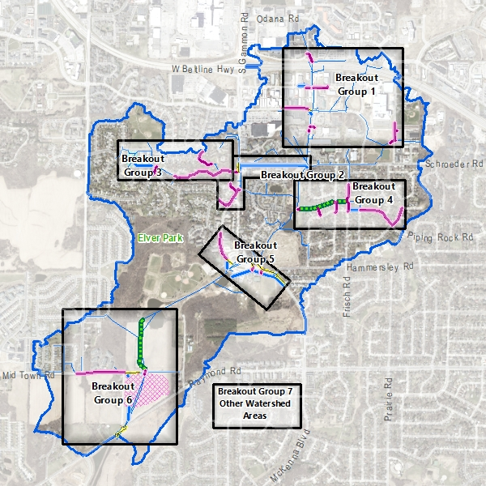
Breakout Groups
Struck/Seybold/Watts and Forward Dr. Reconstruction Projects
Schroeder Rd. and New Washburn Way Reconstruction Projects
Valhalla Way Reconstruction and High Point Estates Pond
Piping Rock Rd., Chapel Hill Rd. and Greenway Reconstruction
McKenna Blvd. Storm Sewer Improvements
Elver Park Greenway and Marty Road/Mid Town Road Regional Pond
Other Watershed Areas

