Slide 1

Public Information Meeting
City of Madison Engineering Division
[Date]
Thank you for attending. We will begin shortly…
[Title]
[Title]

Slide 2
Rules and Housekeeping Items for this Meeting
This meeting will be recorded and posted to the project page.
All attendees should be muted to keep background noise to a minimum.
Use the “Q and A” button for technical issues with meeting to troubleshoot with staff to assist.
Use the “Q and A” button to type questions about presentation. Questions will be answered live after the presentation.
Inappropriate questions may be dismissed.
Use the “raise your hand” button to verbally ask your question. You will be prompted to unmute when it is your turn.

Slide 3
This meeting is being recorded.
It is a public record subject to disclosure.
By continuing to be in the meeting, you are consenting to being recorded and consenting to this record being released to public record requestors.

Slide 4
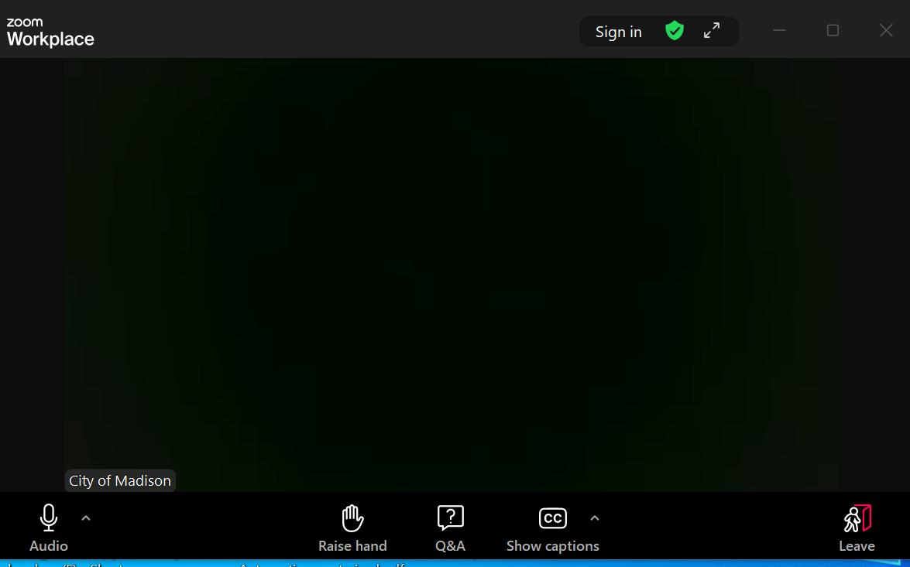
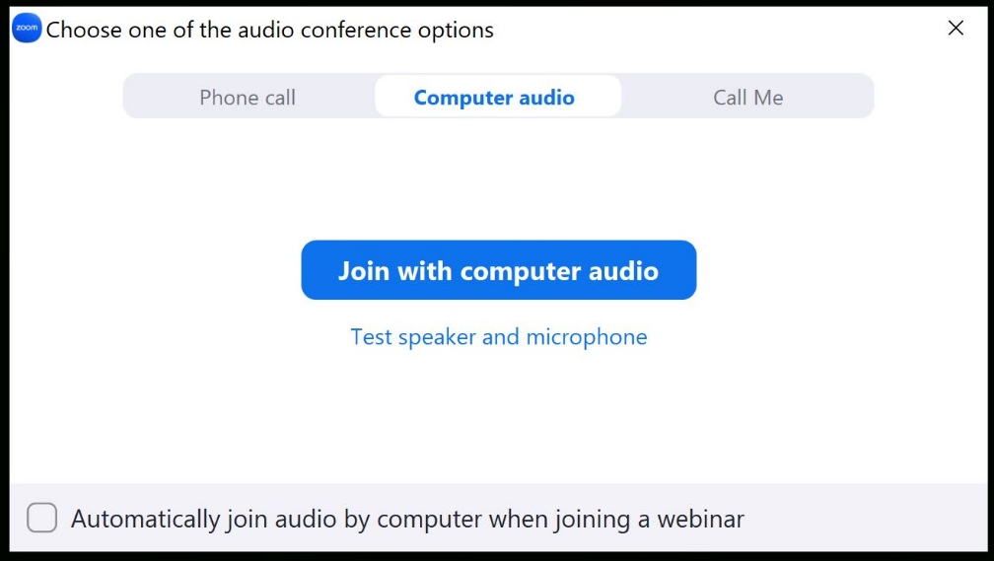
How to Participate
Make sure to
join audio

Slide 5
How to Participate
Raise your hand to be unmuted
For comments or ask additional questions.

Slide 6
How to Participate
Use Q&A button if you have technical issues
or a question for the panelists.

Slide 7
How to Participate
Use Q&A button for all other questions.
We will answer after the presentation.

Slide 8
How to Participate
To leave the meeting, click leave.

Slide 9
How to Participate
If you’d like to enable closed captioning, click “show closed captions” button on the bottom of the screen.
This may already be enabled. If this is not enabled, click the button to allow closed captioning.

Slide 10
Presentation Overview
Thank You for participating!
Welcome (Hannah Mohelnitzky, Public Information Officer, City of Madison)
Introduction (Alder [name], District xx)
Presentation ([engineer(s)])
Q&A (facilitated by Hannah Mohelnitzky)
  Assisted by:
    [engineer]
    [engineer]
Presentation available on the website
  [add link]

Slide 11
Presentation Overview
Project Location
Meeting Purpose
Project Scope
Existing Conditions
Vision Zero
Complete Green Streets
Proposed Design
Proposed Utility Design
Stormwater Requirements
Public Right-Of-Way
Forestry Information
Assessments Policy & Costs
Project Approval Schedule
Construction Schedule & Access
Next Steps
Contact Information & Resources
Q&A

Slide 12
Project Location
[add location map]

Slide 13
Presentation Overview
Project Location
Meeting Purpose
Project Scope
Existing Conditions
Vision Zero
Complete Green Streets
Proposed Design
Proposed Utility Design
Stormwater Requirements
Public Right-Of-Way
Forestry Information
Assessments Policy & Costs
Project Approval Schedule
Construction Schedule & Access
Next Steps
Contact Information & Resources
Q&A

Slide 14
Meeting Purpose
[add information]
[add location map]

Slide 15
Project Development Process
Meeting Purpose
  Staff presents to Board of Public Works
  Staff presents to Transportation Commission
  Project Selected and Budgeted
  Construction
WE ARE HERE
  First Public
  Involvement Meeting
  Second Public
  Involvement Meeting
  Common Council Public Hearing
  Gather team, data, and existing conditions
  Design options developed based on data and public feedback
  Design further developed and refined
  Design finalized and set for bid

Slide 16
Presentation Overview
Project Location
Meeting Purpose
Project Scope
Existing Conditions
Vision Zero
Complete Green Streets
Proposed Design
Proposed Utility Design
Stormwater Requirements
Public Right-Of-Way
Forestry Information
Assessments Policy & Costs
Project Approval Schedule
Construction Schedule & Access
Next Steps
Contact Information & Resources
Q&A

Slide 17
Project Scope
[add information]

Slide 18
Presentation Overview
Project Location
Meeting Purpose
Project Scope
Existing Conditions
Vision Zero
Complete Green Streets
Proposed Design
Proposed Utility Design
Stormwater Requirements
Public Right-Of-Way
Forestry Information
Assessments Policy & Costs
Project Approval Schedule
Construction Schedule & Access
Next Steps
Contact Information & Resources
Q&A

Slide 19
Existing Conditions
Item | Existing Condition
Last Surfaced
Pavement Surface Evaluation & Rating
Curb Rating
Width
Surface
Sidewalk
Sanitary
Water
Storm

Slide 20
Presentation Overview
Project Location
Meeting Purpose
Project Scope
Existing Conditions
Vision Zero
Complete Green Streets
Proposed Design
Proposed Utility Design
Stormwater Requirements
Public Right-Of-Way
Forestry Information
Assessments Policy & Costs
Project Approval Schedule
Construction Schedule & Access
Next Steps
Contact Information & Resources
Q&A

Slide 21
Presentation Overview
Project Location
Meeting Purpose
Project Scope
Existing Conditions
Vision Zero
Complete Green Streets
Proposed Design
Proposed Utility Design
Stormwater Requirements
Public Right-Of-Way
Forestry Information
Assessments Policy & Costs
Project Approval Schedule
Construction Schedule & Access
Next Steps
Contact Information & Resources
Q&A

Slide 22
Presentation Overview
Project Location
Meeting Purpose
Project Scope
Existing Conditions
Vision Zero
Complete Green Streets
Proposed Design
Proposed Utility Design
Stormwater Requirements
Public Right-Of-Way
Forestry Information
Assessments Policy & Costs
Project Approval Schedule
Construction Schedule & Access
Next Steps
Contact Information & Resources
Q&A

Slide 23
[Proposed Street Design]
[street name]
  [add information]

Slide 24
Presentation Overview
Project Location
Meeting Purpose
Project Scope
Existing Conditions
Vision Zero
Complete Green Streets
Proposed Design
Proposed Utility Design
Stormwater Requirements
Public Right-Of-Way
Forestry Information
Assessments Policy & Costs
Project Approval Schedule
Construction Schedule & Access
Next Steps
Contact Information & Resources
Q&A

Slide 25
Presentation Overview
Project Location
Meeting Purpose
Project Scope
Existing Conditions
Vision Zero
Complete Green Streets
Proposed Design
Proposed Utility Design
Stormwater Requirements
Public Right-Of-Way
Forestry Information
Assessments Policy & Costs
Project Approval Schedule
Construction Schedule & Access
Next Steps
Contact Information & Resources
Q&A

Slide 26
Presentation Overview
Project Location
Meeting Purpose
Project Scope
Existing Conditions
Vision Zero
Complete Green Streets
Proposed Design
Proposed Utility Design
Stormwater Requirements
Public Right-Of-Way
Forestry Information
Assessments Policy & Costs
Project Approval Schedule
Construction Schedule & Access
Next Steps
Contact Information & Resources
Q&A

Slide 27
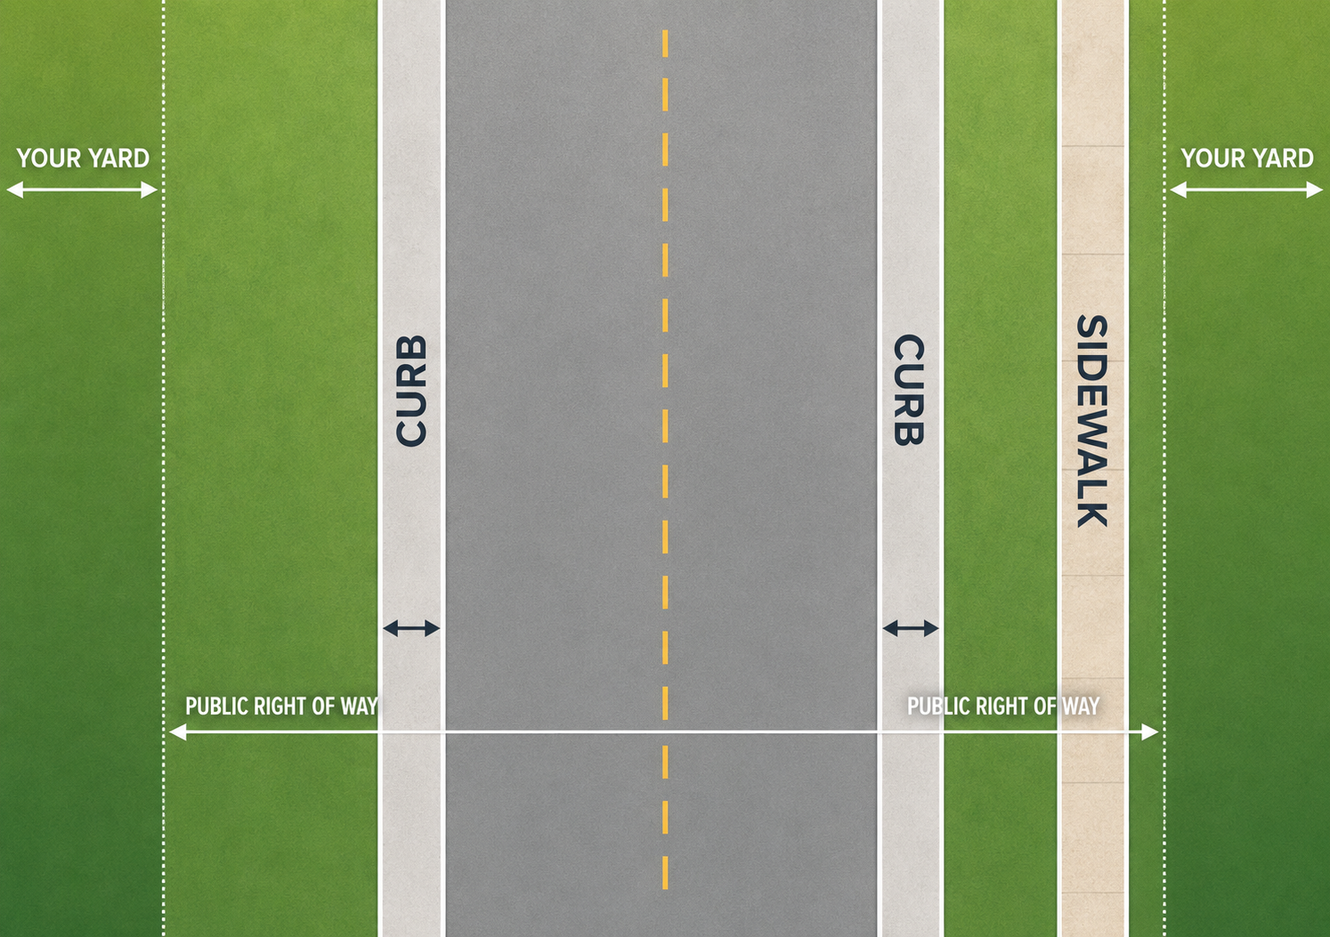
Public Right-Of-Way
Space of property that extends typically from the curb into the homeowner’s yard.
Homeowners are responsible for maintaining the public right-of-way.
The City uses this portion of the yard to improve utilities or other infrastructure the public uses.
Right-of-way & temporary limited easements are potential going to be purchased.

Slide 28
Presentation Overview
Project Location
Meeting Purpose
Project Scope
Existing Conditions
Vision Zero
Complete Green Streets
Proposed Design
Proposed Utility Design
Stormwater Requirements
Public Right-Of-Way
Forestry Information
Assessments Policy & Costs
Project Approval Schedule
Construction Schedule & Access
Next Steps
Contact Information & Resources
Q&A

Slide 29
Forestry Information
[add information]

Slide 30
Presentation Overview
Project Location
Meeting Purpose
Project Scope
Existing Conditions
Vision Zero
Complete Green Streets
Proposed Design
Proposed Utility Design
Stormwater Requirements
Public Right-Of-Way
Forestry Information
Assessments Policy & Costs
Project Approval Schedule
Construction Schedule & Access
Next Steps
Contact Information & Resources
Q&A

Slide 31
Assessment Policy & Costs
[add table]

Slide 32
Assessment Policy & Costs
Special charge for work being done that has a direct benefit to the property
[add more information]

Slide 33
Presentation Overview
Project Location
Meeting Purpose
Project Scope
Existing Conditions
Vision Zero
Complete Green Streets
Proposed Design
Proposed Utility Design
Stormwater Requirements
Public Right-Of-Way
Forestry Information
Assessments Policy & Costs
Project Approval Schedule
Construction Schedule & Access
Next Steps
Contact Information & Resources
Q&A

Slide 34
Presentation Overview
Project Location
Meeting Purpose
Project Scope
Existing Conditions
Vision Zero
Complete Green Streets
Proposed Design
Proposed Utility Design
Stormwater Requirements
Public Right-Of-Way
Forestry Information
Assessments Policy & Costs
Project Approval Schedule
Construction Schedule & Access
Next Steps
Contact Information & Resources
Q&A

Slide 35
Project Approval Schedule
  [discuss approval schedule]

Slide 36
Board of Public Works (BPW Meeting)
Members of the public can watch, register support/opposition, speak (3 minutes), and/or submit written comments.
Subscribe to the email list on project webpage to get notification when BPW meeting registration opens.
If you register to speak, make sure the name you display in Zoom matches the name you registered under so staff know who to unmute when it’s your turn.
BPW meetings start at 4:30 PM but the public hearings for public works projects don’t start until 5:30 PM (or when the item under discussion at 5:30 PM finishes). You can join at any time.
If you have any questions about registering for the BPW meeting, email boardofpublicworks@cityofmadison.com.

Slide 37
Presentation Overview
Project Location
Meeting Purpose
Project Scope
Existing Conditions
Vision Zero
Complete Green Streets
Proposed Design
Proposed Utility Design
Stormwater Requirements
Public Right-Of-Way
Forestry Information
Assessments Policy & Costs
Project Approval Schedule
Construction Schedule & Access
Next Steps
Contact Information & Resources
Q&A

Slide 38
Construction Schedule & Access
[add information]

Slide 39
Presentation Overview
Project Location
Meeting Purpose
Project Scope
Existing Conditions
Vision Zero
Complete Green Streets
Proposed Design
Proposed Utility Design
Stormwater Requirements
Public Right-Of-Way
Forestry Information
Assessments Policy & Costs
Project Approval Schedule
Construction Schedule & Access
Next Steps
Contact Information & Resources
Q&A

Slide 40
Next Steps
Up coming opportunities for public involvement
  Fill out the questionnaire
  Sign-up for project email updates on the website
The public is encouraged to attend the following three City committee meetings and provide written or verbal feedback:
  Transportation Commission Meeting
  Board of Public Works Meeting
  Common Council Meeting
Public notified via website updates and/or mailing
Add website link

Slide 41
Presentation Overview
Project Location
Meeting Purpose
Project Scope
Existing Conditions
Vision Zero
Complete Green Streets
Proposed Design
Proposed Utility Design
Stormwater Requirements
Public Right-Of-Way
Forestry Information
Assessments Policy & Costs
Project Approval Schedule
Construction Schedule & Access
Next Steps
Contact Information & Resources
Q&A

Slide 42
Contact Information & Resources
Engineering
  [add project manager name, phone, email]
  Public Information Officer, Hannah Mohelnitzky, 669-3560, hmohelnitzky@cityofmadison.com
Traffic Engineering
  [add TE designer name, phone, email]
Project Website: [add link]
  Sign-up for project email updates on the website
  A PDF of the presentation, design information, & construction progress will be posted to the project website
Facebook – City of Madison Engineering
Instagram -- @MadisonEngr
X – @MadisonEngr
Podcast: Search Everyday Engineering on Apple iTunes or your podcast provider

Slide 43
Thank You for Attending!
Questions
  Please use the “Q&A” option at the bottom of the screen to type a question.
  To ask a question verbally, click the “raise hand” option at the bottom of your screen and the host will unmute you.
Engineering
  [add project manager name, phone, email]
  Public Information Officer, Hannah Mohelnitzky, 669-3560, hmohelnitzky@cityofmadison.com
Traffic Engineering
  [add TE designer name, phone, email]
Project Website: [add link]
  Sign-up for project email updates on the website
  A PDF of the presentation, design information, & construction progress will be posted to the project website

