Slide 1
Welcome!
We will begin shortly…
Virtual Meeting Schedule
6:00 – 6:10 | Welcome
6:10 – 6:45 | Presentation
6:45 – 7:00 | Presentation Q & A (General)
7:00 – 7:45 | Zoom Breakout Rooms
7:45 – 8:00 | Come Back Together/Wrap-Up

Slide 2


[Title]
[Title]
Please Note: This meeting is being recorded. It is a public record subject to disclosure.
By continuing to be in the meeting, you are consenting to being recorded and consenting to this record being released to public record requestors.

Slide 3
Rules and Housekeeping Items for this Meeting
This meeting will be recorded and posted to the project page.
All attendees should be muted to keep background noise to a minimum.
Use the “Q and A” button for technical issues with meeting to troubleshoot with staff to assist.
Use the “Q and A” button to type questions about presentation. Questions will be answered live after the presentation.
Inappropriate questions may be dismissed.
Use the “raise your hand” button to verbally ask your question. You will be prompted to unmute when it is your turn.

Slide 4
This meeting is being recorded.
It is a public record subject to disclosure.
By continuing to be in the meeting, you are consenting to being recorded and consenting to this record being released to public record requestors.

Slide 5
This meeting is being recorded.
It is a public record subject to disclosure.
By continuing to be in the meeting, you are consenting to being recorded and consenting to this record being released to public record requestors.

Slide 6
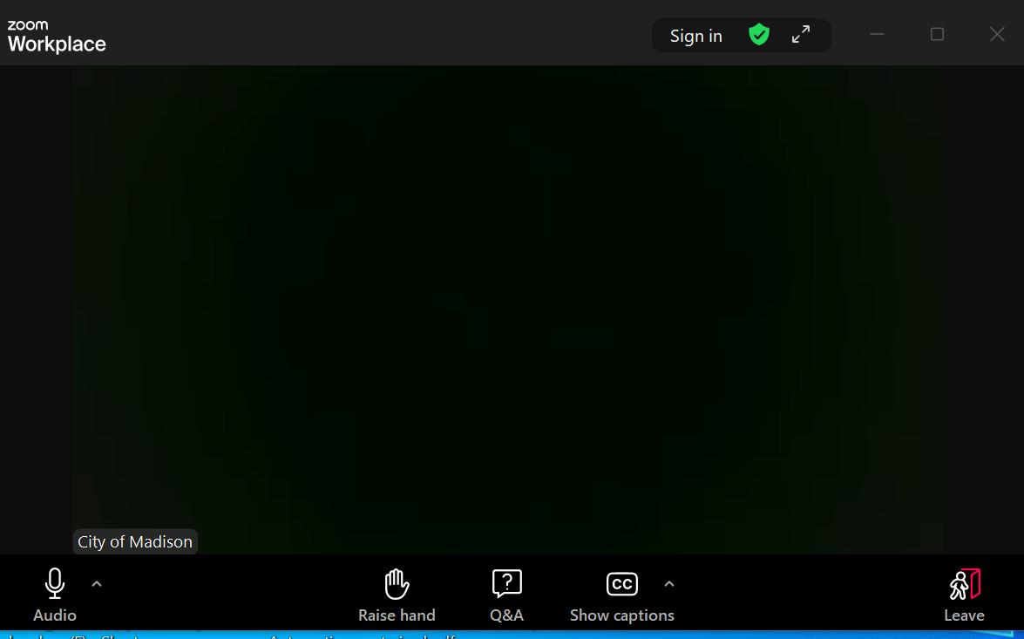
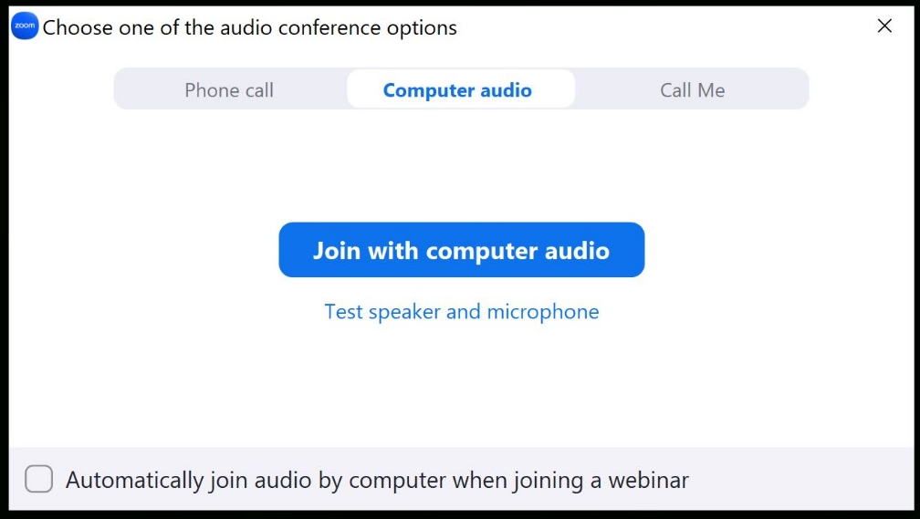
How to Participate
Make sure to
join audio

Slide 7
How to Participate
Raise your hand to be unmuted
For comments or ask additional questions.

Slide 8
How to Participate
Use Q&A button if you have technical issues
or a question for the panelists.

Slide 9
How to Participate
Use Q&A button for all other questions.
We will answer after the presentation.

Slide 10
How to Participate
To leave the meeting, click leave.

Slide 11
How to Participate
If you’d like to enable closed captioning, click “show closed captions” button on the bottom of the screen.
This may already be enabled. If this is not enabled, click the button to allow closed captioning.

Slide 12
Presentation Overview
Thank You for participating!
Welcome (Hannah Mohelnitzky, Public Information Officer, City of Madison)
Introduction (Alder [name], District xx)
Presentation ([engineer(s)])
Q&A (facilitated by Hannah Mohelnitzky)
  Assisted by:
    [engineer]
    [engineer]
Presentation available on the website
  [add link]

Slide 13
Presentation Outline
Definitions of commonly used terms
Study location
Watershed study schedule
Flood mitigation targets
Inundation mapping
Proposed solutions development process
Proposed solutions
  a. Standalone projects
  b. Local storm sewer
Implementation and cost
Why aren’t all flood targets met?
Next steps

Slide 14
Thank You for Attending!
Questions
  Please use the “Q&A” option at the bottom of the screen to type a question.
  To ask a question verbally, click the “raise hand” option at the bottom of your screen and the host will unmute you.
Engineering
  [add project manager name, phone, email]
  Public Information Officer, Hannah Mohelnitzky, 669-3560, hmohelnitzky@cityofmadison.com
Traffic Engineering
  [add TE designer name, phone, email]
Project Website: [add link]
  Sign-up for project email updates on the website
  A PDF of the presentation, design information, & construction progress will be posted to the project website

Slide 15

Zoom Breakout Rooms
Join a Zoom Breakout Room Session
  Window will pop up where you can select which group you’d like to join
  If a window doesn’t pop up, look for a button on the bottom that says “Breakout Rooms.” Click the button and room options will appear.

Slide 16
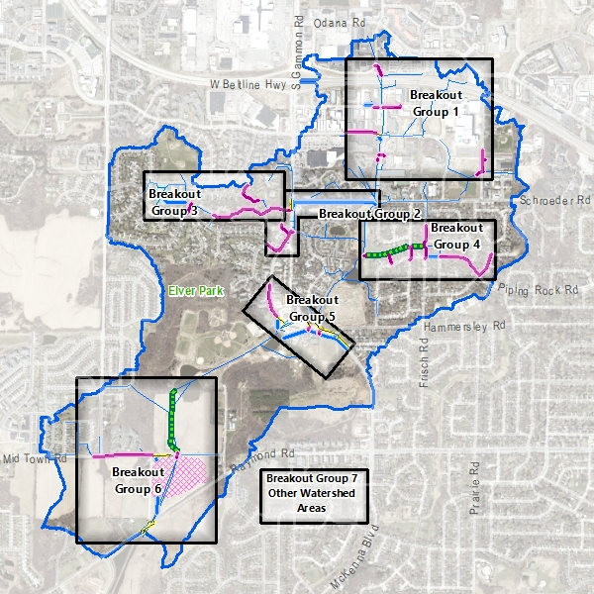
Breakout Groups
Struck/Seybold/Watts and Forward Dr. Reconstruction Projects
Schroeder Rd. and New Washburn Way Reconstruction Projects
Valhalla Way Reconstruction and High Point Estates Pond
Piping Rock Rd., Chapel Hill Rd. and Greenway Reconstruction
McKenna Blvd. Storm Sewer Improvements
Elver Park Greenway and Marty Road/Mid Town Road Regional Pond
Other Watershed Areas

