Slide 1


Spill Prevention, Control, and Countermeasure (SPCC) Training
for City of Madison Facilities

Slide 2
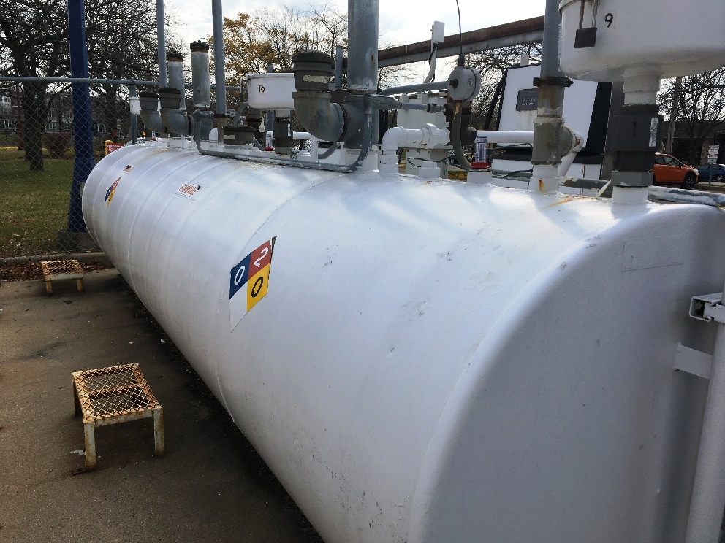
Course Introduction
Welcome to the online Spill Prevention Control & Countermeasure (SPCC) training course for City of Madison facilities. All oil-handling personnel must receive at least ANNUAL training to respond properly to spills in their work areas.
The following City facilities require an SPCC plan:
  Metro Transit
  Summit Parks Maintenance
  Fire Station #7
  Odana Golf Course
  Olin Transfer Station
  Yahara Hills Golf Course
  Nakoosa Trail Fleet
  Forest Hill Parks Maintenance (not required)

Slide 3
Course Objectives
This training course discusses the applicability of the SPCC rule and details of the plan you should be aware of, including information on:
  Why your facility has a SPCC Plan and what’s in it?
  Where does your facility store oil?
  What are realistic spill scenarios?
  How do I prevent spills?
  How do I safely respond to minor and major spills?
  How do I report spills?
  How do I conduct inspections and keep records?
This training does not replace reading your facility’s SPCC plan! Please reference your facility’s plan as you proceed for site-specific information.

Slide 4
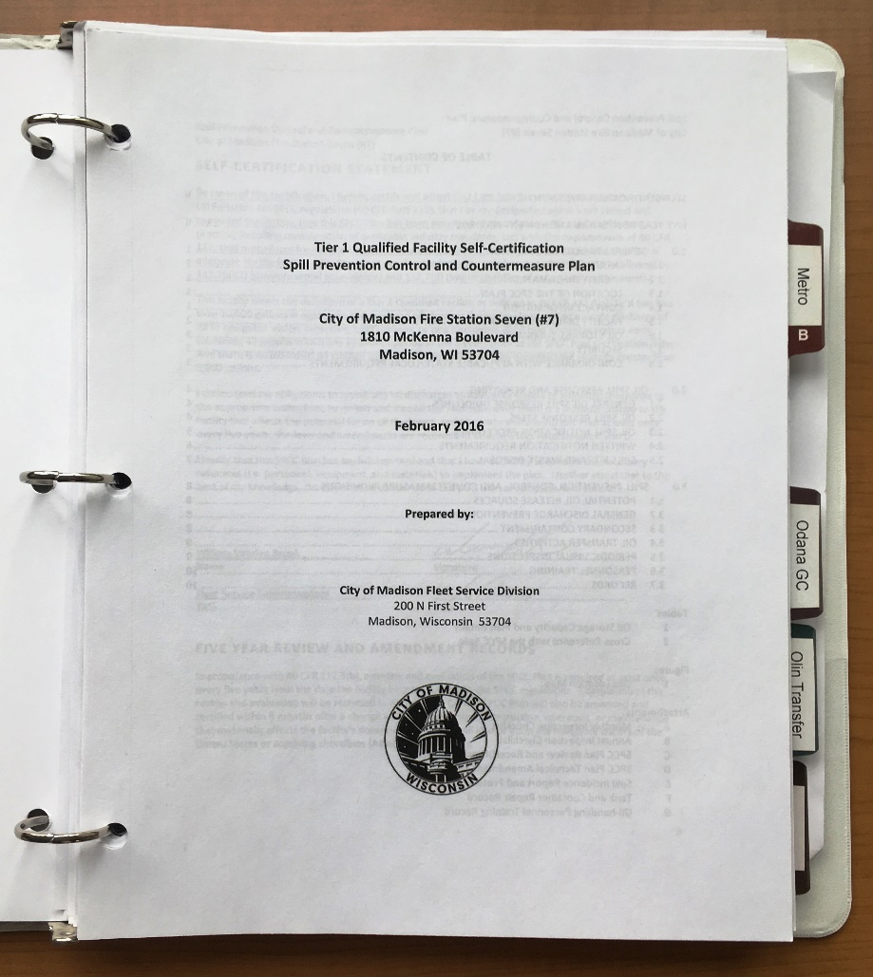
Written SPCC Plan Requirements
The SPCC Plan written for your facility includes the following mandatory information:
  Certification and approval
  Location and description of all oil storage tanks/containers and their contents
  Description of secondary containment
  Potential release scenarios and spill control
  Regular inspections and record-keeping
  Personnel training
  Proper spill response
  Notification and reporting

Slide 5
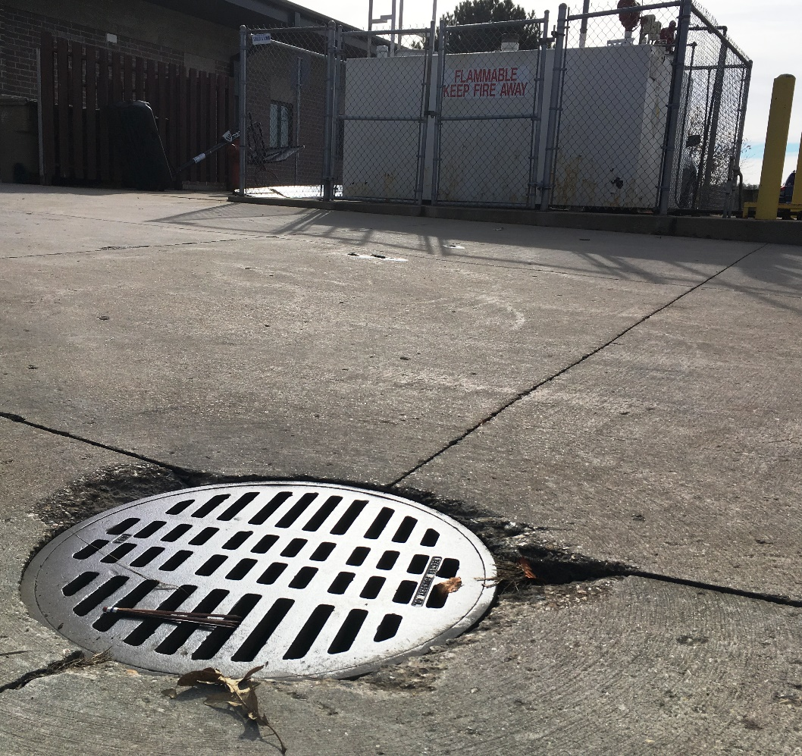
What is the SPCC Rule?
Spill Prevention Control and Countermeasure (SPCC) Plans are required under the Clean Water Act with the goal of preventing the discharge of oil to navigable waters or adjoining shorelines.
An SPCC plan is required for facilities with:
  More than 1,320 gallons of oil storage in aboveground containers 55-gallons or greater in volume; OR
  More than 42,000 gallons of oil in underground tanks; AND
  There is a reasonable potential for an oil spill to reach navigable waters (directly or via the storm sewer)

Slide 6
What is the SPCC Rule?
Let’s break this down more:
This means the rule only applies if all of your aboveground tanks and drums add up to more than 1,320 gallons of storage.
Example:
1000-gal diesel tank
300-gal gasoline tank
+ 55-gal drum of motor oil
1,355-gal of total storage
SPCC plan is required!
Spill Prevention Control and Countermeasure (SPCC) Plans are required under the Clean Water Act with the goal of preventing the discharge of oil to navigable waters or adjoining shorelines.
An SPCC plan is required for facilities with:
  More than 1,320 gallons of oil storage in aboveground containers 55-gallons or greater in volume; OR
  More than 42,000 gallons of oil in underground tanks; AND
  There is a reasonable potential for an oil spill to reach navigable waters (directly or via the storm sewer)

Slide 7
What is the SPCC Rule?
Let’s break this down more:
A leak from any outside tank has a chance to reach ‘navigable waters’ via the storm sewer.
Imagine if you have a tank failure in the middle of a downpour—will runoff carry oil with it into the storm sewer?
Spill Prevention Control and Countermeasure (SPCC) Plans are required under the Clean Water Act with the goal of preventing the discharge of oil to navigable waters or adjoining shorelines.
An SPCC plan is required for facilities with:
  More than 1,320 gallons of oil storage in aboveground containers 55-gallons or greater in volume; OR
  More than 42,000 gallons of oil in underground tanks; AND
  There is a reasonable potential for an oil spill to reach navigable waters (directly or via the storm sewer)

Slide 8
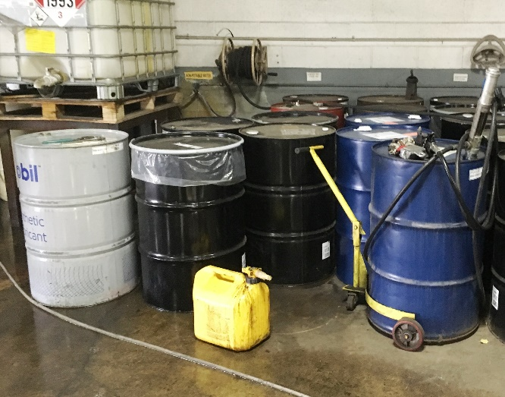
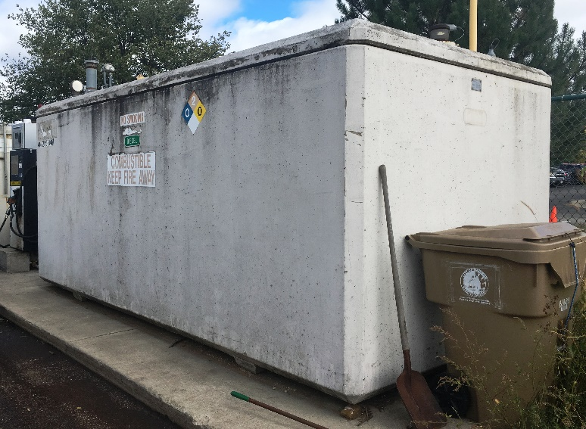
What kind of oils and containers count?
Applicable Container SIZES:
All containers and oil-filled equipment 55-gallons or greater in volume are counted, even if only partially filled.
Examples include: Tanks for vehicle fueling, hydraulic motor oil, asphalt emulsion, used motor oil, and all 55-gallon drums.
5-gallon or 30-gallon containers do not count toward the total volume of oil in an SPCC plan.
FROM
TO

Slide 9
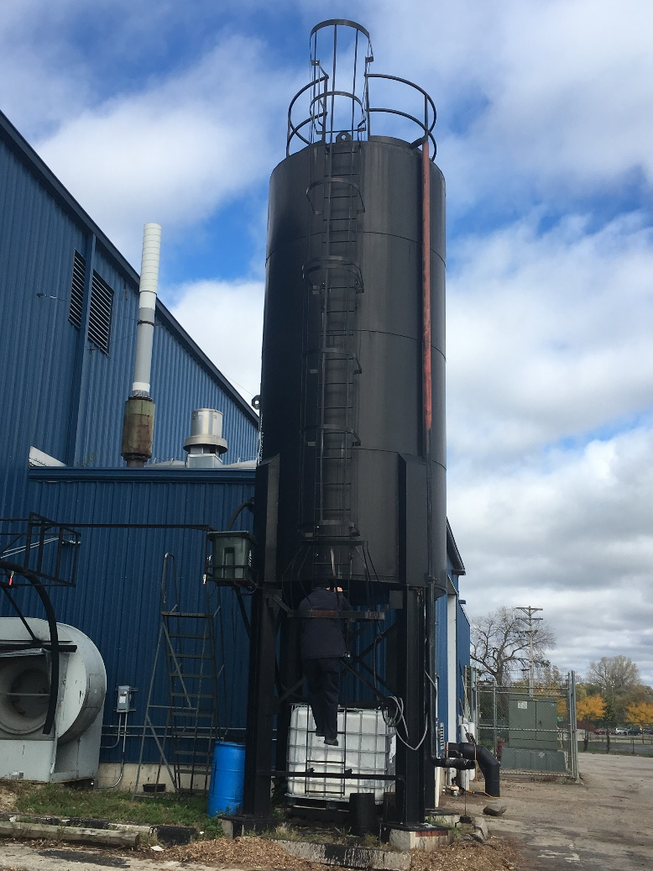
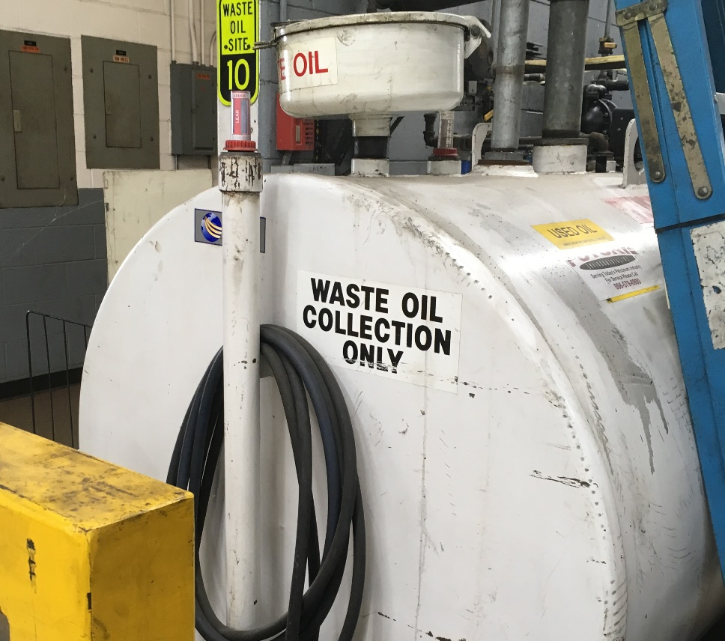
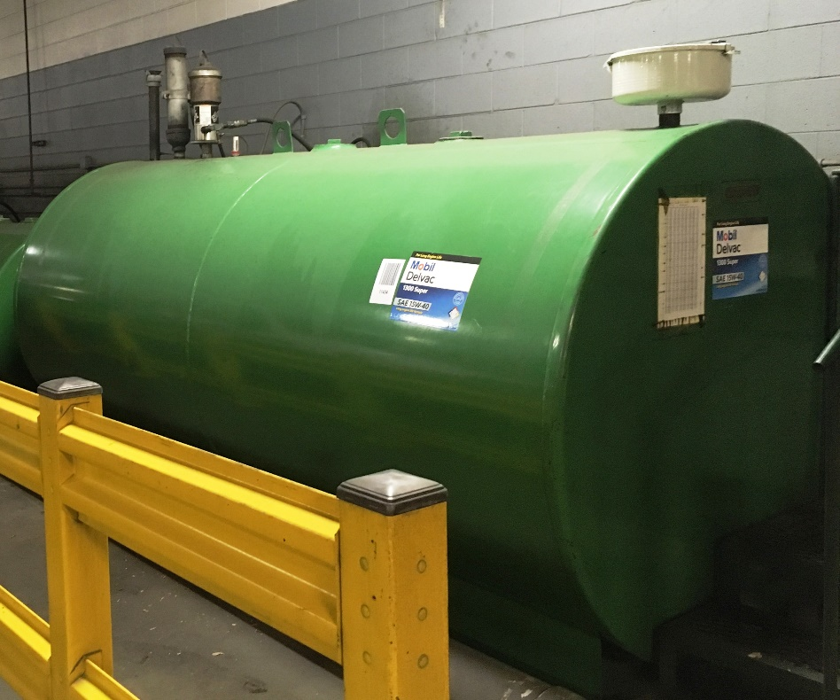
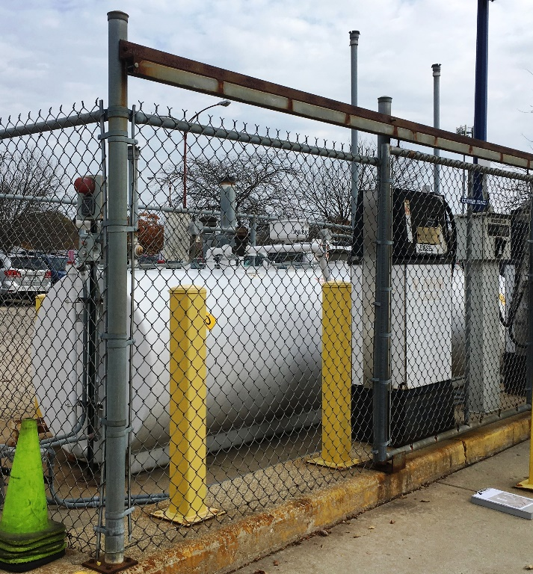
What kind of oils and containers count?
Applicable Oil TYPES:
  Gasoline and diesel vehicle fueling tanks
  Hydraulic motor oil
  Used motor oil
  Asphalt emulsion
  Used cooking oil
  Other applicable oils include: animal fat/oil/grease, synthetic oils, heating oil, crude, oily sludge
  Liquids NOT covered: antifreeze, brine, washer fluid, pesticides, fertilizer, etc.

Slide 10
Mini-Quiz!
1. Which of the following are NOT counted in an SPCC Plan:
  5-gallon bucket of motor oil
  55-gallon drum hydraulic oil
  500-gallon tank of diesel
  300-gallon tank containing only 30 gallons of diesel
  Answer A and D
Answer A: Even if a tank is only kept partially filled, EPA still counts the total volume on an SPCC Plan.
2. Does the following site need an SPCC plan?
    500-gallon diesel tank
    500-gallon gasoline tank
    Six 55-gallon drums of various liquids
  Yes
  No
  More information is needed.
Answer C: The total storage at this site is 1,330 gallons. If all of the drums contain oil, an SPCC is needed. If one or more drums contains a non-oil liquid (e.g. antifreeze), then an SPCC Plan is NOT required, but still recommended.

Slide 11
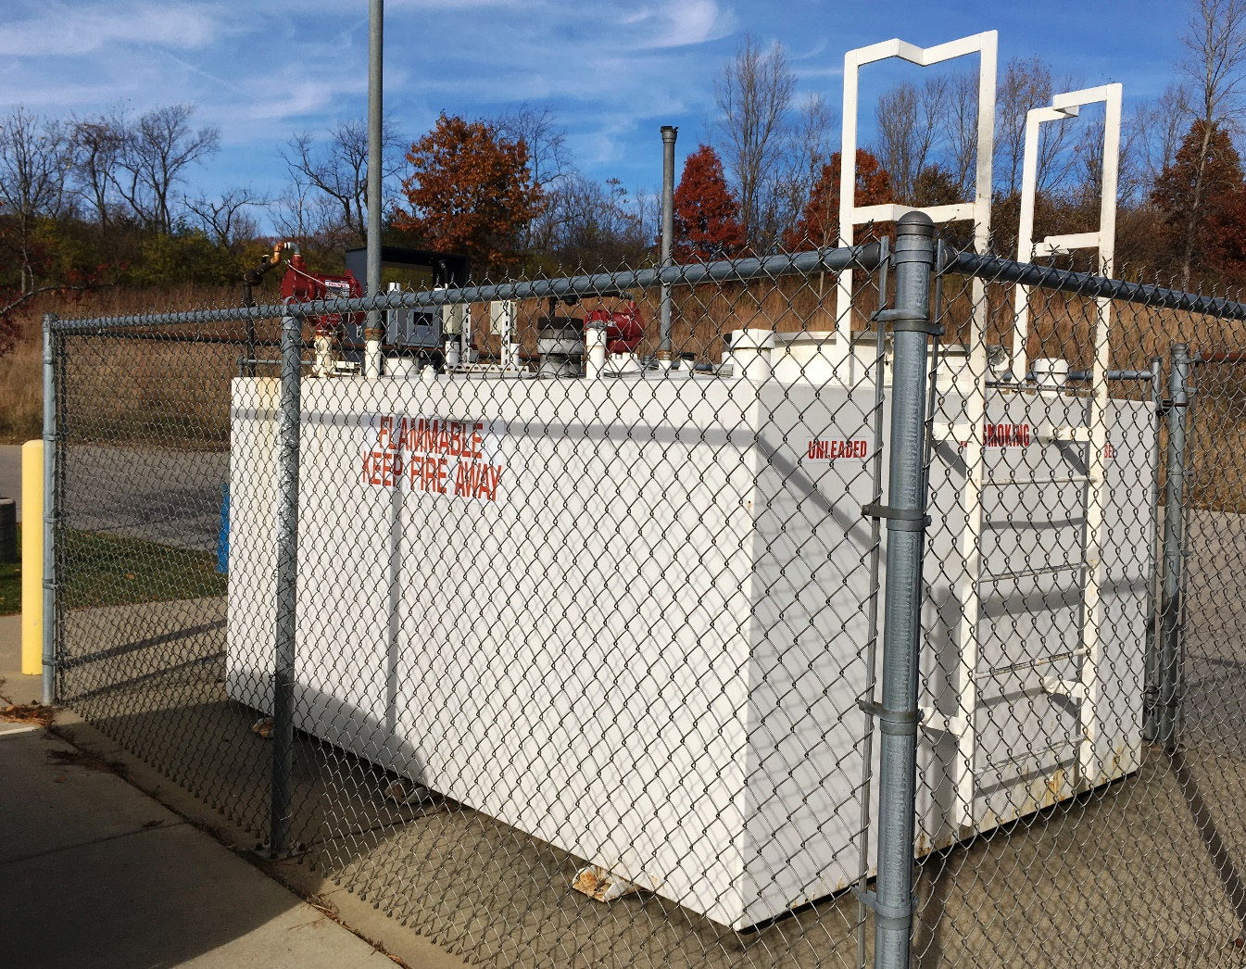
City of Madison Sources
Fire Station #7 – 1810 McKenna Blvd
  1000-gal diesel
  1000-gal unleaded gasoline

Slide 12
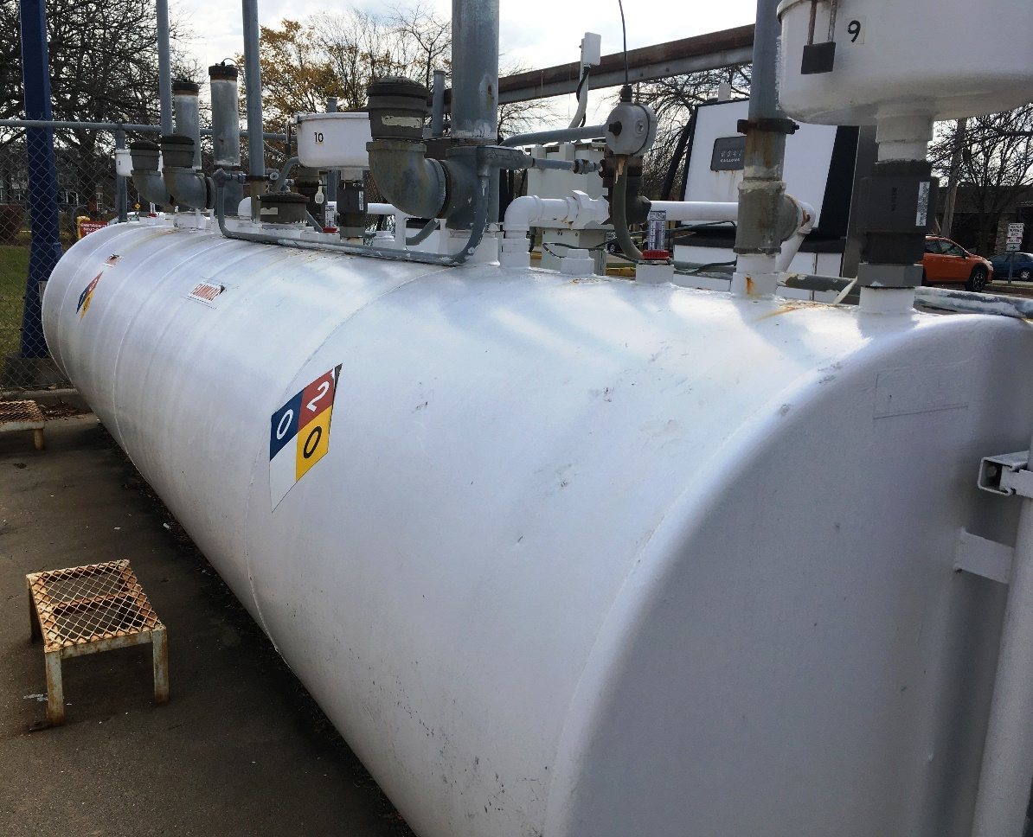
City of Madison Sources
Metro Transit – 1101 E. Washington Ave.
550-gal diesel
550-gal unleaded gasoline
550-gal unleaded gasoline
550-gal used oil
2,205-gal motor oil (15W40)
550-gal motor oil (SAE 40)
1,128-gal transmission fluid
55-gal drums (various)
3-compartment
outside tank
Inside

Slide 13
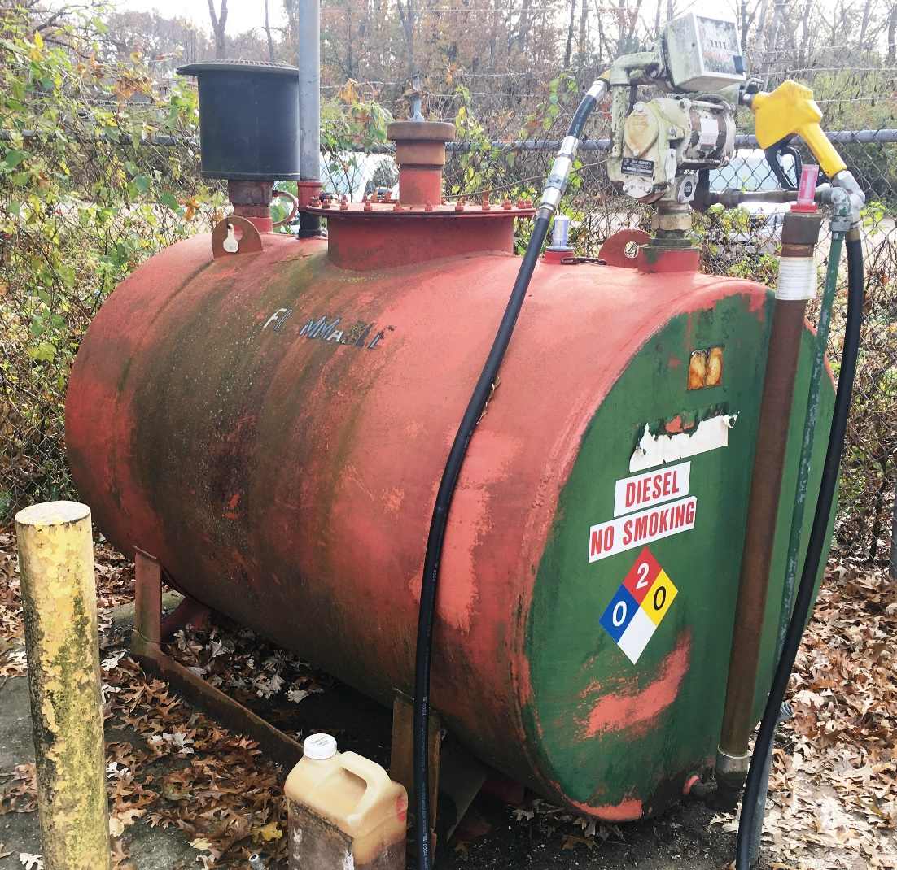
City of Madison Sources
Odana Hills Golf Course –
4635 Odana Rd.
500-gal diesel
1000-gal unleaded gasoline
Waste oil drum (inside)

Slide 14

City of Madison Sources
Olin Transfer Station – 121 E. Olin Ave.
5,000-gal diesel
5,000-gal unleaded gasoline
3,000-gal asphalt emulsion
300-gal waste oil
55-gal drums (motor/hydraulic oil)
150-gal transformer
140-gal hydraulic elevator reservoir
2 400-gal hydraulic compactors
Inside

Slide 15
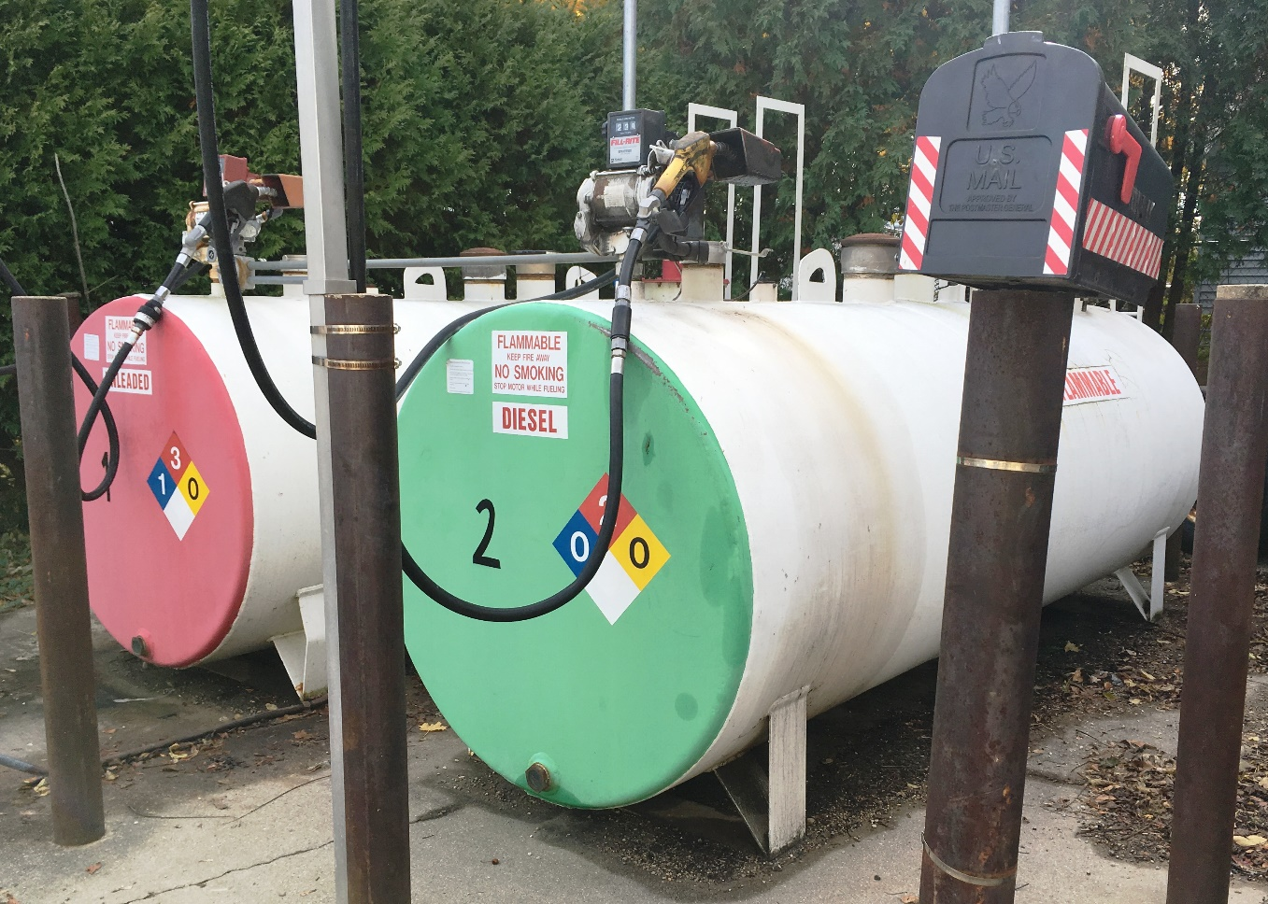
City of Madison Sources
Parks Summit Maintenance Facility –
1902 Freeport Rd.
1000-gal diesel
1000-gal unleaded gasoline
55-gal motor oil (inside)

Slide 16
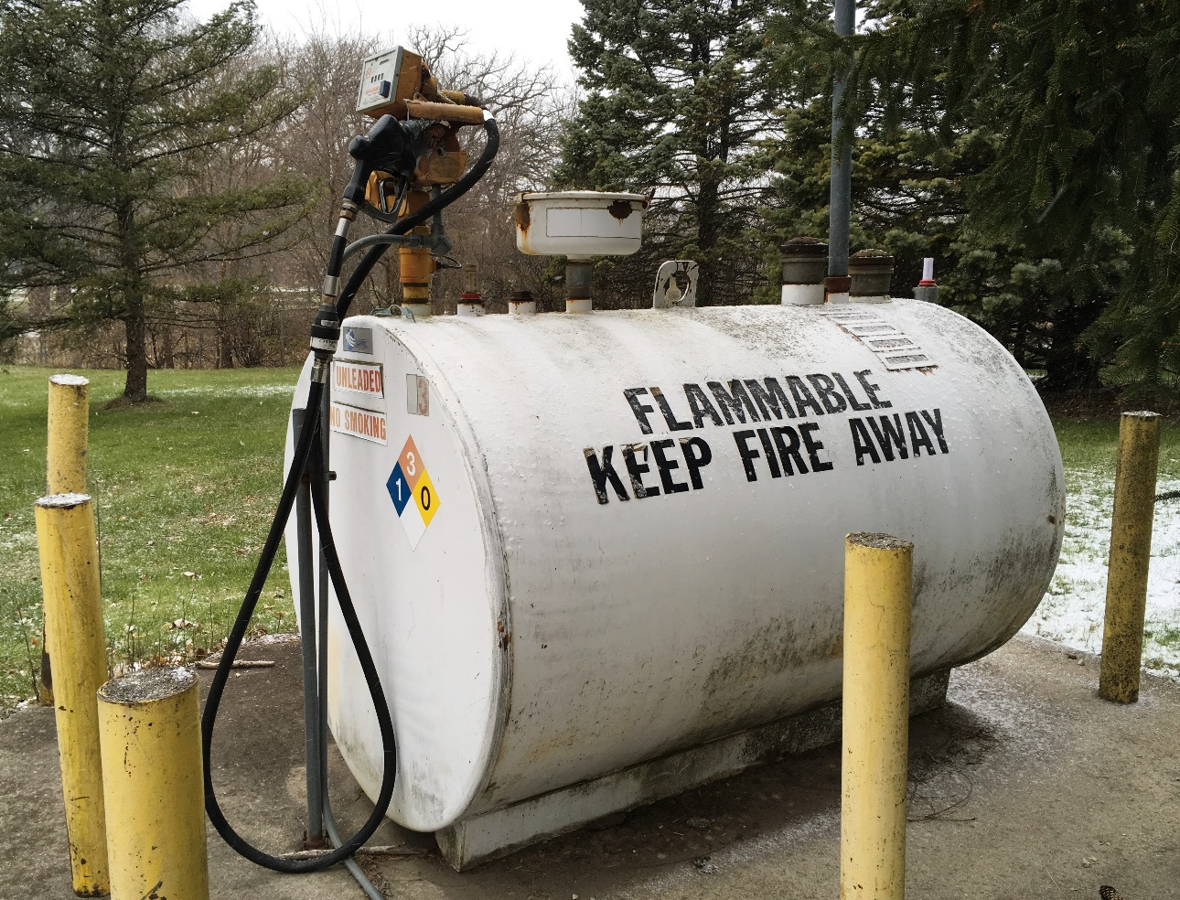
City of Madison Sources
Yahara Hills Golf Course – 6701 Hwy 12 & 18
500-gal unleaded gasoline
500-gal unleaded gasoline (club house)
1,000-gal diesel

Slide 17
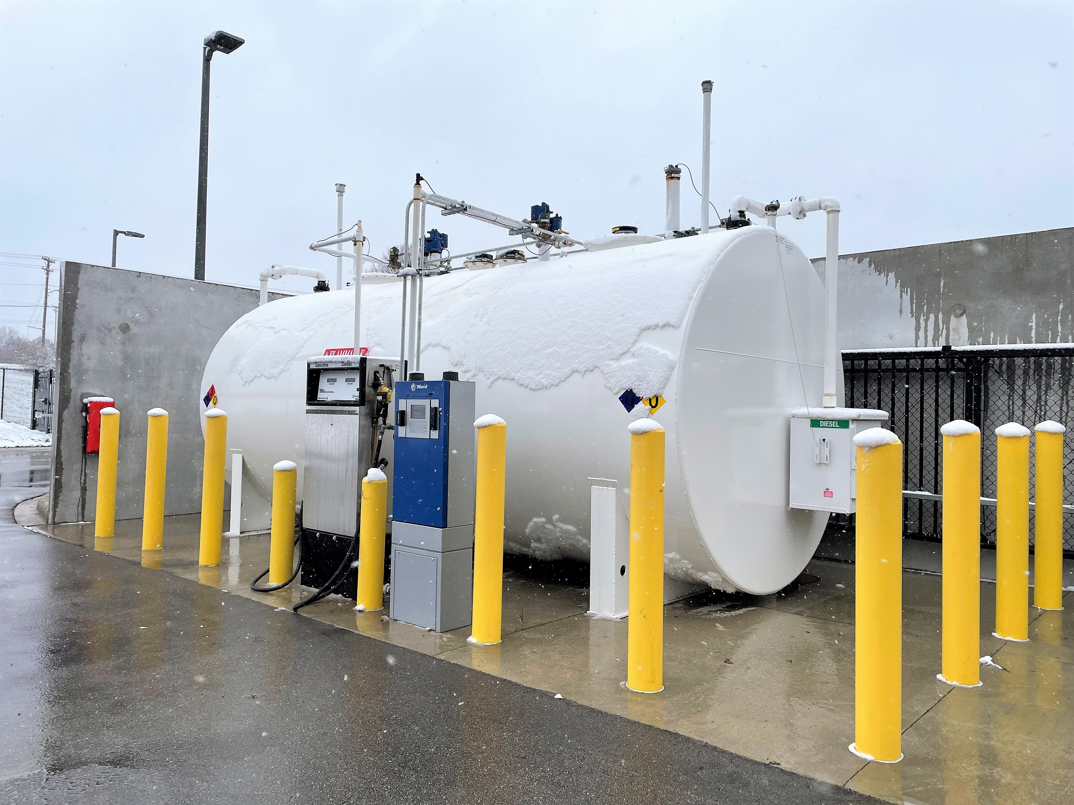
City of Madison Sources
Nakoosa Trail Fleet Facility
6,000-gal unleaded gas
4,000-gal diesel
1,000-gal used oil
250-gal ATF
Split 650-gal 10W-20/5W-30
Split 500-gal hydraulic/ATF
Split 500-gal hydraulic/75W-90
500-gal motor oil (10W-30)
55-gal drums (misc. oils)
Inside

Slide 18
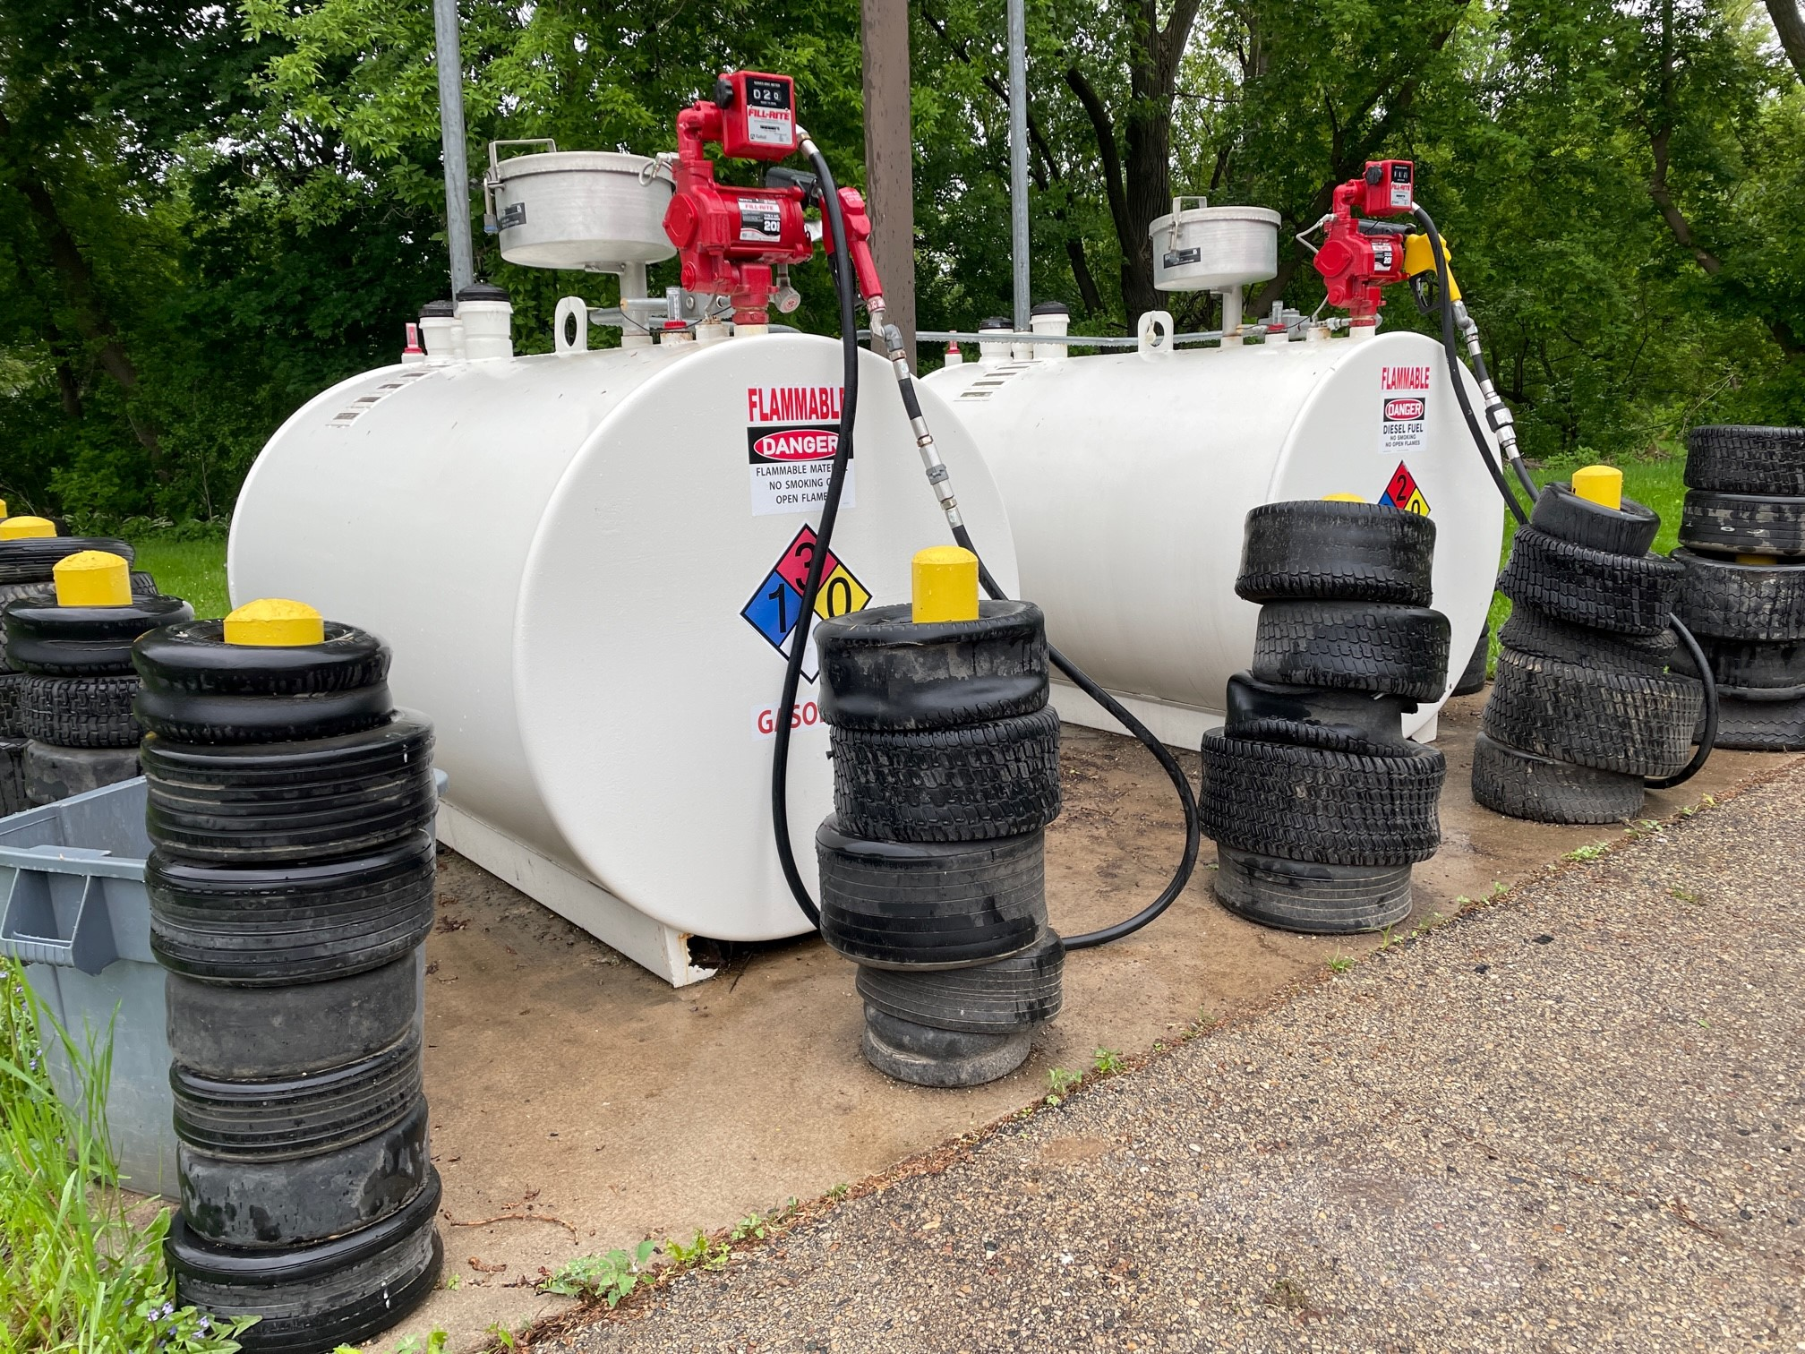
City of Madison Sources
Forest Hill Parks Maintenance
550-gal unleaded gasoline
550-gal diesel

Slide 19
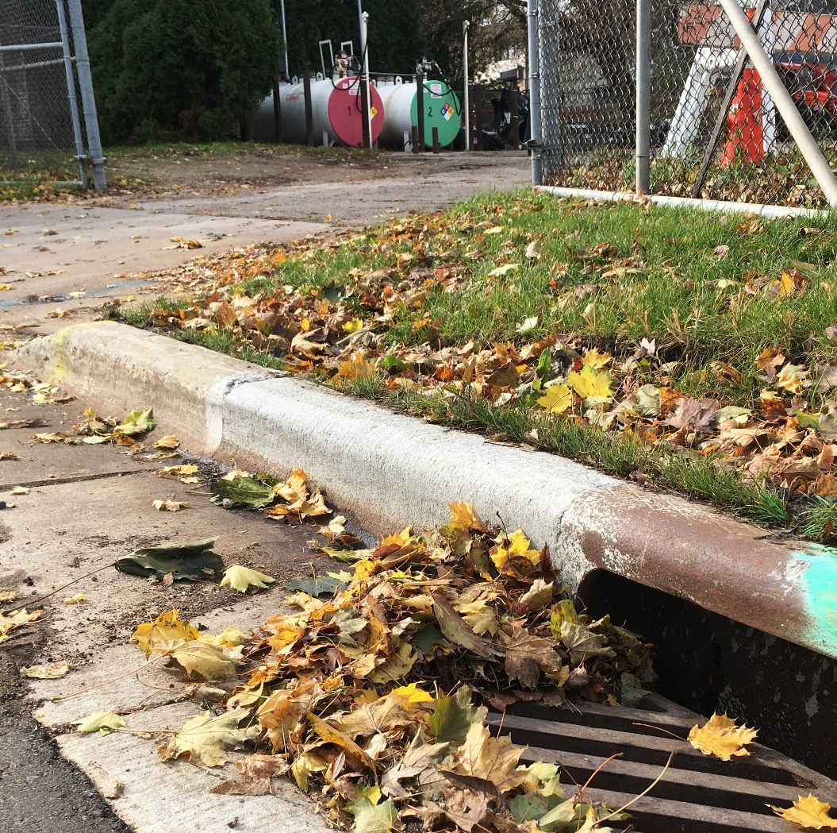
Realistic Spill Scenarios
Potential Major Spills:
  Release from oil delivery equipment during unloading at fill ports
  A truck hitting an outdoor used oil tank/drum not protected by safety bollards.
  Catastrophic tank or pipe failure (low probability)
Potential Minor Spills:
  Minor overfill at fill port
  Automatic stop failure on pump
  Leakage of fuel dispenser
  Spills during transfer from drums or containers

Slide 20
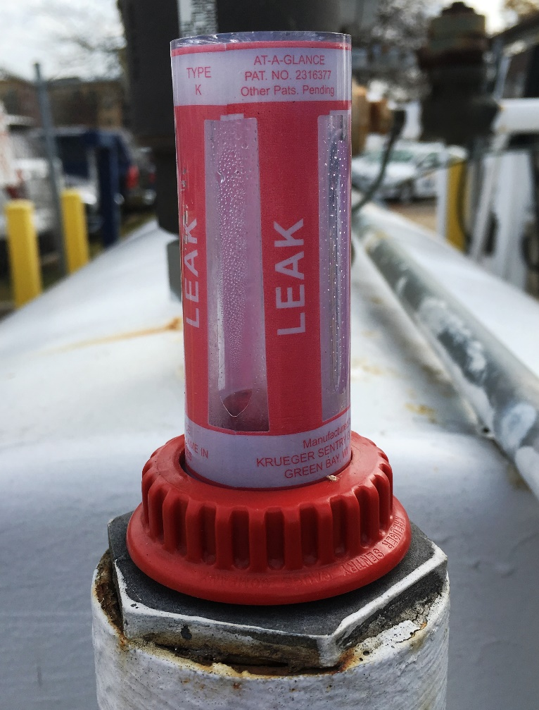
How do you prevent spills?
Spill prevention is achieved through:
Installation of required equipment and secondary containment
Good oil transfer practices and material handling
Regular inspections – As-Used, Monthly, and Annually

Slide 21
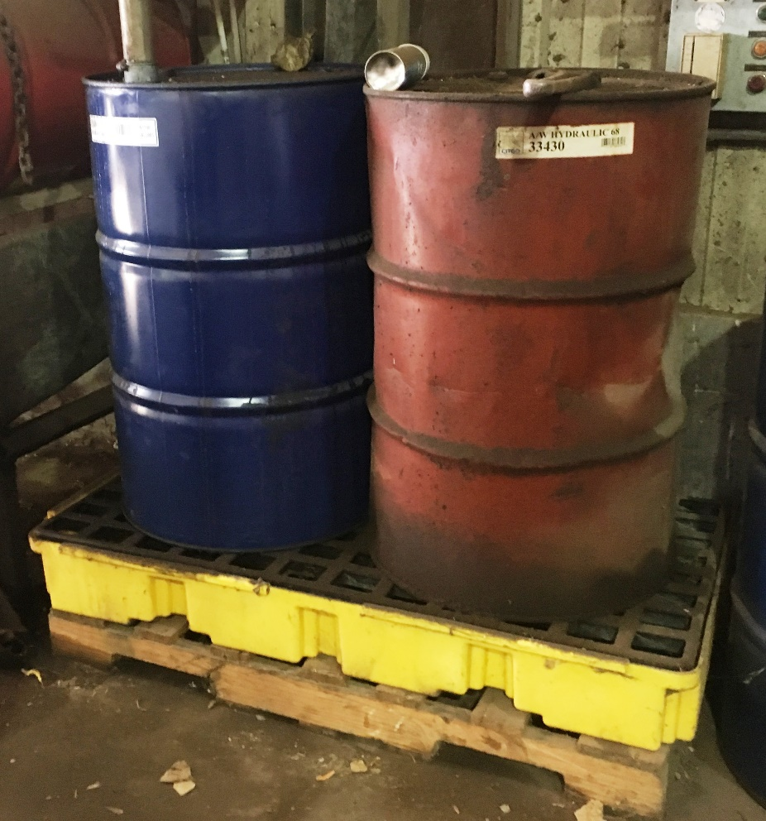
1. Preventing Spills: Secondary Containment
All oil sources listed in your facility’s SPCC plan are required to be designed with appropriate secondary containment to contain the entire capacity of the tank. Outdoor containers must also have sufficient freeboard to contain rainwater. Common examples of secondary containment include:
  Double-wall tank construction
  Concrete containment berm
  Spill pallets for portable drums
  Oil/water separators
  Nearby spill kits or sorbent materials

Slide 22
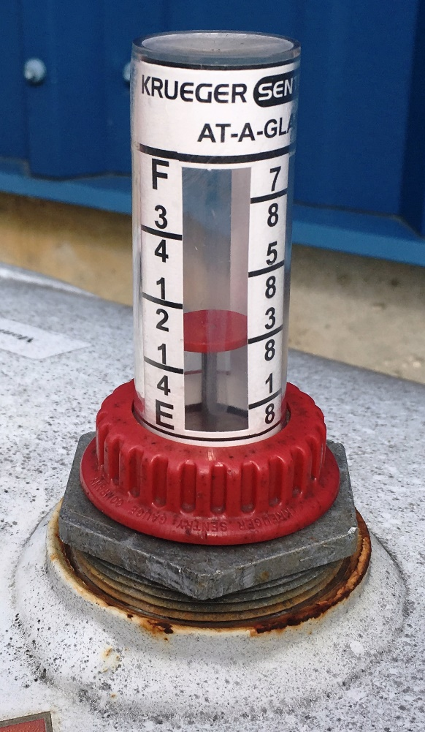
2. Preventing Spills: Oil Transfer Practices
Oil transfers at your facility may include filling, emptying, dispensing, or transferring oil from tanks to containers. During such activities, use the following practices to prevent discharges:
  Provide a visual gauge or high-level sensing alarm for all containers.
  Anyone filling or emptying a tank (including a vehicle tank) must be actively supervising the transfer. No sitting inside the truck!
  Drain lines to the tank before disconnecting.
  Ensure appropriate containment beneath connections.
  Request that tankers be equipped with overflow shut-off valves.
  Use a funnel or pump when adding or removing small quantities to drums/tanks.

Slide 23
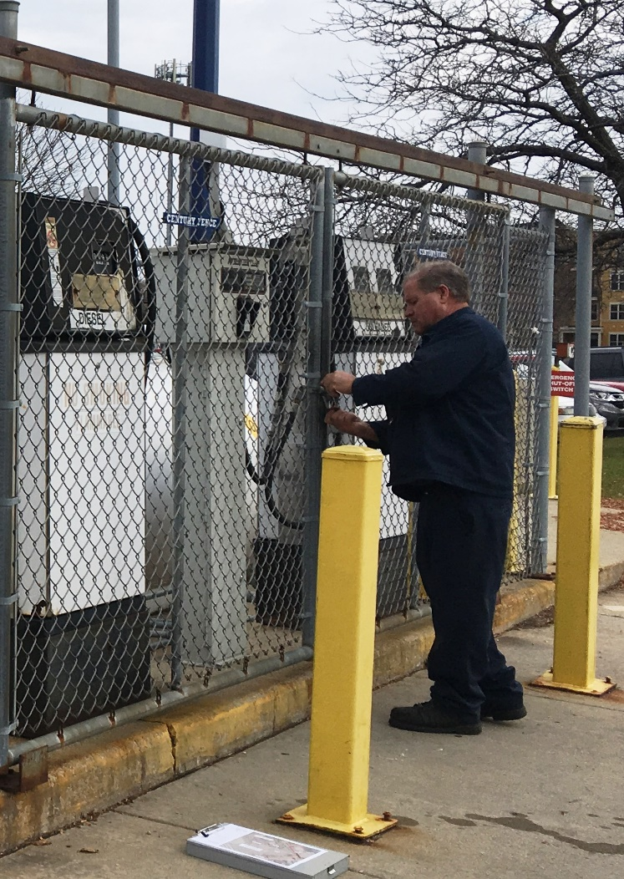
3. Preventing Spills: Regular Inspections
Visual inspection of tanks and piping, dispensing equipment and tank supports shall be conducted on an as-used, monthly, and annual basis:
  Complete monthly and annual inspections using the plan checklists (Attachments A and B).
  Maintain/repair equipment as needed (Attachment F).
  Review inspection logs to promptly follow-up on corrective actions.
  Report all small leaks and unusual observations to maintenance supervisors before they become problems.
  Keep inspection records on file for 3 years.

Slide 24
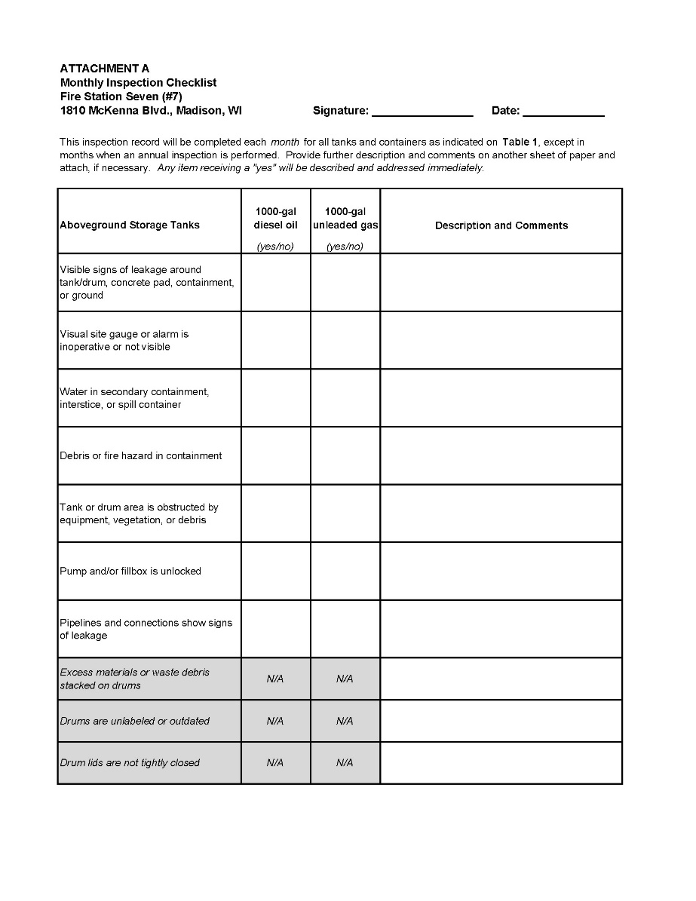
How do you conduct an inspection?
Refer to the monthly inspection form in your SPCC plan (Attachment A). Monthly inspections should include checking:
  Storage areas for signs of debris that may block access
  Storage areas for unlabeled or outdated containers
  Tanks, containers and associated piping for evidence of leakage or spillage
  Tanks and containers for water or oil in the tank interstice or secondary containment.
If you find an issue—address it immediately by referencing the contacts at the end of this training!

Slide 25
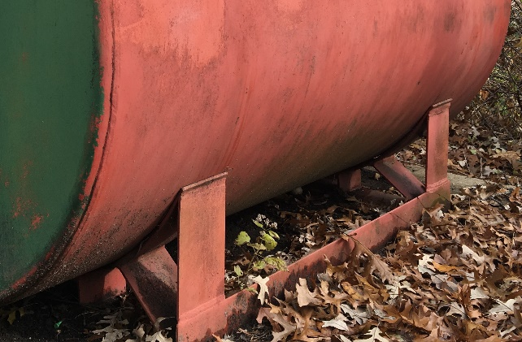

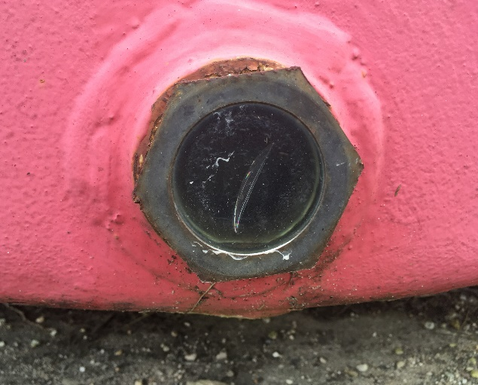
How do you conduct an inspection?
There are various methods to determine if a tank is potentially leaking, including:
  Interstitial leak detection gauge – The gauge will pop up when liquid (water or oil) is detected.
  Visual gauge – The Summit tanks have a glass pane (“site glass”) on the front bottom of the tank to visually observe leakage.
  Electronic monitoring – The Olin Transfer convault tanks have electronic alarm
  Visual spillage – Look for leaking or spillage on the underlying concrete.

Slide 26
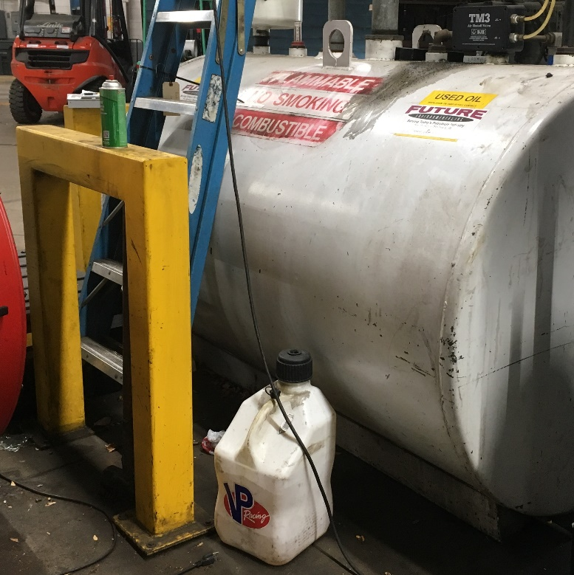
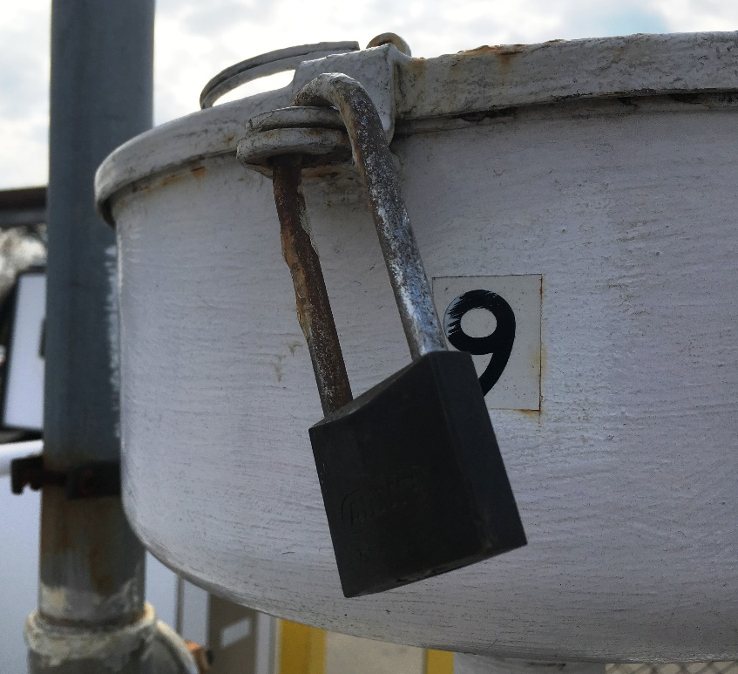
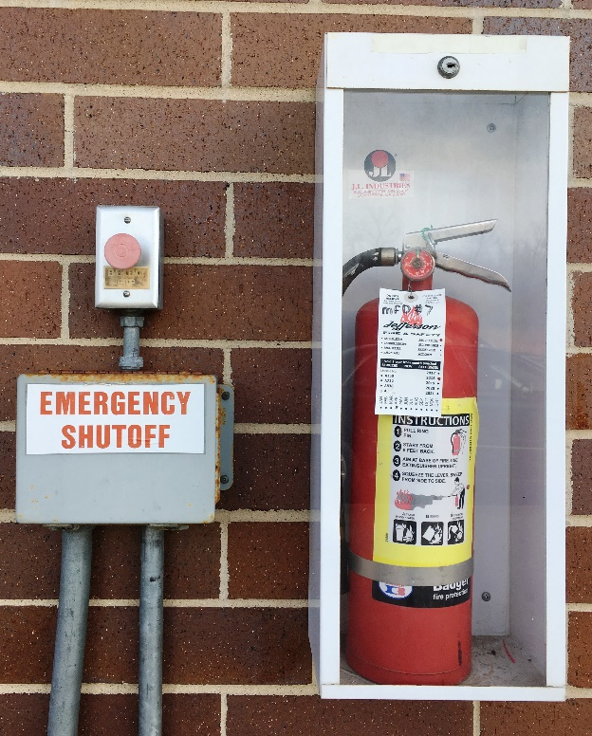
How do you conduct an inspection?
Does the storage area have debris or unlabeled containers?
Is the tank locked or within a locked enclosure?
Is the emergency shutoff and fire extinguisher clearly visible?

Slide 27
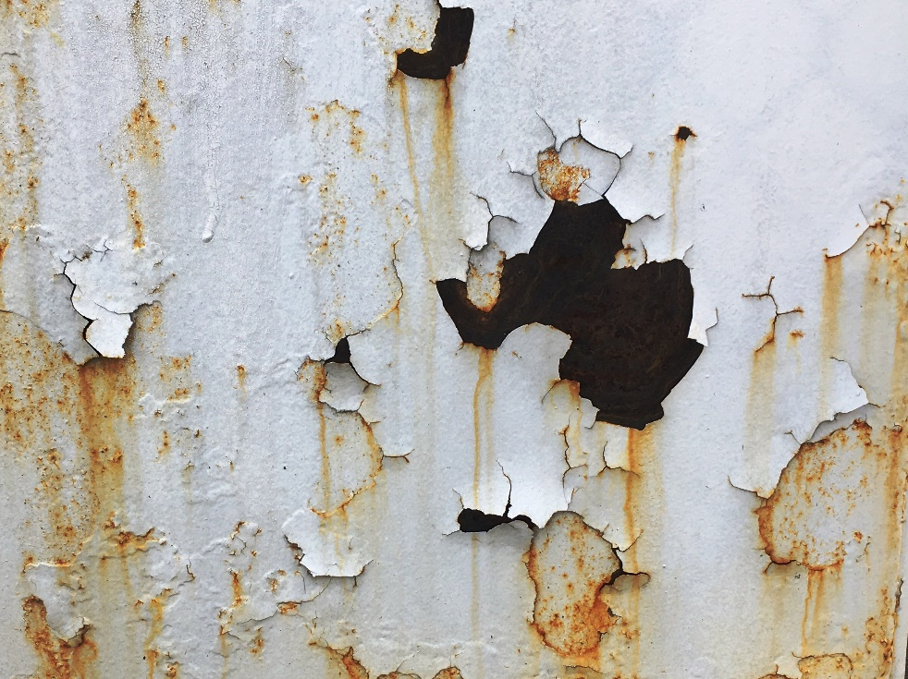
How do you conduct an inspection?
Annual inspections should include checking (Attachment B):
  Secondary containment for evidence of damage
  Tank foundation and support structures for signs of settlement, corrosion or damage
  Tank exterior coatings for signs of rust or other indications that cleaning/painting is needed.
  Tank or container liquid level and overfill prevention sensing devices
  Spill kits for replacement/replenishment of spill response materials
The above rusty tank needs repainting. See the end of the training for references and resources.

Slide 28
Mini-Quiz!
1. Which of the following is adequate secondary containment for a tank?
  Double-walled construction
  Nearby spill kits
  Oil/water separator
  Concrete containment berm
  All of the above
Answer E: All of the above are adequate secondary containment.
2. It is OK to re-enter your vehicle during refueling, especially during the winter.
  True
  False
Answer B: When refueling a vehicle, DO NOT LEAVE IT UNATTENDED. The majority of spills at the City of Madison occur due to failure of the automatic pump shut-off.

Slide 29
How do you safely respond to a spill?
Much of an SPCC plan deals with preventing a spill. However, if a release occurs, evaluate if it’s a minor or major spill to determine the best response:
Minor (Incidental) Spills
  Discharge is small (less than 5 gallons)
  Discharge is easily contained
  Discharge is unlikely to reach storm drain or waterway
  Proper response and personal protective equipment is available.
  If you have been trained in how to properly clean up small spills, proceed with spill control and clean up.
Major (Non-Incidental) Spills
  Discharge is large and cannot be easily contained.
  Discharge may reach a storm drain or waterway.
  Discharge poses a hazard to human health or the environment.
  There is danger of fire or explosion.
  Major spills require response by the Fire Department. Call 911.

Slide 30
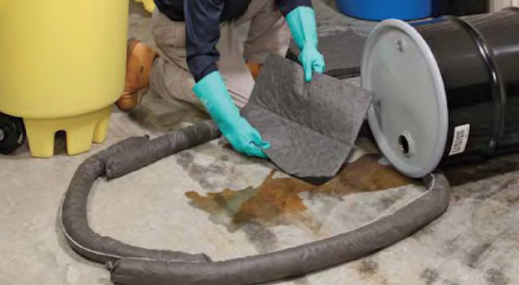
Spill Control: Minor Spills
For MINOR SPILLS, use the following response steps:
  Secure the site.
  Locate the nearest storm drain or receptor.
  Control and contain the spill using materials in nearby spill kit.
  Notify your On-Duty Supervisor.
  Clean up the spill using a spill kit. Place used sorbent materials into plastic bags or 5-gallon buckets for disposal by City’s oil recycling contractor.
  Complete the Spill Incident Report form (Attachment E).

Slide 31
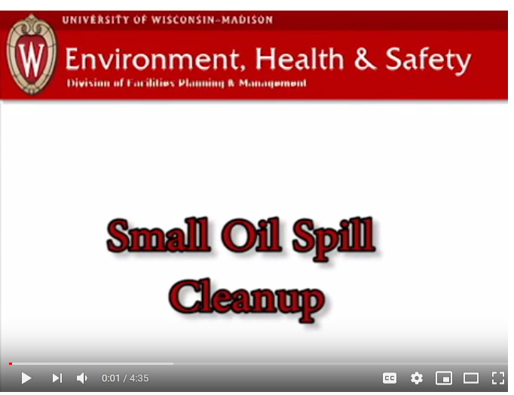
Small Oil Spill Cleanup Demonstration VIDEO
Click the below link for a short video by UW-Madison on conducting a minor oil spill cleanup.
https://tinyurl.com/ycssfs39

Slide 32

Spill Control: Major Spill
For MAJOR spills, use the following response steps:
Secure the site.
Contact the On-Duty Supervisor.
Contact the Fire Department (Call 911).
Complete the Spill Incident Report form for use by emergency responders (Attachment E).
Contact a spill response contractor (Section 1.4). Control and clean up spill as directed by the Fire Department or response contractor.
Determine if additional State or Federal notification is required (Section 2.3)

Slide 33
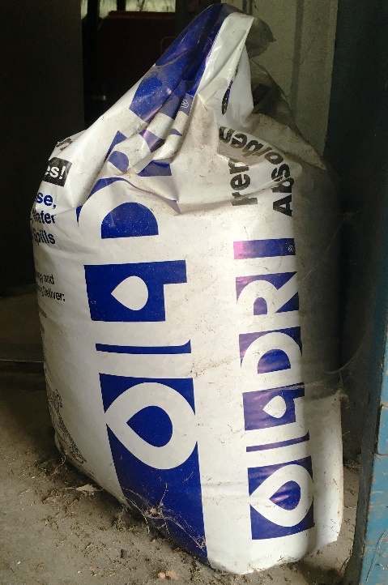
Spill Response Materials
Granular absorbent can be poured on incidental drips and swept up. Spill pads can be placed on small spills to assist clean up.
An absorbent sock or boom can be placed around spills to protect trench or floor drains. Protecting floor drains is critical since it means the difference between a controlled spill and one beyond your control.
Place used sorbents in a bucket or drum for disposal by the City’s waste oil contractor.
This is an example of a weatherproof spill kit. It contains granular absorbent (e.g. Oil Dri), absorbent pads, booms, socks, and personal protective equipment (e.g. shoe covers, rubber gloves). Kits like this should be placed near oil tanks and drums.
Place used sorbent materials into plastic bags or 5-gallon buckets for disposal by City’s oil recycling contractor.
Know the location and contents of your spill kits!

Slide 34
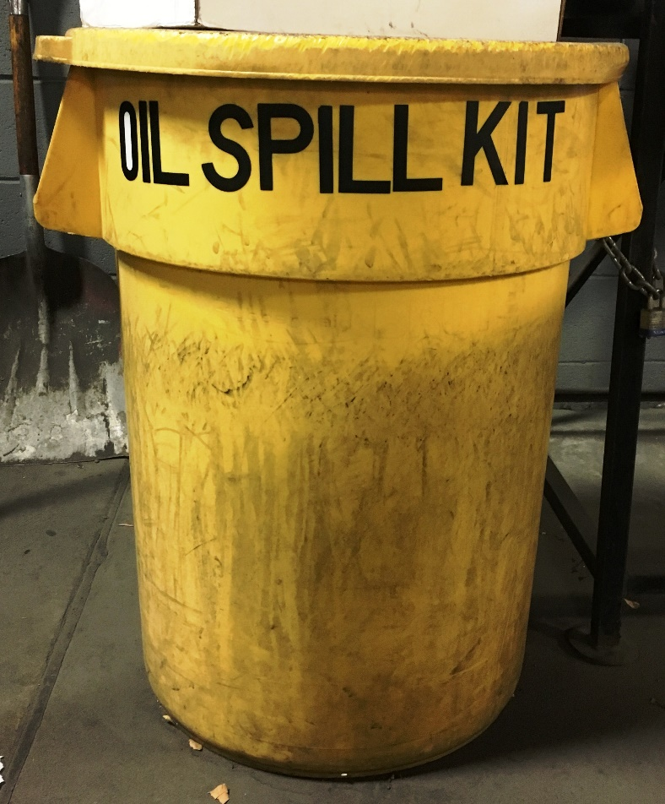
Spill Response Materials
This is an example of a weatherproof spill kit. It should be placed near oil tanks and drums. It contains:
  Granular absorbent
  Absorbent pads, pillows, and socks
  Personal protective equipment (gloves, glasses, mask)
  Bottle of Quick Seal to plug drums/tanks
  Plastic disposal bags
  Know the location and contents of your spill kit! It should be checked annually to make sure it’s adequately stocked and restock regularly!

Slide 35
Spill Reporting and Documentation
In the event of a spill, the employee discovering the spill shall immediately consult the response procedures in your facility’s SPCC plan to make the appropriate notifications (Section 2.3).
Report all spills to the On-Call Supervisor.
For the following situations, also call the WDNR’s Spill Hotline (1.800.943.0003):
  1 gallon or more of a flammable liquid (e.g. gasoline) onto an unpaved surface
  5 gallons or more of a combustible liquid (e.g. diesel) onto an unpaved surface
  Discharge that threatens public health, welfare, or the environment
  Discharge that produces a sheen or threatens navigable waters (e.g. release that reaches a storm drain)
Refer to the Oil Spill Notification Procedures (Section 2.3) of your facility’s SPCC plan for additional reporting requirements.

Slide 36
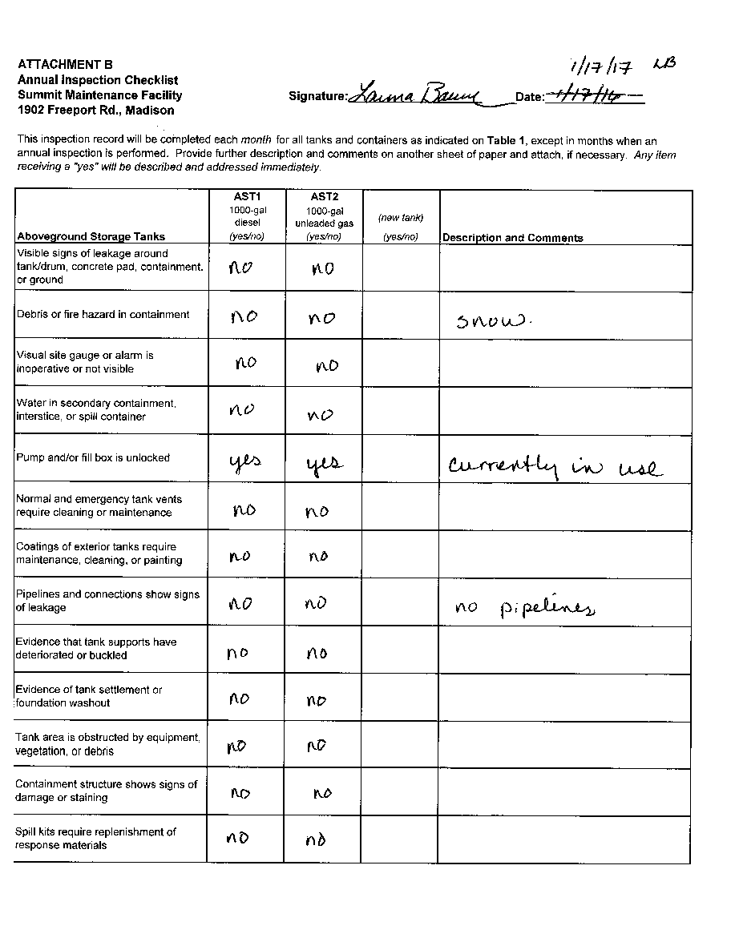
Recordkeeping and Training
EPA requires facilities to maintain SPCC records for at least 3 years. Facilities are required to retain all records (paper or digital) for the following:
  Monthly and annual inspection forms (Attachments A and B)
  5-year recertification (Attachment C)
  Spill incident reports and reporting logs (Attachment E)
  Tank and container repair records (Attachment F)
  ANNUAL training records of ALL oil-handling personnel (Attachment G)

Slide 37
Additional Resources
For questions regarding:
Gas/diesel tanks for refueling vehicles, dispenser issues (e.g. leakage, low flow) or cracked pump hoses:
Tank regulations, inspection training, or adding additional tanks to your facility:
Recertifying or updating your SPCC plan, training/recordkeeping requirements:
Contact:
Rich Saric, Fleet Services rsaric@cityofmadison.com, 246.4541
Amanda Hornung, Fire
ALHornung@cityofmadison.com, 261.9842
Brynn Bemis, Engineering
bbemis@cityofmadison.com, 267.1986

Slide 38
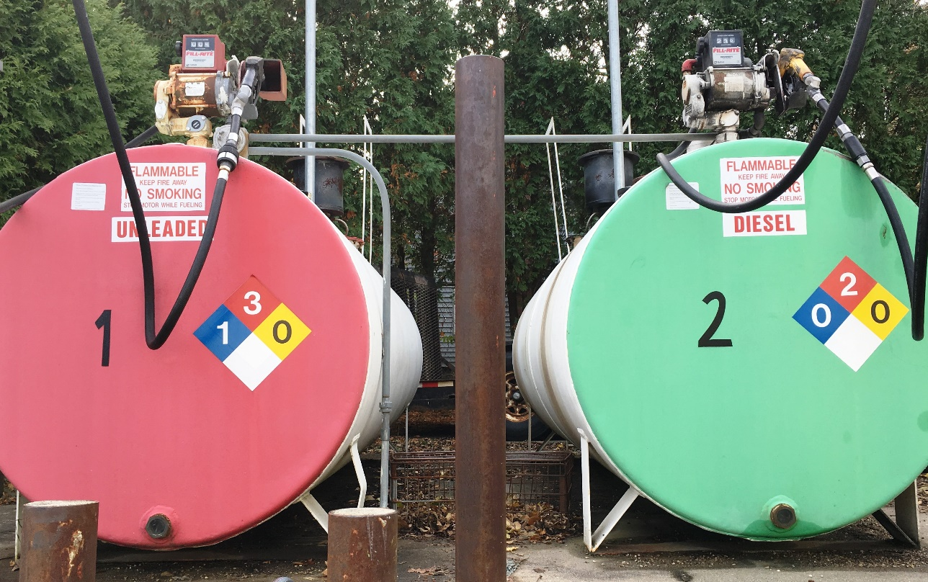
Course Completion Quiz
In order to obtain credit for participating in this training, you must click on the link below and correctly complete the quiz. (It is OK to use the training for reference while taking the quiz).
https://www.surveymonkey.com/r/7PFZLNY
Thank you for participating this SPCC training program!

