Slide 1

Classification and Compensation Study
City of Madison, WI

Slide 2
Agenda
Project Overview
  SAFE (internal equity)
  Market (external equity)
Proposed Pay Plans
Benefits Comparison Results
Pay Equity Findings
Implementation and Next Steps

Slide 3
Methodology
Project Overview
Project Initiation. Planning meeting with City’s project team to understand goals of the study, collect necessary documentation, and setup the project. Included collection of PAQs and onsite communication meetings.
Position Review. Review of each position to ensure appropriate titling as well as an evaluation using our SAFE process to establish a relative-worth hierarchy.
Market Assessment. Distribution of a custom survey to identified public sector peers to collect base pay data for comparison against the City’s base pay.
Pay Plan Development. Development of a new pay plan with consideration to internal and external results, verified through a regression analysis, to establish a fair, equitable, and defensible pay structure. Cost analysis calculation for the City to consider in its adoption of the proposed pay plan.
  Any changes to the pay plan and grade assignments must be bargained with each impacted group, as necessary.
Project Completion. Executive summary outlining the project methodology, the results of the study, and our recommendations based on those results. Training with HR staff to maintain and administer the pay plan going forward.
Project Initiation
Position Review
Market Assessment
Pay Plan Development
Project Completion
We are Here

Slide 4
Project Overview - Detailed
Methodology
Baker Tilly worked closely with HR and the Selection Committee who have been involved in reviewing preliminary results and providing feedback – including the review and selection of peer organizations for the market survey.
Outstanding Items:
Finalizing implementation calculations to address previous and upcoming pay adjustments.
The final report
Training for HR to use SAFE going forward
Pay practices and policies review
*FLSA Review added to scope October 2025
1. Project Initiation
3. Position Review
5. Project Completion
2. Market Assessment
Project Planning
Data Collection
Communication Meetings
PAQs
Peers Selected
Market Survey
Quality Control
Title Review
Job Evaluation
Quality Control
4. Pay Plan Development
Pay Plans Drafted
Grade Assignments
Implementation Calculations
Final Presentations
Final Report
Training for HR Staff
6. Additional Deliverables
Benefits Assessment
Pay Policy Review
Pay Equity Review
FLSA Review*
Benchmarks Selected
Quality Control

Slide 5
Job Evaluation
PHASE 2
Baker Tilly has a point-factor job evaluation system called SAFE® (Systematic Analysis and Factor Evaluation), which was developed specifically for the evaluation of public sector positions.
PAQs were used to evaluate every position.
The end results is a total score for every job based on 8 compensable factors.
This is an evaluation of the position, not the person in the position.
Compensable Factor | Weight | Descriptions / Measurement
Experience | 14% | Minimum years of experience required by the position
Level of Work | 16% | Degree of difficulty of work performed by the position
Human Relations | 9% | Type and level of human interactions
Physical Demands | 6% | Physical exertion performed by the position
Working Conditions | 8% | Environmental conditions experienced by the positions
Independence to Act | 14% | Degree of independence to make decisions and act on them
Impact of Actions | 16% | Severity of consequences as a result of decisions
Supervision Exercised | 16% | Type and level of supervision exercised
 | 100% | TOTAL
Education was removed as compensable factor for internal equity measurement.

Slide 6
Market Peers
Phase 3
16 public peers were identified to receive the custom market survey.
Data was collected or compiled from all peers.
Data from published survey sources were additionally included representing ‘all industries’
Ann Arbor, MI
Aurora, IL
Austin, TX
Boulder, CO
Cincinnati, OH
Columbus, OH
Dane County, WI
Des Moines, IA
Eugene, OR
Grand Rapids, MI
Lincoln, NE
Milwaukee, WI
Spokane, WA (+Transit Authority)
St. Paul, MN
State of Wisconsin
University of Wisconsin - Madison
Comp Analyst
Economic Research Institute
PayFactors

Slide 7




Published Sources
Phase 3
Data Sources | Survey Parameters | Survey Information
Comp Analyst | Wisconsin State Average; All Industry; | Comp Analyst is a salary data resource from Salary.com that is comprised of HR-reported pay data comprised of 800 million market data points from more than 25,000 organizations resulting in data across 15,000 unique job title, 225 industry breakouts, 27,000+ compensable factors, in 42,000+ geographies.
Economic Research Institute | Madison; All Industry; | Economic Research Institute (ERI) is a salary data resource reporting market data for more than 11,000 jobs in more than 9,000 different locations across more than 1,100 industry sectors. ERI data is updated quarterly. ERI data used in this survey was pulled at the 10th and 90th percentile to represent the minimum and maximum thresholds of a salary range.
Pay Factors | Wisconsin State Average; All Industry; | PayFactors is a robust compensation platform that helps organizations develop competitive, fair, and transparent pay strategies. It integrates multiple data sources, including employer-reported, peer, and employee data, providing a comprehensive view of market trends. PayFactors allows organizations to customize salary structures based on factors such as industry, location, company size, and specific job skills or certifications.

Slide 8
Market Review
Phase 3
Quality
Baker Tilly requires a 75% overlap in duties and responsibilities to be considered a ‘good match.’
Job descriptions/summaries were reviewed (neo gov) for each position to determine appropriate overlap of job duties.
Quantity
Baker Tilly required a minimum of 3 matches per benchmark to calculate a market value.
If a benchmark position had less than 3 matches, it will be noted as ‘insufficient data’ in the report.
Data Adjustment
Compiled data was adjusted to account for differences in:
  Work week, fiscal year, and geographic cost of labor

Slide 9
Data Adjustments: Cost of Labor by Geography
External Equity
Where cost of living is a measurement of goods and services in each area, the cost of labor is a measurement of compensation paid.
Cost of labor can be impacted by the cost of living but is mainly influenced by the supply and demand of labor in each area (rate of unemployment and number of qualified laborers).
Data from Boulder was reduced by 13.2% while Data from Lincoln was increased by 7.4% to meet the COL in Madison.
Cost of labor differentials collected from Economic Research Institute’s Geographic Assessor tool

Slide 10
Market Results
Phase 3
Data was compiled from all 16 public sector peers with additional matches, as appropriate, from 3 published sources.
561 positions were benchmarked
  Only 20 positions had insufficient data (less than 3 matches) and a market value could not be calculated for those
    We have internal equity (SAFE scores) and existing equity (current midpoints) to establish an appropriate placement for positions without market values.
Benchmarks had 8.11 matches, on average
Overall, the City’s minimums are “leading” market, midpoints are “at market” while maximums are slightly “lagging” market, on average.
Max 93.5%
Mid 100.9%
Min 110.2%

Slide 11
Market Results
Phase 3
Extremely misaligned
Extremely misaligned
86% of benchmarks are “at” or “leading” market at the midpoint.
Only 3.5% of benchmarks were significantly lagging market, and most of those were hourly positions.
20 benchmarks had insufficient data

Slide 12
Proposed
Pay Plans

Slide 13
Current Pay Plans
Phase 4
The City currently has multiple “pay plans” often aligned with bargaining and employee groups.
To establish a more consistent, transparent, and easier to understand framework = we’ve consolidated all positions into 9 proposed pay plans.
The goal is to have a more intentional hierarchy that stretches across these 9 defined groups.
This will help alleviate unintended overlap and compression between exempt/non-exempt as well as supervisor-subordinate roles.
Current Pay Plans | Proposed Pay Plan | Grades | Positions
Hourly CG 15, 16, 17, 19, 20, 28, 31, 71, 83 | Hourly | 1 - 14 | 78 titles
CG 15, 16, 17, 18, 20, 32, 33, 71 | General | 15 – 32 | 275 titles
CG 41, 42 | Transit | 40 – 54 | 31 titles
CG 13, 16 | Fire | 60 - 67 | 16 titles
CG 11 | Police | 70 -72 | 5 titles
CG 12, 14 | PS Management | 80 - 87 | 7 titles
CG 18, 19, 43, 44 | Professional | 90 -113 | 356 titles
CG 23 | Attorney | 150 | 2 titles
CG 21 | Executive | 200 - 210 | 34 titles

Slide 14
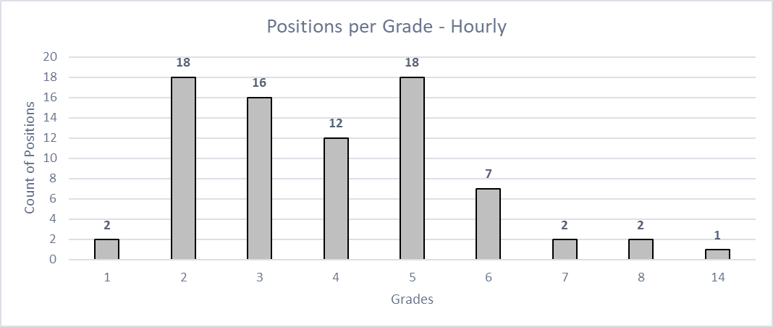
Pay Plan – Hourly
Proposed Pay Plan
Hourly Plan
14 Grades
  Numbered 1 to 14
  10% between each grade
5 Steps
  Numbered 1 to 5
  4.5% between each step
  = 19.3% range spread
Full span of plan is $10.07 to $61.92 per hour
78 positions assigned
Approximately 951 employees allocated
Average Range Penetration (current salary vs. proposed range) = .01%
Avg YIP = 1.4 years

Slide 15
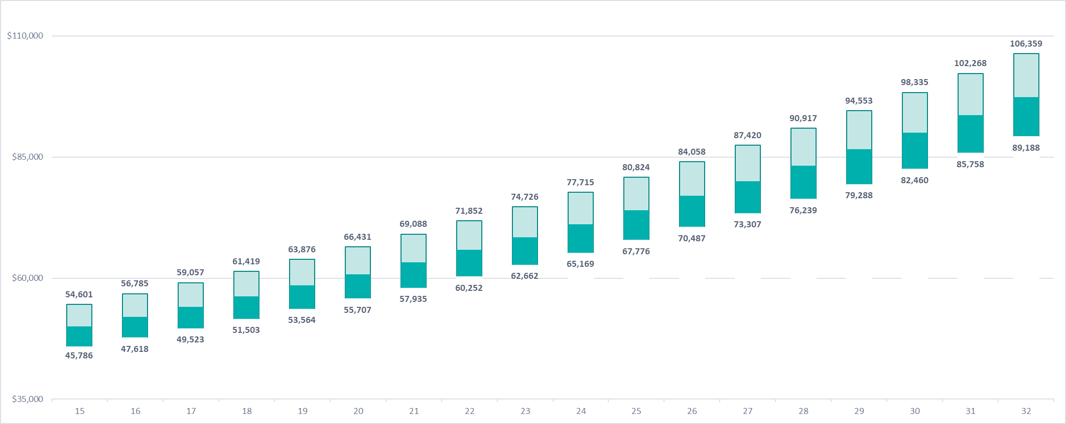
Pay Plan – General
Proposed Pay Plan
General Plan
18 Grades
  Numbered 15 to 32
  4% between each grade
5 Steps
  Numbered 1 to 5
  4.5% between each step
  = 19.3% range spread
Full span of plan is $46,228 to $105,344 annual
275 positions assigned
Approximately 1078 employees allocated
General Grades

Slide 16
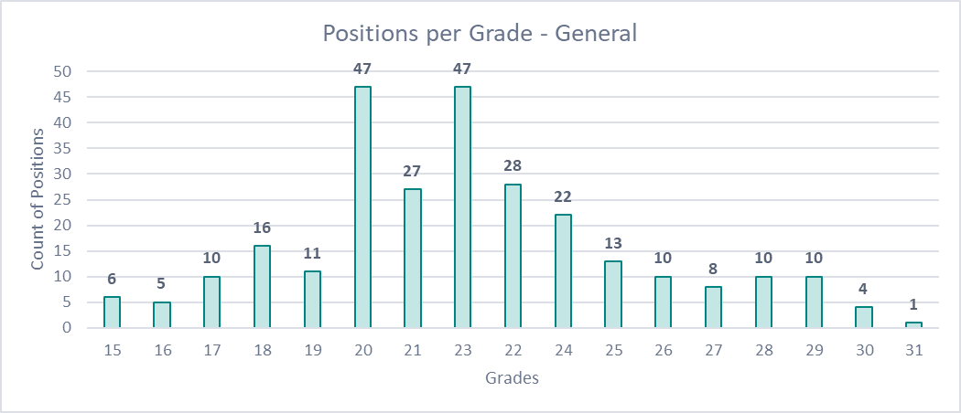
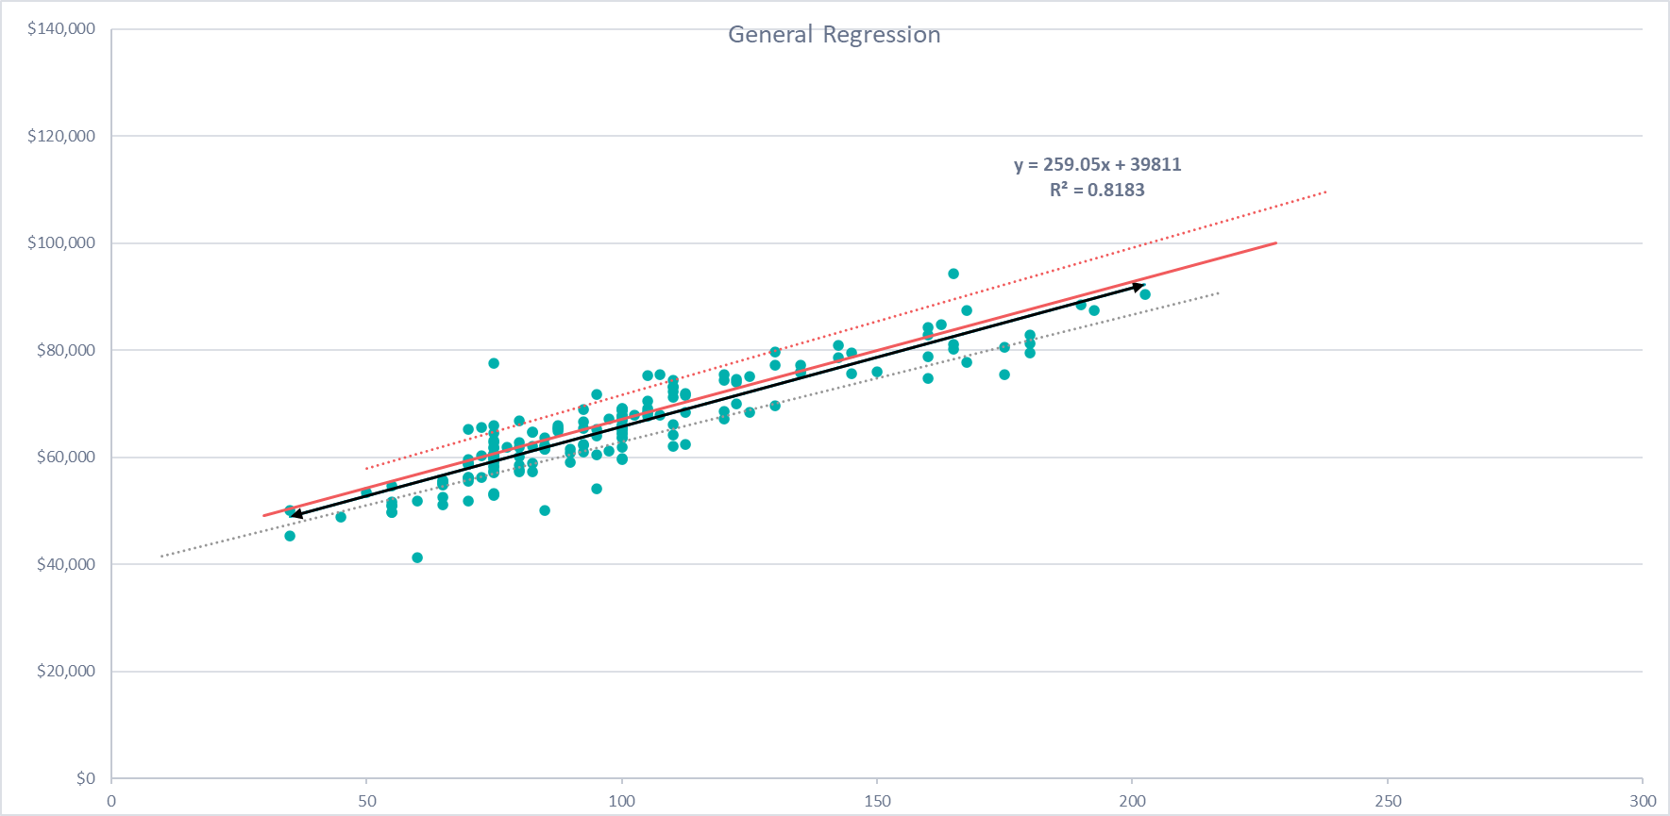
Pay Plan – General
Proposed Pay Plan
Positions were assigned to the plan:
Based on current midpoint
Adjusted per market, if appropriate
Adjusted per SAFE or progression, if appropriate
The regression analysis demonstrates the relationship between SAFE scores and market average midpoints.
There is an 82.3% correlation.
The regression demonstrates raw data points, not grade assignments.
Average Range Penetration (current salary vs. proposed range)
100.7%
Avg. YIP = 4.5

Slide 17
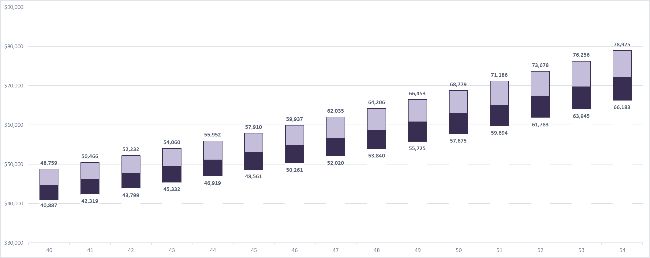
Pay Plan – Transit
Proposed Pay Plan
Transit Plan
15 Grades
  Numbered 40 to 54
  3.5% between each grade
5 Steps
  Numbered 1 to 5
  4.5% between each step
  = 19.3% range spread
Full span of plan is $40,887 to $78,925 annual
31 positions assigned
Approximately 415 employees allocated
Transit Grades

Slide 18
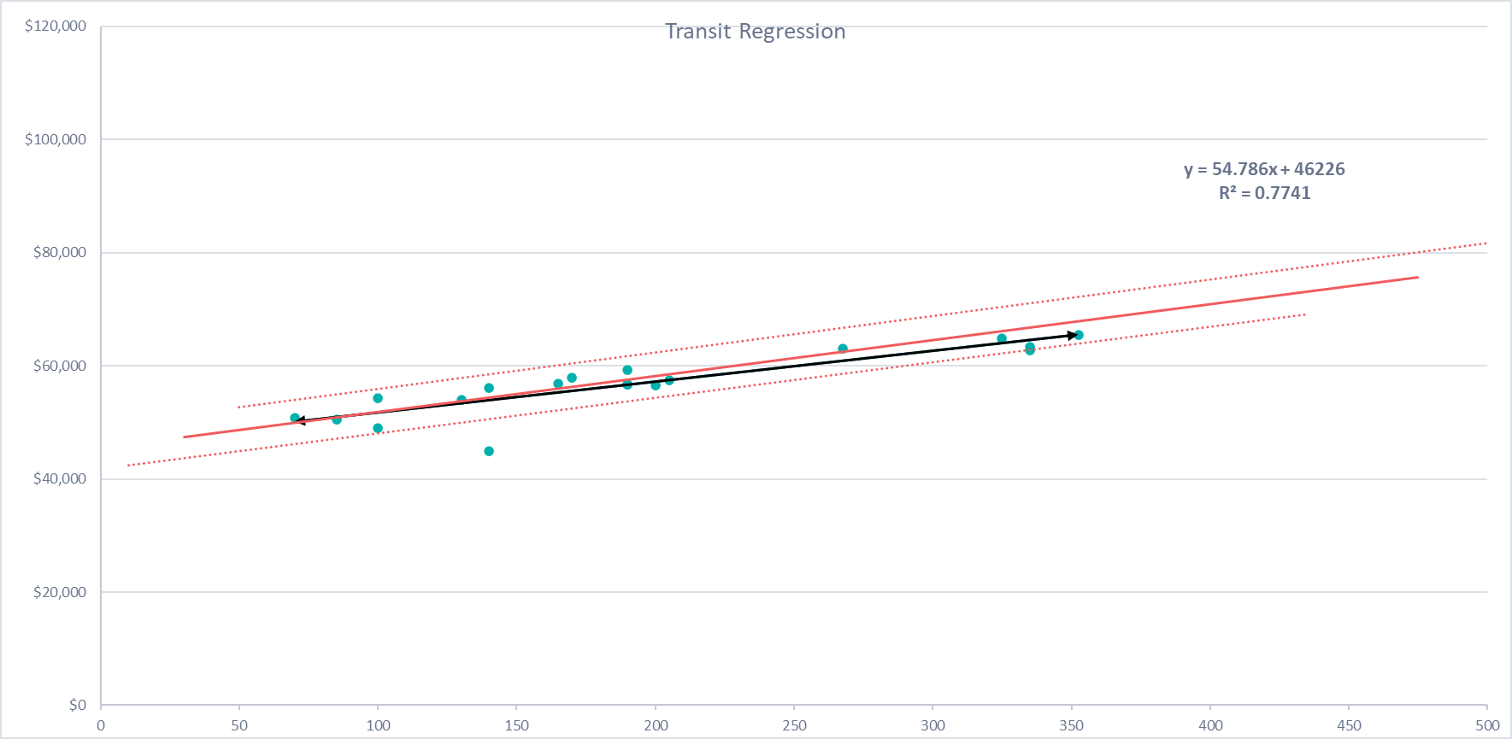
Pay Plan – Transit
Proposed Pay Plan
Positions were assigned to the plan:
Based on current midpoint
Adjusted per market, if appropriate
Adjusted per SAFE or progression, if appropriate
The regression analysis demonstrates the relationship between SAFE scores and market average midpoints.
There is a 77.4% correlation.
The regression demonstrates raw data points, not grade assignments.
Average Range Penetration (current salary vs. proposed range)
53.8%
Avg YIP = 4.5 years

Slide 19
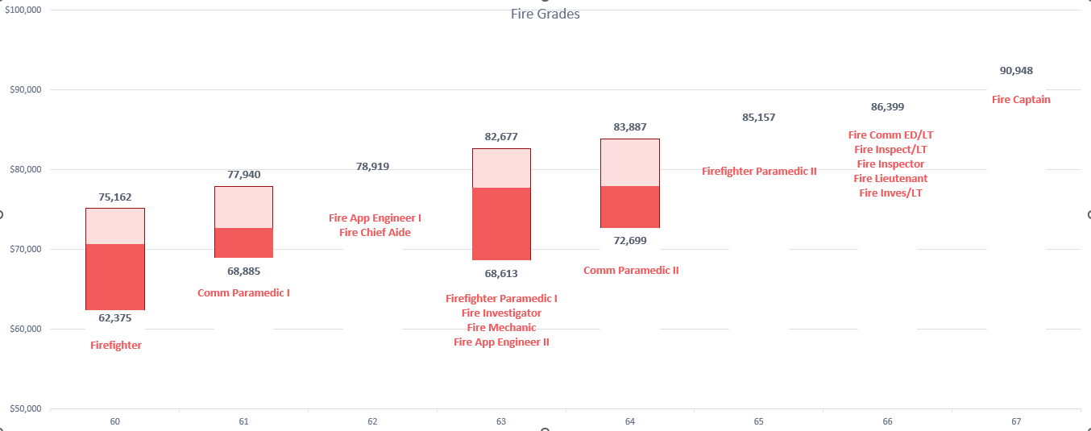
Pay Plan – Fire
Proposed Pay Plan
8 Grades
  Numbered 60 – 67
5 Steps or Fixed Rate
  Decreasing % between steps from 9.6% to 3.1%
Full span $62,374 to $90,948 annual
16 position titles
Approx. 406 employees
Avg Rng Pen = 78%
Avg. YIP 4.3 years

Slide 20
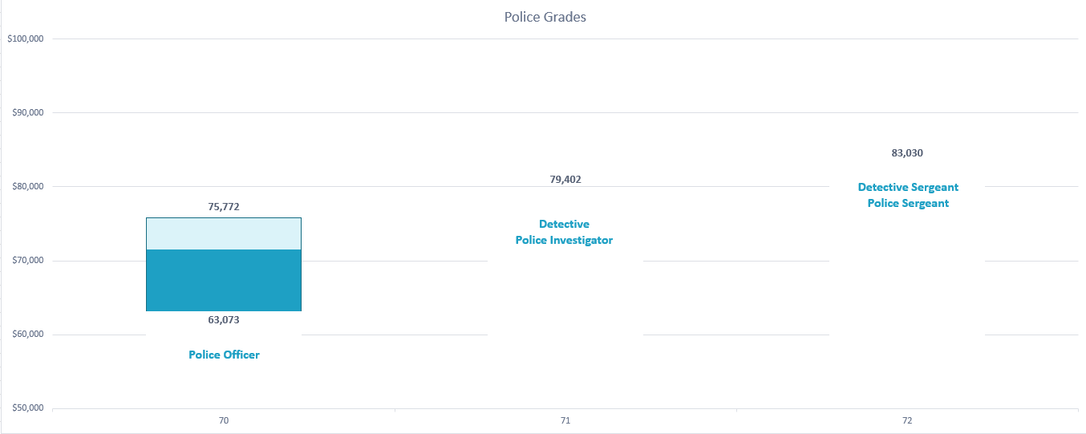
Pay Plan – Police
Proposed Pay Plan
3 Grades
  Numbered 70 – 72
5 Steps or Fixed Rate
  Decreasing % between steps from 10.6 % to 3.0%
Full span $63,073 to $83,029 annual
5 position titles
Approx. 461 employees
Avg. Range Penetration = 89%
Avg. YIP 5.4 years

Slide 21
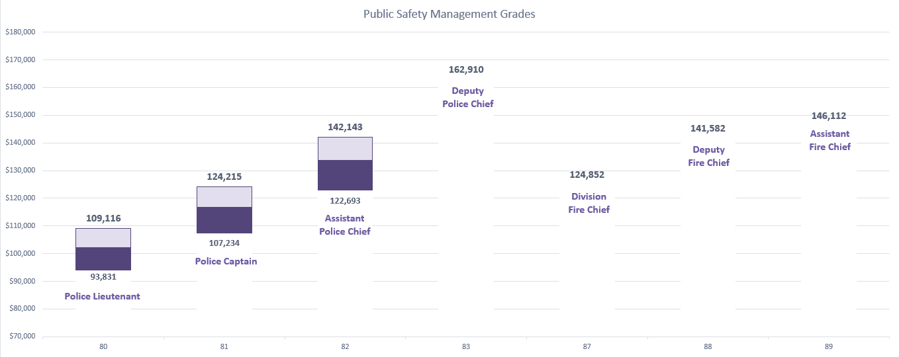
Pay Plan – Public Safety Management
Proposed Pay Plan
7 Grades
  Numbered 80-83 / 87-89
  Grade per classification
5 Steps or Fixed Rate
  Decreasing % between steps from 5.4% to 2.4%
7 position titles
Approx. 46 employees
Avg. Range Penetration = 84%
Avg. YIP 3.2 years

Slide 22
Pay Plan – Professional
Proposed Pay Plan
Professional Plan
24 Grades
  Numbered 90 to 113
  4% between each grade
5 Steps
  Numbered 1 to 5
  4.5% between each step
  = 19.3% range spread
Full span of plan is $53,112 to $170,170 annual
356 positions assigned
Approximately 546 employees allocated
General Grades

Slide 23
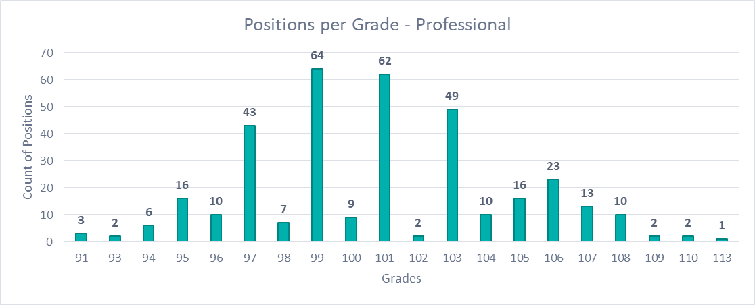
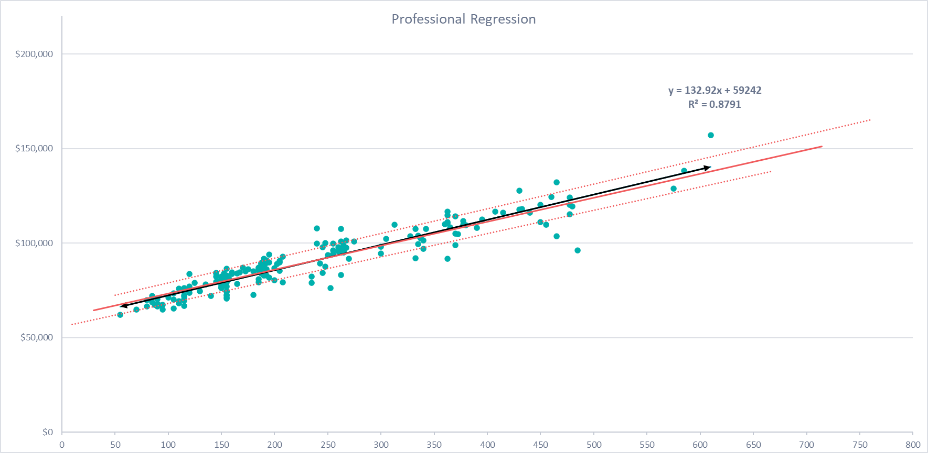
Pay Plan – Professional
Proposed Pay Plan
Positions were assigned to the plan:
Based on current midpoint
Adjusted per market, if appropriate
Adjusted per SAFE or progression, if appropriate
The regression analysis demonstrates the relationship between SAFE scores and market average midpoints.
There is an 87.9% correlation.
The regression demonstrates raw data points, not grade assignments.
Average Range Penetration (current salary vs. proposed range)
113%
Avg YIP = 3.7 years

Slide 24
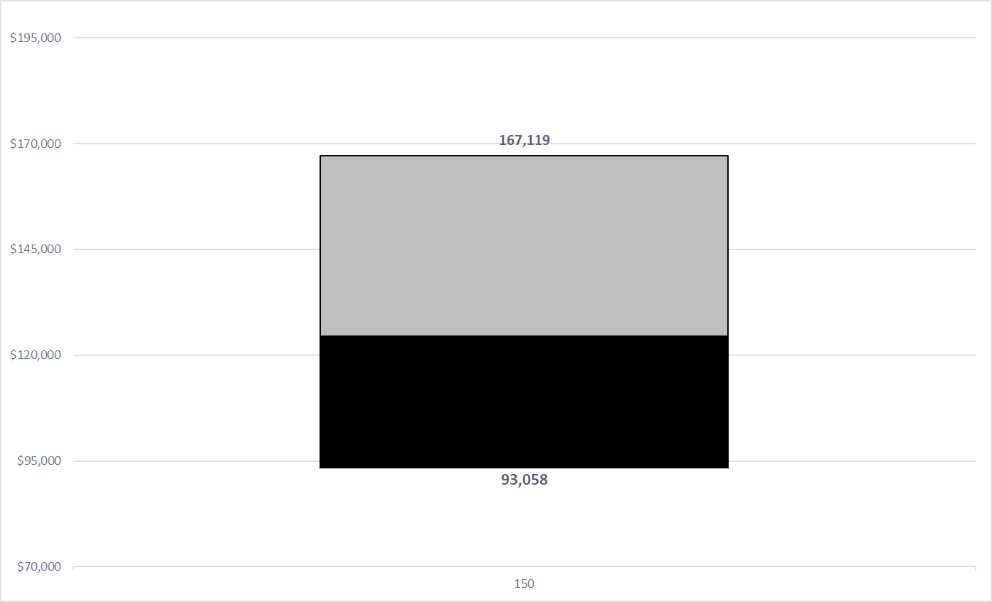
Pay Plan – Attorney
Proposed Pay Plan
1 Grades
  Numbered 150
13 steps
  5% between each step
  = 79.6% range spread
2 position titles
Approx. 17 employees
Avg. Range Penetration = 52%
Avg. YIP 6.3 years

Slide 25
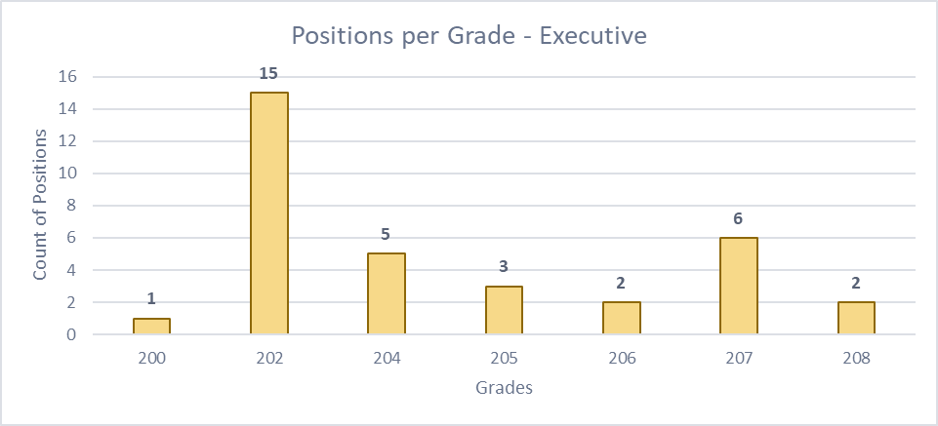
Pay Plan – Executive
Proposed Pay Plan
Executive Plan
11 Grades
  Numbered 200 to 210
  4% to 5% between grades
No steps / open range
  35% range spread
Full span of plan is $106,383 to $224,084 annual
34 positions assigned
Approximately 32 employees allocated
Average Range Penetration (current salary vs. proposed range) = 95%
Avg YIP = 2.2 years
General Grades

Slide 26
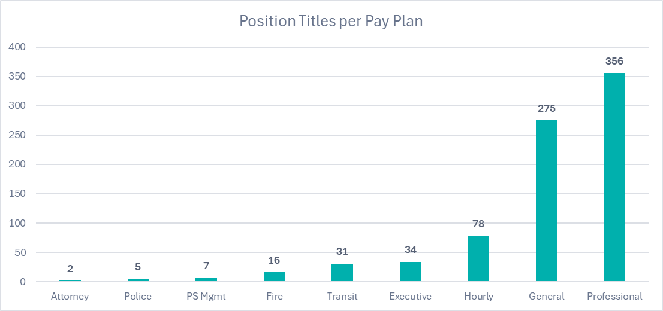
Grade Assignments
PHASE 4
Initial pay plans and grade assignments were reviewed by HR, the Selection Committee, and Department Heads (7/15).
Feedback was collected and incorporated as appropriate.
Results were finalized with the City’s project team.
Positions were assigned based on the following:
Internal equity (job evaluation scores)
External equity (market midpoints)
Existing equity (current midpoints and grade groupings)
Career progressions
Supervisor / Subordinate separation
For some positions (Hourly, Police, Fire, PS Mgmt) there was a greater focus on current and external equity as internal equity is less applicable for these groups.
The following information is NOT considered:
The person in the position
Performance
Length of service
Existing employee salary

Slide 27
Benefits Comparison
Results

Slide 28
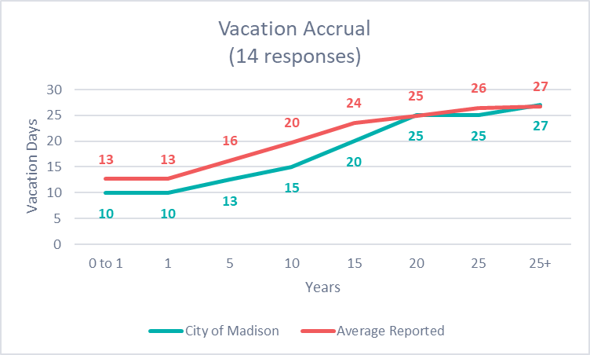
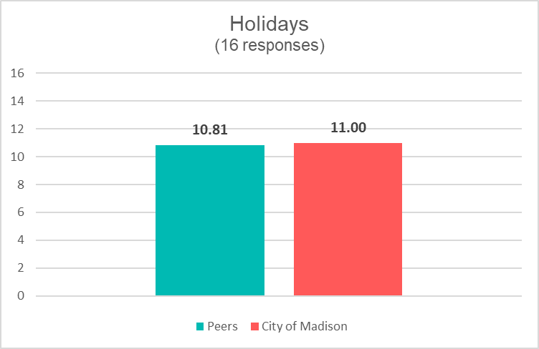
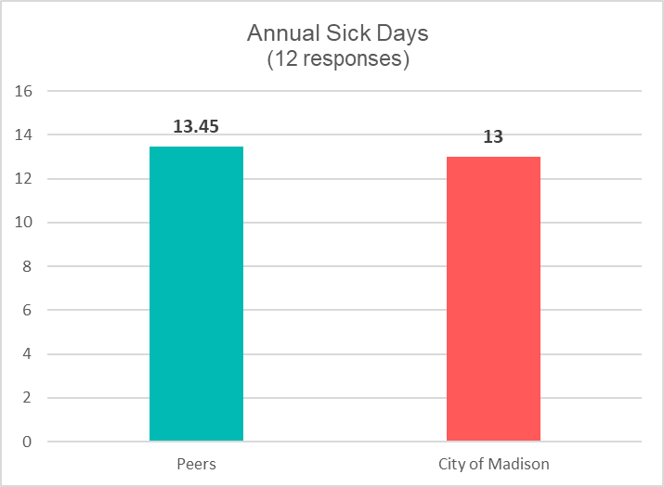
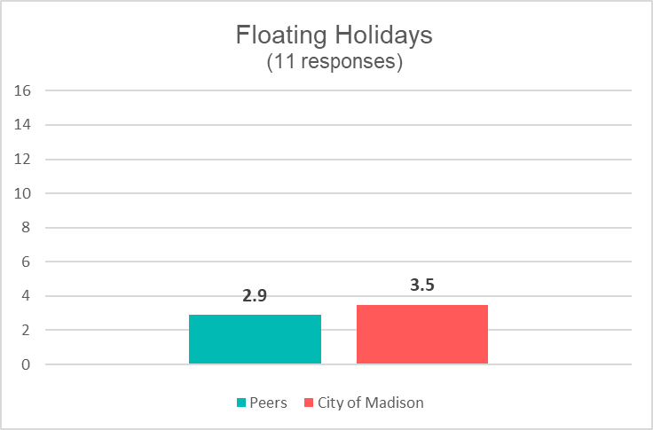
Paid Time Off
Benefits Comparison
14 organizations reported using a Vacation-Sick model, similar to Madison, while 2 organizations have PTO.
13 organizations allow unused vacation days to carry forward, similar to Madison.
Organizations were 50/50 on allowing sick days to be cashed out.

Slide 29
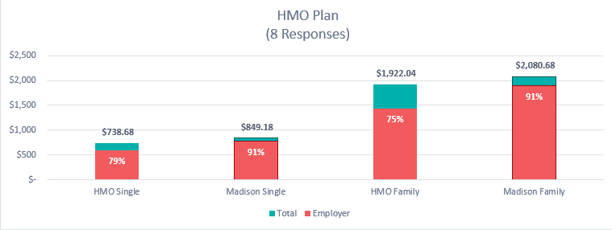
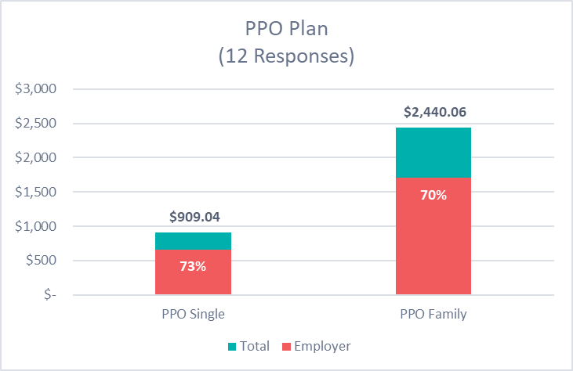
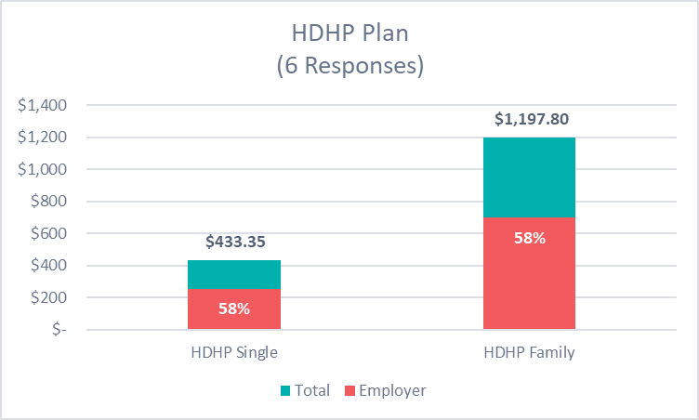
Health Insurance
Benefits Comparison
HMO: On average, employers cover 79% of the cost for single coverage plans and 75% of the cost for family plans.
Madison covers 91% of the cost for single and family coverage.
PPO: On average, employers cover 73% of the cost for single coverage plans and 70% of the cost for family plans.
HDHP: On average, employers cover 58% of the cost for single coverage plans and 58% of the cost for family plans.

Slide 30
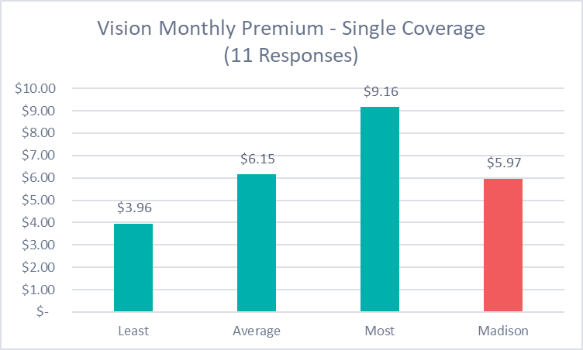
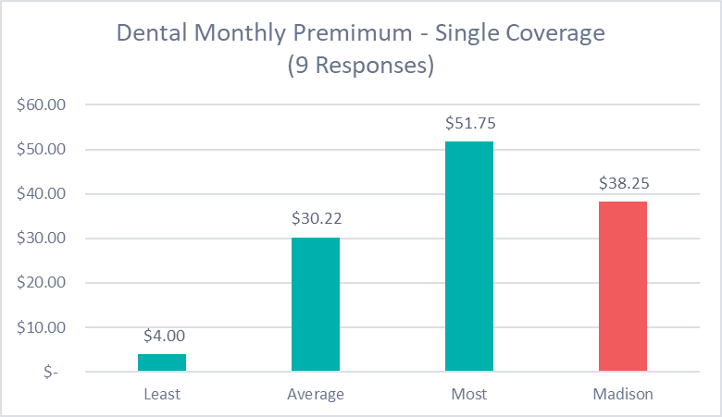
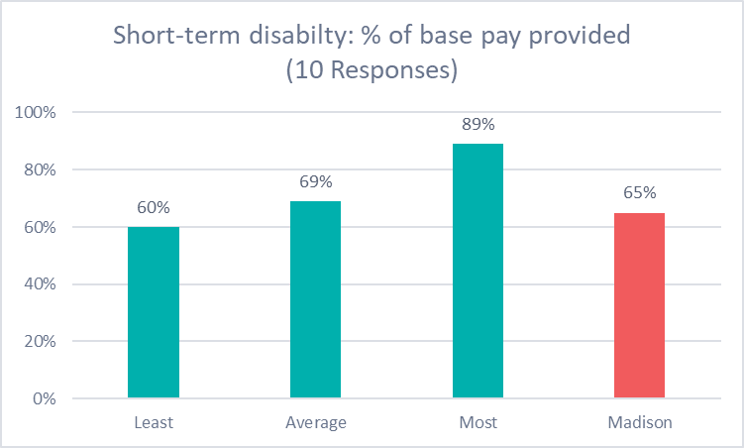
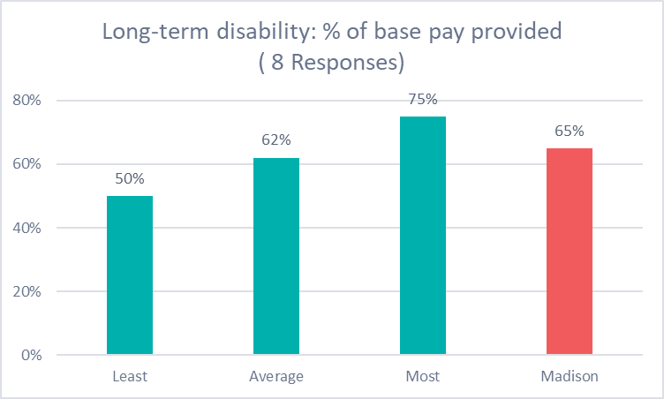
Health Insurance +
Benefits Comparison
15 organizations reported providing dental insurance coverage.
15 organizations reported providing vision insurance coverage.
14 organizations reported providing life insurance with an average maximum payout of $320k (based on 7 responses).
9 organizations reported providing accidental death and dismemberment (AD&D) insurance.
10 organizations reported providing long-term disability insurance.
12 organizations reported providing paid parental leave, with 8 of those being separate from short-term disability benefits.

Slide 31
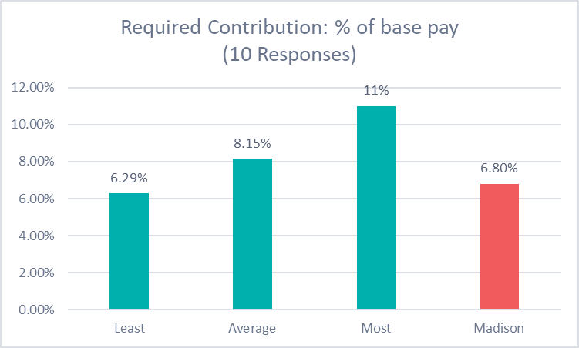
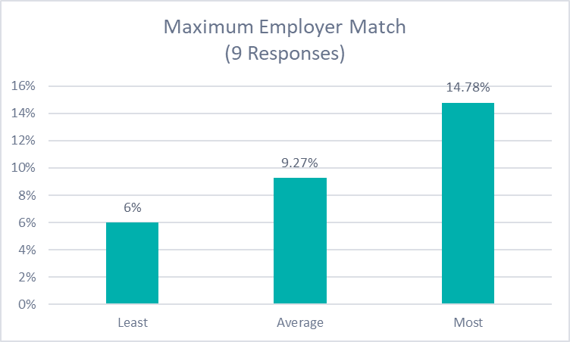
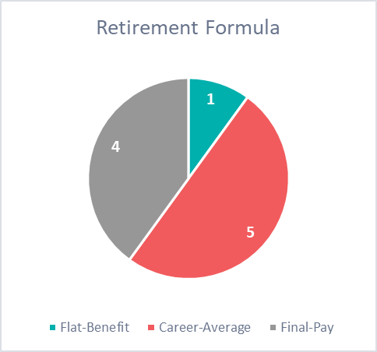
Retirement
Benefits Comparison
10 organizations reported that employee contributions are required to their Defined Benefit (pension) plan. Madison requires 6.8% for non-represented employees.
Like Madison, most reporting organizations use a ‘career-average’ formula to calculate retirement benefits.
13 organizations reported that group health insurance is available to retirees, similar to Madison.

Slide 32
Pay Practices
Benefits Comparison
The chart below demonstrates how many organizations reported paying when employees are called back to work for the following:
6 organizations reported that they have a ‘minimum’ amount of hours paid to employees who are called back.
14 organizations reported that new hires can receive a pay range above the starting minimum for their position, based on years of related experience (2), experience or education (3), experience AND education (4), or at managements discretion (5).
  Madison allows this at managements discretion.
Pay Rates | Holiday | Saturday | Sunday | Day off | On leave
Straight Time | 2 | 5 | 5 | 6 | 4
Overtime (1.5x) | 8 | 3 | 3 | 4 | 5
Madison | Double Time | CBA | CBA | Overtime | Overtime

Slide 33
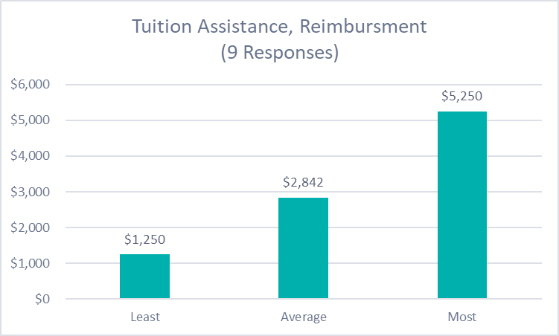
Additional Benefits
Benefits Comparison
Madison provides tuition assistance to police and fire only; rates are set annually.
8 organizations reported to providing parking or commuter benefits, similar to Madison.
10 organizations reported to providing gym reimbursement. Madison only provides this to police.
9 organizations reported they do not provide referral or recruitment bonuses, but 3 do.
11 organizations reported they do not provide pet insurance, but 1 does – similar to Madison.
13 organizations reported to providing flexible work schedules or compressed work week.
Longevity Pay by Years of Service

Slide 34
Pay Equity Findings

Slide 35
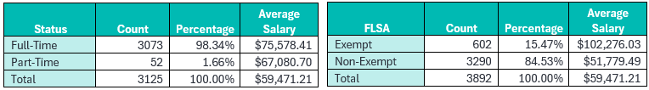
Key Findings
Pay Equity Analysis
The City employs approximately 3,974 people across a wide range of roles, with most in full-time positions that are non-exempt.
  Supervisors earn about 80% more than non-supervisors, consistent with leadership and job complexity differences.
Workforce Demographics: 68% male and 75% white, with men and white employees earning slightly higher average salaries.
  Across departments, gender and racial composition vary widely and align with occupational distribution, where technical, trade, and public safety roles remain more male-dominated, while administrative and service-oriented positions have higher female representation.

Slide 36
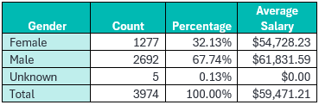
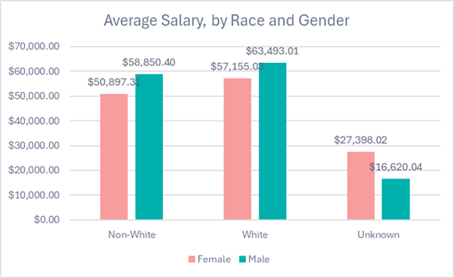
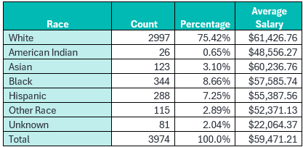
Key Findings
Pay Equity Analysis
Pay Equity Results: Men earn about 4.6% more per hour than women, and white employees earn about 7.9% more than non-white employees, both statistically significant gaps.
  However, further analysis shows these differences are largely due to occupational sorting and tenure, not unequal pay for equal work.

Slide 37
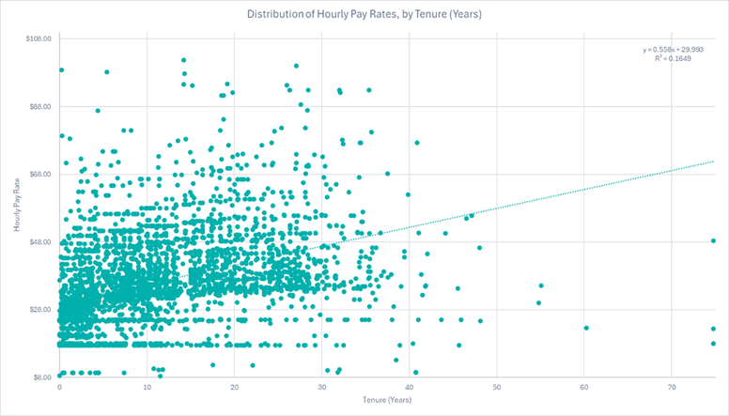
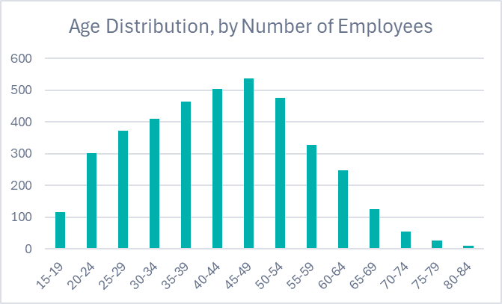
Key Findings
Pay Equity Analysis
Occupational Pay Analysis: Six occupations showed statistically significant pay differences. In three, women earned more due to longer tenure and experience; in three others, white employees earned more, driven by tenure-related retention differences rather than pay inequity.

Slide 38
Key Findings
Pay Equity Analysis
Occupational Pay Analysis:
  Gender-based differences in Firefighter Paramedic, Transit Operations Supervisor, and Assistant City Attorney favored women, explained by longer tenure rather than inequity (women Assistant City Attorneys average 17.5 years of tenure versus 7.4 years for men).
  Race-based differences in Transit Operator, Detective, and Street Machine Operator favored white employees and are tenure-related, indicating potential retention and advancement challenges for non-white employees rather than direct pay inequities.

Slide 39
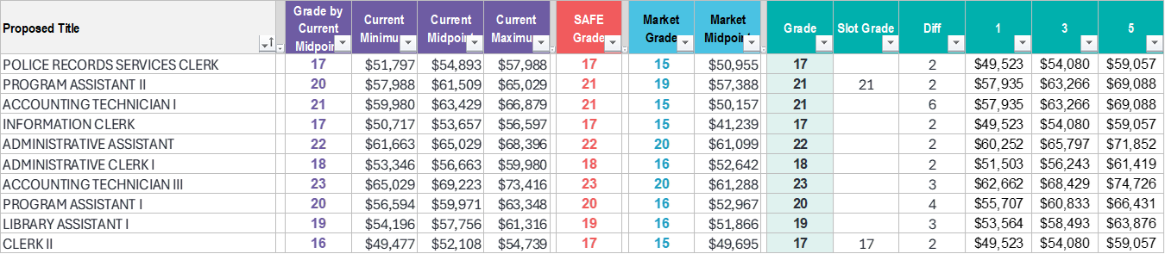
Key Findings
Pay Equity Analysis
Occupational Valuation and Market Alignment
Focusing on positions that have historically been undervalued in the market, often due to gender bias, and remain heavily female-dominated.
The proposed grade assignments for these positions are 2 to 6 grades higher than grade assignments based on market alone. This is justified by our internal equity review using SAFE.
  Our process additionally considered existing pay alignment to ensure placement is not a decrease. It’s worth noting the City’s placement, above market, has already alleviated some of these gender biased market conditions.

Slide 40
Implementation

Slide 41
Implementation
Cost calculations
3 scenarios were prepared across the 9 proposed pay structures for the City to consider in its adoption of the proposed classification and compensation plans.
Cost represents base pay only
  Overtime, certification pay, employer/employee contributions, taxes, etc. are not included in cost calculations shown.
If an employee’s existing salary is greater than the proposed maximum, the best practice recommendation is for salaries to be frozen or ‘red circled.’
  Baker Tilly does not recommend a pay decrease for any employee as a result of the study.
Implementation for step plans include placing employees onto a step in the new range.
Implementation for an open range plan (executive) includes making sure employees fall somewhere within the proposed range.

Slide 42
Implementation Scenarios
Step Plans
Option 1 – Employees move to the step closest to their existing salary, without a decrease. Employees below the minimum move to Step 1 while employees above the maximum retain their existing salary.
Option 2 – Employees move to the step related to their years in position. For example, 3 years in position = step 3. If the existing salary is already greater, employees receive Option 1 related to their existing salary.
Option 3 – Employees move to the next step from what is established by Option 1.

Slide 43
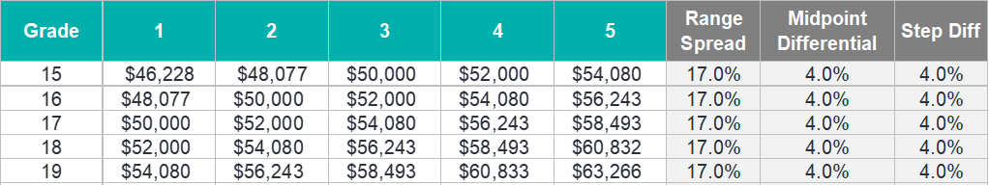
Step Plan Example
Cost calculations
Your position is assigned to Grade 17 in the General Plan
Example | Current Salary | Option 1 | Difference | New Step | Explanation
Robert | $49,500 | $50,000 | $500 | 1 | Current is below minimum
Jimmy | $50,001 | $52,000 | $1,999 | 2 | Next step, w/o decrease
John | $54,079 | $54,080 | $1 | 4 | Next step, w/o decrease
JP | $59,500 | $59,500 | $0 | N/A | Current is above maximum

Slide 44
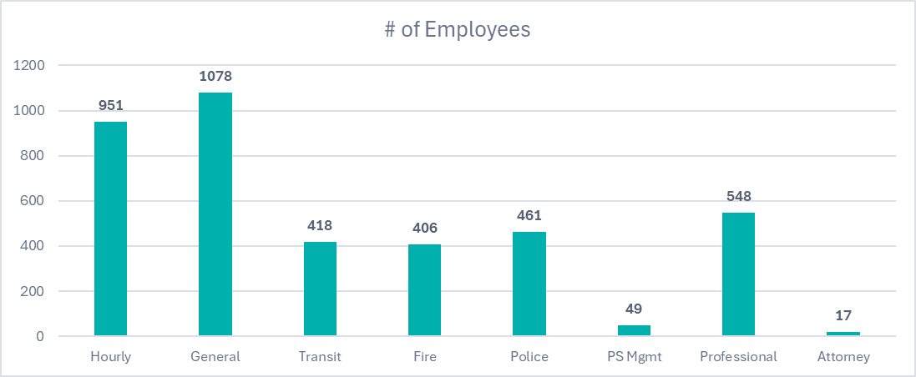
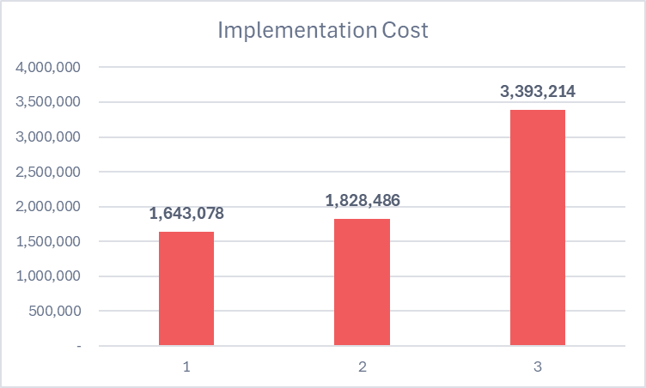
Implementation Scenarios
Cost Breakdown by Pay Plan

Slide 45
Implementation Scenarios
Executive Plan
Implementation Scenarios
Option 1 – Employees move to the minimum if their current salary is below their new minimum.
Option 2 – Employees received the greater of movement to the minimum or 2%.
Option 3 – Employee move to the minimum then received 3% per YIP. If their current salary is already greater, they retain their existing salary

Slide 46
Next Steps
City Timeline
Finalize findings including full report
Meet with Steering Team to cost and design implementation plan
Share information with key decision makers related to implementation needs
Complete training with HR and begin to process through new studies using new framework

