Slide 1
Access and Inclusion for Meeting Hosts and Facilitators
Rebecca Hoyt, Disability Rights and Services Specialist
Cass Hill, Digital Inclusion Coordinator

Slide 2
Roadmap
A culture of access & inclusion
Inclusive virtual meetings
Common access features across platforms
Accessible recordings
Using the features in Teams
Using the features in Zoom
Language Access Program

Slide 3
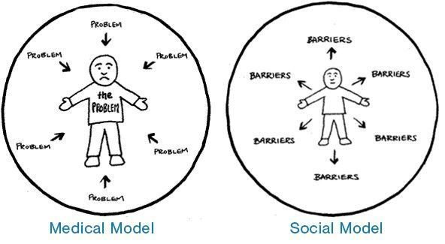

Slide 4
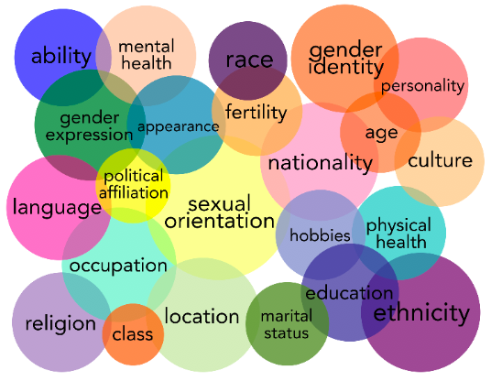
Disability Justice: Expands the Social Model of Disability by examining the ways that intersectional parts of identity impact Disabled People.
Notes:
Disability Justice recognizes that experiences of disabled people are impacted by many other social structures and identities. This movement, led by two queer disabled activist of color, Patty Berne and Mia Mingus, began in 2005. Disability Justice recognizes that a rights model, only addresses symptoms of systemic problems and ableism. This progressive approach to disability incorporates the principals of intersectionality, restorative justice, community-led advocacy and collective liberation. In other words, it is a movement for equality that leaves no members of the disability community behind and that recognizes people have multifaceted identities that impact their experiences of the world.

Slide 5
A Disability Justice Framework Understands that:
All bodies are unique and essential.
All bodies have strengths and needs that must be met.
We are powerful, not despite the complexities of our bodies, but because of them.
All bodies are confined by ability, race, gender, sexuality, class, nation state, religion, and more, and we cannot separate them.
- Sins Invalid

Slide 6

Notes:
ID: Tabletop with blue and white blows of blueberries, blueberry muffins and milk. Some blueberries are scattered on a geometric print gray tabletop.

Slide 7
Planning for Access
Agendas and Pre-Reading Materials
  Who will be attending?
  When will the meeting be?
  How can I join?
  Describe agenda items in plain language.
  What pre-reads and handouts go with which items?
  What should participants expect?
  Who to contact for accommodations and language access needs?

Slide 8
Participating in Virtual Meetings
Make sure your audio and visual connection is good.
When speaking, position your face at an angle that allows participants to read your lips.
Let your face and body talk when you are not speaking.
Describe accessibility features of your meeting and how to access them.

Slide 9
When Speaking
When introducing yourself, give your pronouns, and a brief visual description.
Participants should state their name each time they speak.
Speak directly to the person benefiting from the interpreter, not the interpreter.
Speak at a normal pace. Pause after using names of places and people. These often need to be spelled out by ASL interpreters.
Pause the meeting if there are any issues with the interpreters so key information is not missed.

Slide 10
Language
Plain language
Gender neutral language
Avoid metaphors, acronyms, slangs or idioms
The City of Madison is committed to removing ableist metaphors such as crazy, insane, lame, suffers from/with, high or low functioning, duh, spaz, and many more from our speech.
“Accessible feature” vs. “Accommodation”

Slide 11
“People with Disabilities” or “Disabled People?”
Language is a part of people's culture, identity, and pride. Disability is not a bad word. Much of the language people with disabilities use is rooted in different social movements.
When in doubt, ask the person how they like to be described.

Slide 12
People-First Language
The People-First movement began in the 1970’s. It literally puts the person first - “person with a disability,” “employee who is bi-polar.” This language is rooted in the idea that people with disabilities are not defined by their disabilities. They are people first.
It was a movement that rejected the medical model of disability where people and communities where labeled by their diagnosis rather than being seen as whole people.

Slide 13
Identity-First Language
Identity-First language is rooted in the social model of disability. ‘Disabled people’ is a political term that used to emphasize the social cause and nature of the exclusion and discrimination faced as people with impairments. It uses the term “Disabled” to mean disabled by society.
Identity-First language is also a way disable people express pride.

Slide 14
Visual Information
Use a high-contrast color scheme (such as black and white).
Use large fonts (44 point for slide titles, 24-36 point for information).
Include minimal information per slide.
Use standard slide transitions and avoid decorative fillers.
Briefly describe all visuals.
Use numbers instead of bullet points.
Use built-in layouts & PowerPoint Accessibility Checker if you share your slides.
Add alt text

Slide 15
Common Access & Inclusion Features
  Captions
  Participant option to highlight speakers or interpreters
  Screen sharing

Slide 16
Captions
Captions in virtual meetings are critical for access and inclusion.
They improve understanding and engagement for everyone, including:
  D/deaf or hard of hearing participants
  non-native speakers
  people in noisy environments.
  They’re needed for ADA compliance.
  Generally automated or Communication Access Realtime Translation (CART).

Slide 17
Captions
  Can be:
    Automated in Zoom & Teams
    CART in Zoom & Teams
    Media Team productions

Slide 18
Highlight the Interpreter or Speaker
Ensures interpreter is always visible or hearable, independent of who shares or is currently talking.
Supports multiple/simultaneous interpreters.
Supports visual (not just spoken) languages, such as ASL.
Normalizes accessibility and inclusion.
Ensures compliance with ADA & City values.
Teams: Participant options allow this.
Zoom: The ASL Channel supports this.

Slide 19
Screen/Audio Sharing Best Practices
Zoom in so that fonts and graphics are readable.
Avoid complex layouts (use built-in slide design).
Avoid high speed scrolling.
Narrate anything you demonstrate on the screen (visual description).

Slide 20
Screen/Audio Sharing Best Practices
If you plan to screen share, you need to provide materials in advance.
  Allows time for participants to request an alternate format, if needed.
  Enables participants to access documents through their AT and computer settings.
If you’re sharing audio, announce it and keep the volume moderate.
If showing visuals with no audio that convey information or meaning, provide an audio description of that content.

Slide 21

Creating an Accessible Recording
Please visit the IT Service Center Knowledge Base for Zoom Recording Instructions.
Important:
For captions to record (as a transcript) in Zoom meetings:
  At least one participant must turn captions on and,
  View them throughout the meeting.
  Planning who will do this ahead of time will assist in smoother meeting facilitation.
Recording with simultaneous interpretation requires unique Zoom recording settings. Please request Media Team production for these events.

Slide 22
Teams: Demo Settings & Practice
Captions (Automated & CART)
Highlight (Spotlight, Pin, Sign Language Mode)
Screen sharing
See Accessibility in Teams for more how-to guidance.

Slide 23
Zoom: Demo Settings & Practice
Captions (Automated & CART)
ASL Channel
Screen sharing
See Accessibility in Zoom for more how-to guidance.
Notes:
Cass

Slide 24
Language Access Program
The Language Access Program coordinates the following services for all City programs: Email lap@cityofmadison.com to request services.
Qualified interpreters
Translation services
Communication Access Realtime Translation (CART)
Assistive listening systems and devices
Braille materials
Plain language consultation

Slide 25
Thank you
Want more information?
Rebecca Hoyt: RHoyt@cityofmadison.com
Cass Hill: chill@cityofmadison.com
The Digital Accessibility, Teams, and Zoom categories of the Knowledge Base (IT Service Center) offer self-help articles and guidance for virtual meetings.

