Slide 1
Occupational Accommodations Training For Supervisors
Leah Reinardy, Occupational Accommodations Specialist
Tory Larson, Benefits Supervisor

Slide 2







Tech
Check
Rename Yourself
  Participants > Hoover over your name > 3 dots > Rename. Type your Name, Pronouns, and Department.
Mic & Video Test
  Select the microphone button to unmute yourself & say hello! Select the video button to go on/off camera.
Locate the Chat Feature
  Select the three dots > Chat to open up the chat box.
Raise Hand or Use Reactions
  Select the three dots > Reactions > Raise Hand to raise your hand.
Turn on Closed Captioning
  Select Show Captions button, select your preferred language, click Save.
Turn off your VPN
Grab a Copy of the Learner Workbook / Handouts
  Found in Chat from your facilitator!
Disruption? Try logging out and logging back in again.

Slide 3

About Leah
Leah Reinardy
(they/she)
Occupational Accommodations Specialist
Started with the City in April 2025

Slide 4

About Tory
Tory Larson
(she/her)
Benefits Supervisor (and former Occupational Accommodations Specialist)

Slide 5

Group Agreements
Be Present
Take Space
Make Space
Take Notes
Be Curious
Ask Questions
Additions?

Slide 6
Learning Objectives
Define what an accommodation is and have a basic understanding of laws related to accommodations.
Know how and when to identify and refer an accommodation request.
Articulate your role in the disability accommodations process.
Gain strategies for creating a culture of accessibility within your team and agency.

Slide 7

Agenda
Understanding Disability & Disability Accommodations
Identifying & Referring Accommodation Requests
Your Responsibilities in the Accommodations Process
Creating a Culture of Accessibility

Slide 8
Understanding Disability & Disability Accommodations

Slide 9
Definition of "Disability" According to ADA
One of these criteria must be true for an employee to have a disability according to the Americans with Disabilities Act (ADA):
Physical or mental impairment that substantially limits one or more major life activities
Record of a physical or mental impairment that substantially limited a major activity
Actual or perceived impairment that is not both transitory and minor

Slide 10
Definition of "Disability"
A person is also considered to have a disability if they have difficulty:
Performing various functions (seeing, hearing, talking, walking, lifting, concentration, etc.)
Difficulty performing activities of daily living
  Bathing, dressing, eating, mobility, using the restroom
Difficulty with certain social roles
  Working at a job, performing household activities, completing schoolwork

Slide 11
Activity: Understanding Disability
Think about someone (outside of work) who has a disability and/or chronic medical condition.
How do limitations from this disability or medical condition impact the person's life (communication, self care, recreation, family, transportation) outside of work?
What does this person do differently to live or participate?

Slide 12

What Is An Accommodation?
Video Link

Slide 13

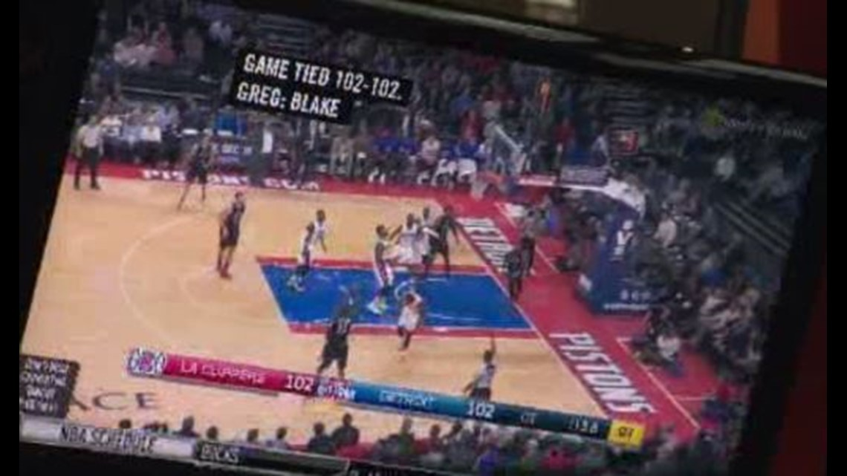

Accommodations Benefit Everyone
Many inventions created to accommodate some individuals are so commonplace we don't think of them as accommodations!
Captioning on TVs at a loud restaurant or on social media content (Instagram Reels, TikTok)
Siri/Cortana/Alexa
Glasses

Slide 14
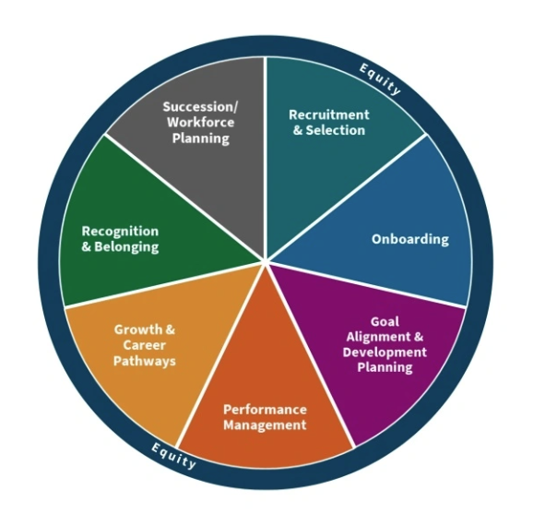
Why Disability Accommodations Matter
Alignment with City's Mission, Vision, and Values.
Intersects with every aspect of the City's Talent Management Strategy
Increases representation of disabled employees in government
Accessibility improvements benefit everyone
Compliance with federal/state law and City APMs

Slide 15
Laws Related to Accommodations
Many laws intersect with the Americans with Disabilities Act depending on the case:
Pregnant Workers' Fairness Act (PWFA)
Protecting Urgent Maternal Protections Act (PUMP Act)
Family and Medical Leave Act
WI Fair Employment Law

Slide 16
City Policies Related to Accommodations
APM 2-22: Workplace Accommodations
APM 2-21: Family and Medical Leaves of Absence
APM 2-31: Leave of Absence Without Pay
APM 2-40: Fitness for Duty Examinations
APM 2-45: Disability Leave/Layoff
APM 2-7: Temporary Transitional Assignments

Slide 17
Agenda Check-In 1
Understanding Disability & Disability Accommodations
Identifying & Referring Accommodation Requests
Your Responsibilities in the Accommodations Process
Creating a Culture of Accessibility

Slide 18
Identifying & Referring Accommodation Requests

Slide 19

Navigate Multiple Lanes
As supervisor, you may be navigating multiple "lanes".
  Performance concerns
  Misconduct allegations
  FMLA requests
  Promotions/transfers
Limit the information you share at first about performance, promotion/transfer, and misconduct "lanes" when discussing an accommodations case.

Slide 20
Identify the "Link"
Look for the "link" between these two things to identify a disability accommodation request:
The employee's medical condition and/or disability
The employee's job, job application, and/or benefit of employment
If you're not sure – refer!

Slide 21
Activity: Is This An Accommodation Request?
The following slides contain case scenarios of potential requests.
Unmute your microphone or type "Yes" or "No" in chat to share whether you think it is an accommodation request or not.
If you are comfortable, share what next steps you would take as the supervisor.

Slide 22
Is This An Accommodation Request?: Training Materials
One of your employees shares that they struggle reading training materials in a 1:1 meeting with you. They also mention they have a unit training coming up next week in this conversation.

Slide 23
Is This An Accommodation Request?: Training Materials
Yes, this is a request.
Prioritize this and be mindful of deadlines (1 week).
Refer the employee to Leah.
Give Leah the employee's contact information.
Provide any training materials for the upcoming training to Leah.

Slide 24
Is This An Accommodation Request?: Lifting Difficulties
You are a supervisor of Facility Maintenance Workers for your agency. One of your employees comes into work. At the start of their shift, they tell you they can't complete their shift for the night because they can't lift more than 10 lbs, but they should be better by next week.

Slide 25
Is This An Accommodation Request?: Lifting Difficulties
Yes, this is a request.
If their assigned work requires them to lift more than 10 lbs, the employee needs to go home on their own leave.
Connect with Leah as soon as possible (if this is night shift, you may not get a response until the morning)
Provide the employee with Leah's contact information.

Slide 26
Is This An Accommodation Request?: Care of a Child With A Disability
Your employee texts you requesting a shift change because they need to care for their child with complex medical needs.

Slide 27
Is This An Accommodation Request?: Care of a Child With A Disability
No, this is not an accommodation request.
There is no link between the employee's own medical condition and their job.
Flexible work arrangement requests would follow other processes.
Provide FMLA information to the employee.

Slide 28
Is This An Accommodation Request?: Disclosure in Discipline Meetings
You are conducting a disciplinary meeting with one of your employees. When you review the allegations about the employee's behavior, they share that they behaved that way due to a medical condition.

Slide 29
Is This An Accommodation Request?: Disclosure in Discipline Meetings
Yes, this is an accommodation request.
Refer the employee to Leah.
Provide Leah the employee's contact information.
Refrain from making assumptions at this point in the process.
Be aware that you may also working with City HR Labor Relations in these cases.

Slide 30
Making A Referral
If an employee requests to connect with the Occupational Accommodations Specialist, please do the following:
  Give the employee the Accommodations contact information.
  Phone: 608-267-1156
  Email: Accommodations@cityofmadison.com
Email Leah the employee's contact information.
If you're not sure – refer!

Slide 31
Break Time
10 Minutes

Slide 32
Agenda Check-In 2
Understanding Disability & Disability Accommodations
Identifying & Referring Accommodation Requests
Your Responsibilities in the Accommodations Process
Creating a Culture of Accessibility

Slide 33
Your Responsibilities in the Accommodations Process

Slide 34
Accommodations Process Overview
Employee makes an accommodation request.
  There is no "official" process/form to start a request.
Occupational Accommodations Specialist meets with the employee and supervisor separately to gather information.
Third parties may be pulled in on a "need to know" basis to give technical expertise.
Employee and supervisor will receive a copy of a determination letter.
Some accommodations may be re-evaluated in the future.

Slide 35
Supervisor Responsibilities
Identify and refer accommodation requests.
Maintain confidentiality of employee information.
Meet with the Occupational Accommodations Specialist to review the request.
Keep an open mind and be creative.
Provide a current position description.
Check in with various City HR colleagues if you are navigating multiple "lanes" at once.
Avoid making assumptions and work through the interactive process in every case.

Slide 36
Maintaining Confidentiality
If emailing about an employee, use their initials in the subject line (not their full name).
If an employee expresses medical concerns, offer to meet with them in a private space so others do not overhear.
Check in with the Accommodations Specialist to see if an individual is in the "need to know" before adding additional people to an email chain or meeting.
If you receive a medical note from an employee, forward it to the Accommodations Specialist and delete it from your inbox.
Do not share with an employee's colleagues that they have an accommodation (especially when those colleagues ask).

Slide 37
Ways the Accommodations Specialist Supports Supervisors
Works with employee to identify limitations and accommodations
Reviews medical documentation and restrictions
Conducts a job analysis based on the employee's request
Advises and coaches managers and supervisors
May work with other providers on specific cases
Manages complex processes (placement, fitness for duty)
Facilitates returns from disability layoff

Slide 38
Job Applicant Accommodations
Work quickly with your recruitment contact and the Occupational Accommodations Specialist on these.
If the request is related to an interview panel, consider educating the panel on disability etiquette (ie, how to interact with ASL interpreters)
Be careful of what clarifying ("off script") questions you ask an applicant regarding their ability to complete tasks (as it may get close to asking them about a disability).
  Work with the Accommodations Specialist and your HR Analyst if you have questions.

Slide 39
Equipment Purchases
Over 50% of purchases cost $0 (Job Accommodation Network)
If an agency purchases equipment as an accommodation, it is the agency's property, not the employee's as this comes out of the agency's budget.
High bar for "undue hardship" because the City is one employer.
Consider setting aside budget money in your agency's budget for accommodation-related purchases.
Common purchase requests:
  Ergonomic office equipment (keyboards, chairs)
  Headphones, headsets
  Software

Slide 40
Pregnant Workers' Fairness Act (PWFA)
Requires employers to provide reasonable accommodations for known conditions "related to pregnancy, childbirth, or related medical conditions"
Work quickly on these and expect needs to change month to month.
Can temporarily suspend an essential function of the job as an accommodation. (The ADA does not allow this.)
Different requirements for collecting medical documentation.
A condition may qualify under the ADA and PWFA (example: postpartum depression)

Slide 41
PWFA “Just Do It” Accommodations
There are 4 "just do it" accommodations:
Ability to carry or keep water nearby.
Ability to take extra restroom breaks.
Ability to take breaks to eat or drink.
Ability to change workstation from standing to sitting or vice versa.

Slide 42
PUMP Act
The City has been practicing this through APM 2-50: Lactation Policy for Breastfeeding Employees and Visitors.
Requires employers to provide employees with reasonable break times and spaces to express breast milk.
  Space: Must be a private, non-bathroom space.
  Time: Allows for some flexibility in how/when breaks are taken. Consult with the Occupational Accommodations Specialist with questions.

Slide 43
Leave As An Accommodation
If an employee is ineligible for FMLA or has exhausted their FMLA time for the year, they may request leave as an accommodation.
  Ensure that you are making the referral if necessary.
This is seen as an accommodation of last resort.

Slide 44
"Last Resort" Accommodations Processes
The following accommodations are highly complex processes. Please work with HR for approval – they must determine it is appropriate.
Leave as an accommodation
Fitness for Duty assessments
Job Placements
  The Occupational Accommodations Specialist works with an employee to search for a City position within 60 business days.

Slide 45
Religious Accommodations
There are many similarities to the disability accommodations process.
The City receives a few of these cases each year.
If you receive a request:
  Contact the Occupational Accommodations Specialist.
  You will be provided just-in-time training.

Slide 46
Activity: Case Scenarios
We will review a series of complex case scenarios together.
Unmute your microphone or share in chat:
  Your approach to the situation
  Factors you would consider
  Questions you may have

Slide 47
Case Scenario: Remote Work
An employee who spends 40% of time at their desk preparing reports and presentations requests to work remotely because they are having difficulty concentrating.

Slide 48
Case Scenario: Remote Work - Answers
Make the referral to Leah.
Be prepared to send a copy of the position description.
Review the essential functions of the job.
  What essential functions can be done in person versus remotely?
  What existing policies are in the unit related to telework and/or flexible working arrangements?

Slide 49
Case Scenario: Remote Work/Colleagues
You work with the Occupational Accommodations Specialist and approve a 40% telework schedule per week for the employee.
One of the employee's colleagues (and one of your direct reports) asks you in a 1:1 why this employee gets to telework 40% of the time while they are required to work fully in-person.
How do you respond?

Slide 50
Case Scenario: Remote Work/Colleagues - Answers
Ways to respond to colleague questions:
"This is a confidential matter that I am already aware of. I work to follow City policies and procedures related to assigning and managing work."
Attempt to redirect the conversation to another topic.

Slide 51
Case Scenario: Observed Workplace Difficulties
You are a supervisor of Mechanics in an agency. One morning, you walk out on the shop floor and notice one of your employees is having difficulty completing their assigned tasks for the day. You notice them holding their shoulder, stretching their shoulder, and wincing, then momentarily stepping away from the vehicle they are working on before continuing to work.

Slide 52
Case Scenario: Observed Workplace Difficulties
Walk up to the employee and generally check in on how their day is going.
If they share medical information:
  Treat this like an accommodation request and refer to Leah.
  Give Leah the employee's contact information.
If they do not share medical information:
  Reach out to Leah and Risk Management to assess the situation.
  We would discuss the following:
    Are you noticing performance difficulties with the employee?
    Are you observing the employee wincing/holding their shoulder repeatedly over time?
    Are you are aware of any workplace incidents this might be related to?

Slide 53
Case Scenario: Religious Accommodation
One of your employees, a Streets employee, shares with you that they cannot follow the unit's uniform guidelines. They share that they must wear a long skirt instead of pants due to the religion they practice.

Slide 54
Case Scenario: Religious Accommodation - Answers
Provide the employee a copy of the Religious Accommodation Request Form.
  This is required for these requests (different from disability/pregnancy accommodations)
Instruct the employee to directly submit the form as soon as possible to the Accommodations inbox or to Leah.
Consult quickly with the Accommodations Specialist to determine if a temporary accommodation can safely be granted while working through the process.
  Assess safety requirements when reviewing the position description.
  Leah will likely consult with Safety in these cases.

Slide 55
Case Scenario: Pregnancy Accommodation
You are a fire lieutenant. One of your employees, a firefighter, discloses to you that they are pregnant and shares they are unable to respond to 911 calls.

Slide 56
Case Scenario: Pregnancy Accommodation - Answers
Refer the employee to Leah.
Provide the employee with FMLA contact information.
Do not make assumptions based on contract language.
If the employee brings in a note with restrictions and there is no work within their restrictions, they will likely go out on their own leave.
Be open to discussing a potential temporary reassignment as an accommodation (this is possible under PWFA).
Be flexible and open-minded; this employee's needs will likely change month to month.

Slide 57
Agenda Check-In 3
Understanding Disability & Disability Accommodations
Identifying & Referring Accommodation Requests
Your Responsibilities in the Accommodations Process
Creating a Culture of Accessibility

Slide 58
Creating a Culture of Accessibility

Slide 59

Intersectionality
Intersectionality = someone's life experiences are shaped by overlapping aspects of their identity (race, gender, class, sexual orientation, etc.)
Disabled employees' experiences will vary based on the level of privilege they have in various intersectional identities.
Two employees with the same diagnosis may have very different experiences.

Slide 60
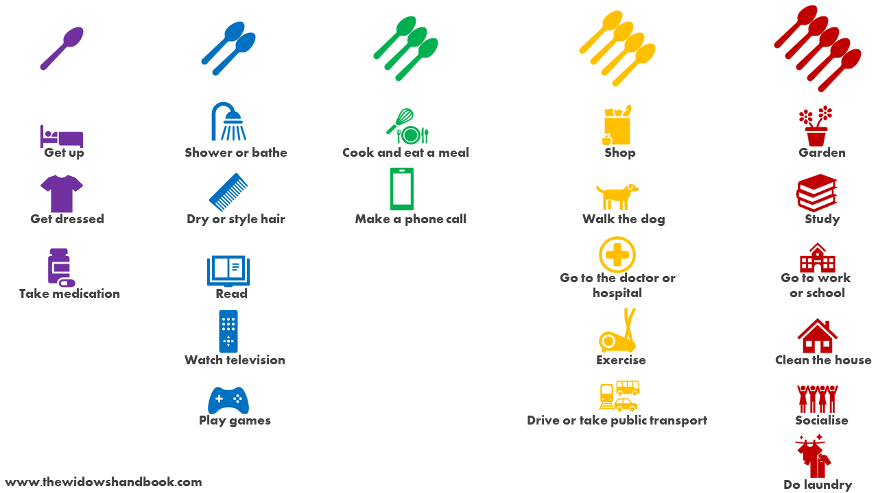
Spoon Theory

Slide 61
Energy Management
Disabled employees may be depleted more quickly by tasks that do not deplete their nondisabled colleagues.
  Daily commute to/from the office
  Large meetings or trainings
  Team lunches or networking events
  Taking a meeting with cameras on versus cameras off
  Attending last-minute or same-day meetings
  Rapid context switching (transitioning from task to task)

Slide 62
Healthcare System Barriers
The healthcare system has many barriers that impact employees going through the accommodations process:
Cost of medical appointments, medications, and tests.
Long wait times to see specialists.
Many marginalized groups are underrepresented in medical research and may be less likely to receive a diagnosis.
Disabled employees must take extra time and energy to manage appointments, advocate for their own care, and present themselves to providers so they are taken seriously.

Slide 63
Inclusive Communication Strategies
Actively listen to and believe your employees' experiences.
Use plain language in spoken and written communications.
Actively create onboarding plans and training sessions with diverse learning styles and needs in mind. Contact OD if you need guidance on adult learning strategies.
One framework to try: "What by When, Why" method for clarity
  Example: "I need an agenda 24 hours before this meeting. Receiving this will help me better prepare to answer your questions for me."
Celebrate the strengths and wins your team brings to you!

Slide 64
Accommodations Office Hours
You all have access to "drop in" office hours with Leah over the next couple of weeks:
  Tuesday, November 11 – 9 AM – 11 AM
  Thursday, November 13 – 2 PM – 4 PM
  Monday, November 17 – 10 AM – 12 PM

Slide 65
Resources for Further Learning
City of Madison Disability Resource Group (DRG)
  Attend events and/or support your employees' attendance at events!
Additional City Trainings
  Family and Medical Leave for Supervisors
  Handling Confidential Information
  Plain Language & Effective Communication
  Document Accessibility Basics
Job Accommodation Network

Slide 66
Learning Objectives Revisited
Define what an accommodation is and have a basic understanding of laws related to accommodations.
Know how and when to identify and refer an accommodation request.
Articulate your role in the disability accommodations process.
Gain strategies for creating a culture of accessibility within your team and agency.

Slide 67
Takeaways
What's one action you can commit to taking based on today's training?

Slide 68
Key Concepts
Identify the "link" and make the referral in a timely manner
Respect confidentiality of the process
City HR is here to support you!

Slide 69
Contact Information
Leah Reinardy
Occupational Accommodations Specialist
Email: LReinardy@cityofmadison.com
Phone: 608-267-1156
Accommodations Inbox (direct employees here): Accommodations@cityofmadison.com

Slide 70
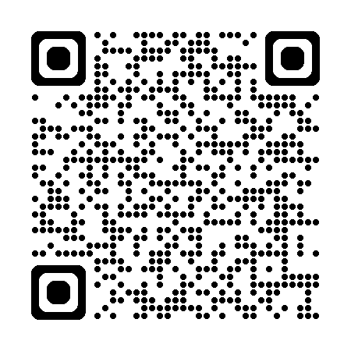
Thanks for Joining!
QR Code Holder
Please participate in our Course Evaluation Survey – your feedback is important!

