Slide 1
Document Accessibility with
Microsoft 365 Applications
Chad Hester, VP Digital Accessibility Services
Sol Escobar, Team Lead Digital Accessibility Services

Slide 2
Agenda
Definitions
General Accessibility for All Documents
Word and Accessibility
PowerPoint and Accessibility
Q&A

Slide 3
Definitions Disability (Social model, Modern)
Definitions
Disability
Equality and civil rights
Inclusion, not cure
Human diversity
Person-first and identity-first language

Slide 4
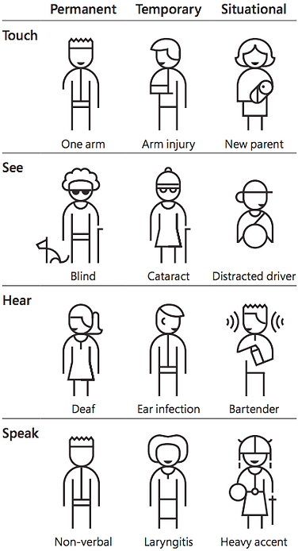
Visual Examples
Designing documents with many needs in mind…

Slide 5
Close to Home
12.4% of Wisconsin residents have a permanent disability.
1 in 5 individuals are neurodivergent.
75% of all disabilities are non-apparent—we don’t know who is affected.
83% of individuals will experience disability (permanent, situational and/or temporary).
These numbers include our residents and our colleagues.

Slide 6
Definitions
Accessibility
Simply put –
Accessibility means removing barriers so everyone can benefit.

Slide 7
Document Accessibility
Definitions
What is Document Accessibility?
  Making documents usable and understandable for all users
Why Document Accessibility Matters?
  Enables full participation for people with disabilities
  Supports compliance with laws
  Universal benefit for improving communication for everyone.

Slide 8
Assistive Technologies
Common Applications and Hardware
Screen readers
Magnifying applications
Speech-to-Text software

Slide 9
Agenda General Accessibility for All Documents
Agenda
Definitions
General Accessibility for All Documents
Word and Accessibility
PowerPoint and Accessibility
Q&A

Slide 10
General Accessibility for All Documents
Accessibility Topics
Document Properties
Document Structure
Images
Links
Tables

Slide 11
Document Properties
Key Areas of Focus
Environment Setup
Document Title
Language
Built-in Styles
Color Contrast

Slide 12
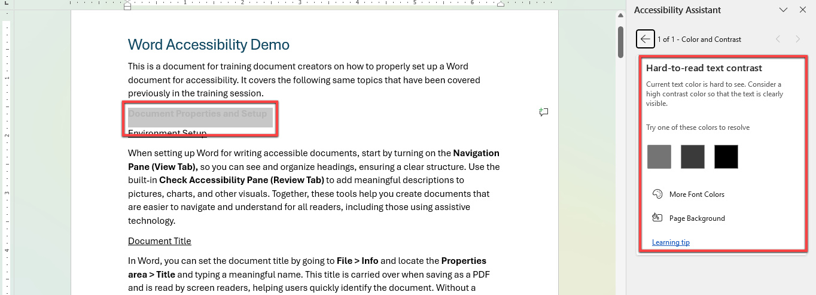
Color and Contrast
Visual Example

Slide 13
Document Structure
Key Areas of Focus
Headings
Lists
Spacing

Slide 14
Images
Key Areas of Focus
Why images matter?
  Supports the context of the information provided
  Provides a secondary method of delivering information
Why alternative text matters?
  Describes image to screen reader users
  Without alt text, inequality for screen reader users exists

Slide 15
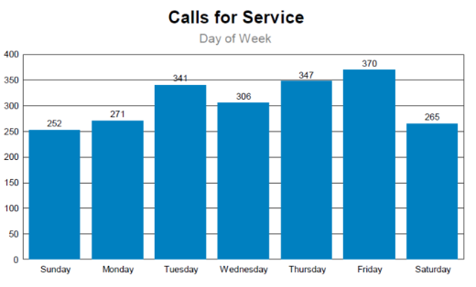


Images examples
Images
Examples
Alt Text for Informative Image:
Firefighter smiles as she holds a ladder in place. Banner image states: “Help shape the future of Madison Fire”
Alt Text for Complex Image:
Bar chart showing calls for service data for the west district in November.
Alt Text for Decorative Image:
Decorative
Or: “Mark as Decorative” in the alt text panel

Slide 16
Links
Key Areas of Focus
Should communicate the destination
Should be visibly identifiable
Avoid providing links as URLs
Avoid phrases like “Click here” and “Read more”

Slide 17
Links
Examples
Correct Form
Form labels and fields also need to be next to each other on the page so all users can easily associate them. Learn more about forms and accessibility
Incorrect Form
Form labels and fields also need to be next to each other on the page so all users can easily associate them. Learn more about this here
Notes:
Here are some examples to simplify what I am describing.
Notice how the correct form is so much easier to understand the purpose of the link

Slide 18
Tables
Key Areas of Focus
Why table accessibility matters?
  People who are blind use a screen reader to navigate.
  Screen readers allow people who are blind to navigate documents quickly
Why structured tables matter?
  Tables are complex to mentally map
  Well structured tables simplify understandability
Notes:
Tables are important for sharing tabular data. These elements are challenging to navigate for people who use screen readers.
The structure and setup of a table is simple, but a few key options can reduce the accessibility challenge immensely. We’ll show you how to do that in our demo coming up next.
What questions about general accessibility?

Slide 19
Agenda Word and Accessibility
Agenda
Definitions
General Accessibility for All Documents
Word and Accessibility
  Rely on built-in styles, tables and fonts
  Set up document structure
  Ensure links follow best practices
PowerPoint and Accessibility
Q&A
Notes:
Inform the group again we covered… now we are going into some applied training… if you joined late… please download those now..

Slide 20
Word and Accessibility: Demo Instructions
Word and Accessibility
Demo Instructions
If using Desktop Version
      Use the Windows key to bring up your menu
      Type in “Word”
      Press “Enter” key
    If using Online Version, browse to Word for the Web
  Login to Office Online
  Select the “Word” document called “Word Accessibility Training”
Notes:
Go to the chat area, the document is there, be sure to download the document and open the downloaded version for this next section

Slide 21
Demo in Word

Slide 22
Agenda PowerPoint and Accessibility
Agenda
Definitions
General Accessibility for All Documents
Word and Accessibility
PowerPoint and Accessibility
  Rely of built-in styles, tables and fonts
  Built-in Slide Layouts and Themes
  Ensure links follow accessibility best practices
Q&A

Slide 23
PowerPoint and Accessibility: Demo Instructions
PowerPoint and Accessibility
Demo Instructions
If using Desktop Version
      Use the Windows key to bring up your menu
      Type in “PowerPoint”
      Press “Enter” key
If using Online Version, browse to PowerPoint for the Web
  Login to Office Online
  Locate and activate the “PowerPoint” document called “PowerPoint Accessibility Training”

Slide 24
Demo in PowerPoint

Slide 25
Agenda Q & A
Agenda
Definitions
General Accessibility for All Documents
Word and Accessibility
PowerPoint and Accessibility
Q&A
Notes:
Could introduce plain language and other trainings here

Slide 26
Final: Any questions?
Any Questions?

