Slide 1
Creating an Equitable Interview Process
Bill Wick, Human Resources Analyst
Brooke Gillitzer, Human Resources Analyst
Notes:
Check in Question:

Slide 2






Tech Check
Rename Yourself
  Participants > Hoover over your name > 3 dots > Rename. Type your Name, Pronouns, and Department.
Mic & Video Test
  Select the microphone button to unmute yourself & say hello! Select the video button to go on/off camera.
Locate the Chat Feature
  Select the three dots > Chat to open up the chat box.
Raise Hand or Use Reactions
  Select the three dots > Reactions > Raise Hand to raise your hand.
Turn on Closed Captioning
  Select Show Captions button, select your preferred language, click Save.
Turn off your VPN
Disruption? Try logging out and logging back in again.

Slide 3
Your HR Services Team
Bill Wick
Attorneys
Civil Rights
Julie Trimbell
Brittney Hayes
Assessors
Common Council
Fleet
Finance
Brooke Gillitzer
Building Inspection
IT
Streets
Police
DOT Office of Director
Parking
CDA Housing
Community Development
DPCED Office of the Director
Economic Development
Fire
Human Resources
Planning
Metro
Parks
Clerks
EAP
Engineering
Library
Office of the Independent Police Monitor
Mayor’s Office
Monona Terrace
Municipal Court
Traffic Engineering
Parks Assist
Water Utility

Slide 4

Group Agreements
Be Present
Take Space
Make Space
Take Notes
Be Curious
Ask Questions
Additions?

Slide 5
Learning Objectives
Understand behavioral interview questions and benchmarks.
Explain how bias, including unconscious bias, can affect interview outcomes.
Implement strategies to combat bias in interviewing.

Slide 6
Purpose of Interviewing
Determine the necessary skills for the position.
Find candidates with the skills, ability and potential to meet the needs of the job.
Evaluate for cultural add to the team.
* Everything starts and ends with the position description*

Slide 7
POLL TIME
Which of these questions is necessary to evaluate a candidate’s ability to perform the job?

Slide 8
Legal Framework
Federal Laws
  Age Discrimination in Employment Act (ADEA)
  American’s with Disabilities Act (ADA)
  Civil Rights Act of 1964
  Pregnancy Discrimination Act
  Civil Rights Act of 1991
Wisconsin Laws
Madison General Ordinances

Slide 9
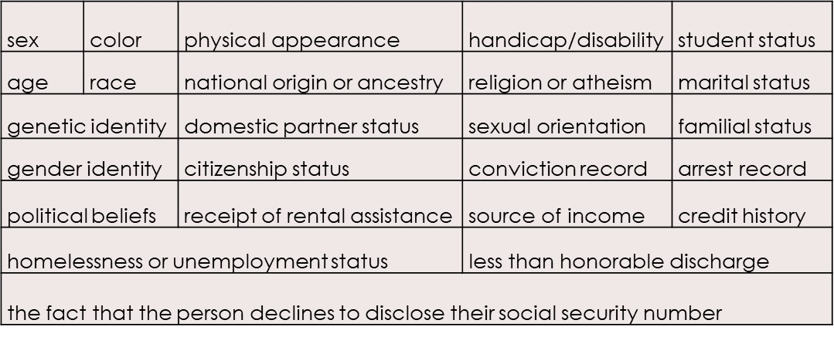
Madison General Ordinance 39.03

Slide 10
Irrelevant Information
Factors that have no bearing on the ability to perform the job may be considered discriminatory.
  English Language Learner (ELL) – Race or Disability
  Lack of eye contact – National origin or ancestry, or Disability
  Firm handshake – Sex or Disability
  Grooming habits - Physical Appearance or Homelessness/Unemployment
  Clothing/attire - Homelessness/Unemployment
  Fidgeting, nervousness, slouching – Disability

Slide 11
Common Biases
Halo Effect / Beauty Bias
Affinity / “Similar to Me” Bias
Horns Effect
Leniency/ Severity
Contrast Effect
First/Last Effect
Assumed Characteristics
Central Tendency
Conformity Bias
?

Slide 12
Behavioral Interviewing
Past behavior is a strong predictor of future performance
Identifies actual behaviors and choices based on similar situations in the past

Slide 13
Designing Questions
Identify Core Competencies
  What skills fall into that competency
  Example: Communication – written and verbal reports. Clearly convey information in written or verbal.
Design Behavioral Interview Questions
  Follow up Questions for clarification
Create Benchmarks

Slide 14
Defining Core Competencies
Technical
Skills
Analytical
Skills
Organizational
Skills
Managerial
Skills
Communication
Skills
Interpersonal
Skills

Slide 15
The STAR Approach
Situation
Task
Action
Result
Evaluate candidates by:
Candidates respond by:
Questions lead candidates to identifying specific situations
These situations caused them to complete specific tasks
The actions they took
The results of those actions

Slide 16
Payroll Clerk Interview Question
Situation | Traditional Question | Behavioral Question
One of the more difficult aspects of the job can be dealing with employees who did not get paid correctly. | How would you handle someone who comes to you with a mistake on their paycheck? | Tell us about a time when you had to assist an irate customer. How did you manage it?

Slide 17
Benchmarks
What is a Benchmark
Creating Benchmarks
Rates candidates’ responses to interview questions
Helps limit bias in the interview process
Ensures panel members understand desired response expectations
Make your benchmarks objective, measureable and job related
What is a good/ideal response?
Give higher rating to most important benchmarks
Use an ‘Other’ category

Slide 18
Examples of Benchmarking
“Tell us about a time when you had to assist an irate customer. How did you manage it?”
Factors to Consider
(2 points each):
Shared applicable situation
Factors to Consider:
5 pts – Describes similar situation; Exhibits ability to stay calm, be adaptable, deescalate; Follows policies; Resolves issue
Exhibited the ability to remain calm and professional
Adaptable
Ability de-escalate the situation
Followed/explained policies and procedures
Other related response
4 pts
3 pts -Describes similar situation, but lacks details; No resolution discussed
2 pts
1 pt - Limited exp with such situations; example not really applicable to question
Resolved the issue
Active listening skills

Slide 19

Let’s Practice
Breakout Rooms!

Slide 20
Panel Selection
Agency Expert
Diverse Panel
Outside Expert

Slide 21
Hire for Culture Add
What does it mean that someone is a “Culture Add?”

Slide 22
Common Interview Mistakes
Failure to listen
Jumping to conclusions
Asking leading questions
Making early decisions
Irrelevant information
Lack of defined standards

Slide 23
Ins Interviews 101
Step 1
Opening
Step 2
Information Gathering
Step 3
Information Giving
Step 4
Closing

Slide 24
Interview Process:
Step 1 – The Opening
Remember … be consistent
Candidates review questions prior to the interview
Be friendly & introduce the panel
Review the position
Department/organization highlights

Slide 25
Interview Process: Step 2
Information Gathering
Remember … be consistent
Active Listening
Good Note taking
Clarifying
Watch the clock

Slide 26
Interview Process: Step 3
Information Giving
Questions may be related to work function
Questions may be related to work culture
It is ok to get back to the candidate later if you don’t know the answer

Slide 27
Interview Process: Step 4
Conclusion
Explain the next steps
Keep the enthusiasm going
Gather any needed materials from the candidate

Slide 28
Candidate Evaluation
Bias awareness
Consistency through benchmarks
Review notes
Post interview discussion
Second Interviews

Slide 29
Documentation
Watch what you record
Watch what you don’t record
Keep documentation for 3 years

Slide 30

Red Flag Review
DCR notification
Purpose
Process
Practice
Eliminate discriminatory practices & minimize cultural, racial, gender and disability differences
Take special measures during process when there is an opportunity to reduce underrepresentation
Managers demonstrate several affirmative steps to eliminate biases before making the offer to hire

Slide 31
Next Steps (review from Hiring Foundations session)
Select final candidate
Review Red flag with DCR
Conduct Reference Checks
Make the initial conditional offer of employment
Work with HR on necessary background checks
Finalize job offer
Draft Appointment Letter
Complete NEOGOV process

Slide 32
Our objectives were that by the end of this session, you would be able to:
Develop skills-based behavioral interview questions and benchmarks.
Identify and explain how bias, including unconscious bias, can affect interview outcomes.
Identify bias and implement strategies to combat bias in interviewing.

Slide 33
Resources
A Manager’s Guide to Interviews and Background Checks
Supervisor Resources on EmployeeNet
Equitable Hiring Plan

Slide 34
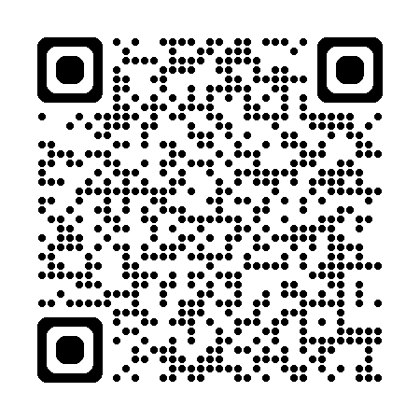
Thanks for Joining!
Please participate in our Course Evaluation Survey – your feedback is important!
Notes:
Hold 3-5 minutes at the end of the course to ensure folks have this dedicated time to submit feedback.
Add Course Eval Survey hyperlink to chat for folks to click on as well!
www.surveymonkey.com/r/2025CourseFeedback (Current QR Code above goes to this 2025 survey).

