Slide 1
Managing the Drug and Alcohol Testing Process
Notes:
APM 2-23

Slide 2

Katherine Roe - HR
Katherine
Administrative Assistant – Employee and Labor Relations
Designated Employer Representative FMCSA
Notes:
Designated Employer Representative (DER)– help manages the drug and alcohol testing program
FMCSA, Federal Motor Carrier Safety Administration

Slide 3
Objectives
Overview the policy and process of drug testing at the City
Understand related supervisor responsibilities
Discuss the impacts of drugs and alcohol in the workplace
Build awareness about the Drug and Alcohol Clearinghouse

Slide 4
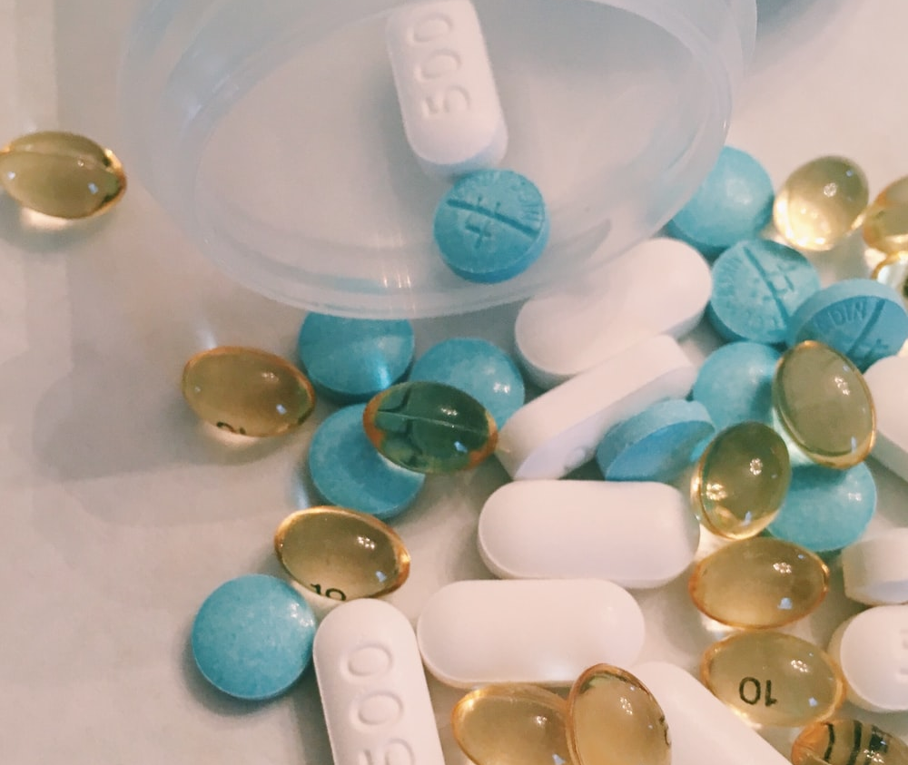
Impacts of Drug and Alcohol Misuse

Slide 5
Alcohol and Drug Abuse Impact Data
Drug abuse and addiction cost American society more than $740 billion annually
Approximately 1.15 million overdose deaths in the US since 2000
51.2% of people have used illicit drugs at least once
Approximately 9.49 million Americans misuse opioids annually
Taking opioids for a period longer than 3 months increases the risk of addiction 15 times- most persons in acute pain rarely need more than 7 days’ worth
$11 billion was incurred in healthcare costs related to the use of illegal drugs and $26 billion for prescription opioids
*National Center for Drug Abuse Statistics
Notes:
We pulled some recent statistics related to some of the costs and incidence of Alcohol and Drug abuse.
https://drugabusestatistics.org/

Slide 6
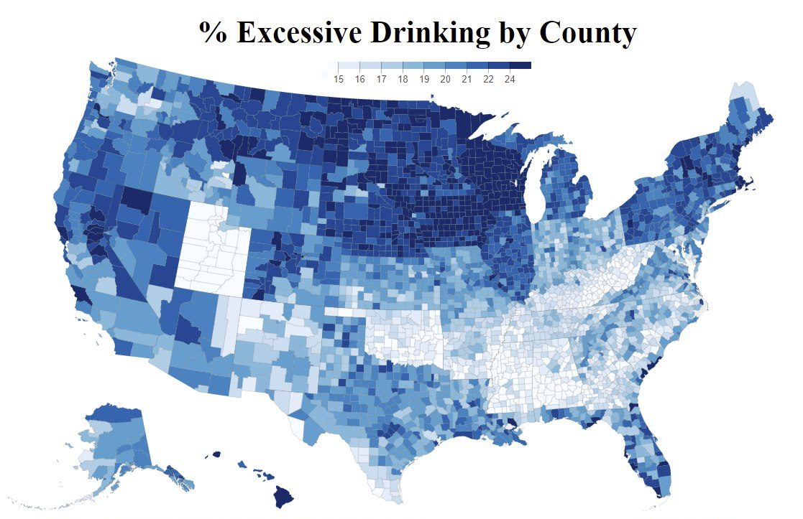
Notes:
While excess drinking can be a problem in any workplace, this map demonstrates the prevalence of excessive drinking in Wisconsin. Notice that every single one of our counties is shaded in dark blue.
Wisconsinites are banned from drinking competitions world-wide

Slide 7

List in the Chat: What are some of the potential impacts on the workplace of drug and alcohol misuse or abuse?
Notes:
Given the societal issues caused by drug and alcohol abuse, you can imagine there are also significant impacts just to the workplace. Please drop in the chat at least one impact you have directly seen to the workplace of drug and alcohol abuse.
High turnover
Lost wages due to illness or health problems
Absenteeism
Highly stressful work environment
Lack of safety and responsibility
Loss of productivity

Slide 8
Enabling
Enabling = Good intentions with bad results
Unwittingly allowing the illness to progress to later and more serious states by preventing the dependent person from experiencing the consequences of their harmful chemical use, keeping the chemically dependent sick.
Notes:
Given some of the impacts of drug and alcohol abuse, it can seem surprising that as supervisors we sometimes don’t want to address the issues we see with employees who are misusing drugs and alcohol. However, when we have personal and professional relationships with employees it can create an unwillingness in us to address some of these issues. This can lead to enabling. Enabling is Unwittingly allowing the illness to progress to later and more serious states by preventing the dependent person from experiencing the consequences of their harmful chemical use. Keeping them chemically dependent sick.

Slide 9
Supervisor Support
When supervisors notice employees who are struggling with drug and alcohol abuse, it is important to do all of the following:
1. Ensure the employee’s safety
2. Contact Employee and Labor Relations related to the potential for drug and alcohol testing
  This may require a reasonable suspicion test, information on these tests are included later
  There may be other interventions Human Resources recommends
3. Reach out to EAP to obtain additional support for both the employee and yourself
  Internal EAP – Arlyn Gonzalez – 266-6561
  External EAP – FEI Behavioral Health - 1-800-236-7905 FEI Workforce Resilience
Notes:
Supervisor support is critical to ensuring safety in the workplace and that issues with drugs and alcohol are resolved rather than being enabled long term. When you notice employees who are struggling, please make sure to do all of the following:
Ensure the employee’s safety. For example, if they are performing a safety sensitive task, please pull them from that task
Contact us right away. *Contact Tameaka Bryant as first point of contact and for backup – Kurt Rose
Reach out to EAP – they can also provide support to both you and the employee.

Slide 10

Drug and Alcohol Testing Policy

Slide 11
Policy Impacts to the Workplace
Through this policy we hope to:
Assure employees are able to safely perform their duties
Create a workplace environment free from the adverse effects of drug and alcohol abuse or misuse
Prohibit the unlawful manufacture, distribution, dispensing, possession or use of drugs/controlled substances
Provide employees with necessary related resources
Comply with the federal law
Notes:
Remembering all of the workplace impacts drug and alcohol abuse can have, our policy was set up to help mitigate those impacts. The purpose of the policy includes (read above boxes)

Slide 12
All Employees are Covered
Employees whose position requires them to hold a Commercial Driver’s License (CDL)
Applicants for positions that require CDL
All applicants may be subject to pre-employment testing
Employees moving to a position that requires CDL
Madison Metro is covered by a slightly different policy
FTA vs FMCSA
All other employees
Notes:
All employees are covered, but may be covered differently dependent upon their position and responsibilities.
Federal Motor Carrier Safety Administration
Federal Transit Administration
**employee gone on an extended leave, medical leave or military AWOP, 6 months undergo drug testing, preemployment not on random list, or non-DOT if on random list

Slide 13
Types of Tests
Pre-employment
Any person applying for a position that requires a CDL must complete a drug test AND alcohol test
Post-accident
Loss of human life, serious injury, citation, major property damage
Random
Reasonable Suspicion
Result of trained observers reasonable belief that employee has violated policy
Return-to-duty
CDL test for alcohol > 0.04 (return at .00)
Follow-up
Unannounced testing prescribed SAP to ensure compliance to treatment program
Conducted quarterly on randomly selected pool of drivers
Positive drug/controlled substance test
Notes:
There are six different types of tests, pre-employment, post accident, random, reasonable suspicion, return to duty, and follow up.

Slide 14
Pre-employment Tests – CDL*
Potential employees must have either a CDL or CDL Permit before they can submit a pre-employment test
If an employee submits a pre-employment test without a CDL or CDL Permit they will have to submit another test once they’ve obtained their CDL Permit
Clearinghouse check and Drug screen conducted prior to obtaining position
Breath Alcohol Test conducted on first day
Results must be provided prior to beginning work in safety sensitive position
Notes:
Pre-employment tests are mainly done for CDL drivers, and a few specific positions in the City like police property clerks.
Drug tests – send candidates to 24/7 only after proof of temps or CDL, against federal regs for a non CDL driver to take a DOT test

Slide 15
Hiring before CDL/Permit is obtained
Some departments will hire and start employees for CDL positions before the employee has a CDL/Permit.
If your department does this, you must communicate with the DER and HR Analyst:
  Which employee has yet to obtain their CDL/Permit
  When they plan to have their CDL/Permit by
  When they obtain their CDL/Permit
No CDL safety sensitive work can be preformed without a CDL/Permit and completed pre-employment tests
Employee hired without CDL/Permit
DER and Analyst Informed
CDL/Permit obtained by deadline
Reach out to DER to schedule Pre-employment tests
Employee completes clearinghouse and drug test
Once drug test and

Slide 16
Pre-employment Tests – Paperwork
Employees as part of their first day should be filling out the Employee Acknowledgement and Clearinghouse Limited Consent Forms
Please return these forms to HR by:
  Including it with your new hire paperwork
  Sending physical copies to the DER directly
  Sending digital copies to the DER directly

Slide 17
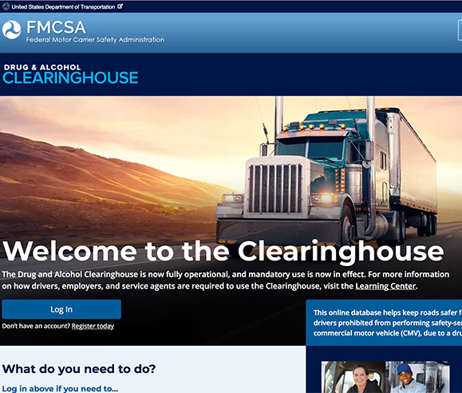
Drug and Alcohol Clearinghouse

Slide 18
Pre-Employment Query
Prior to employment, employees are required to go online and provide authorization for us to complete a full query through the Federal Drug and Alcohol Clearinghouse
Employees are to register with the Drug and Alcohol Clearinghouse at this time
Provided the employee is not listed in the Clearinghouse as “prohibited, they are allowed to move forward in the hiring process
Notes:
Prior to employment, (CDL, non-Metro) employees (including those with a permit) are required to go online and provide authorization for us to complete a full query through the Federal Drug and Alcohol Clearinghouse
Employees are given the option to register with the Drug and Alcohol Clearinghouse at this time (not required, but preferred)
Provided the employee is not listed in the clearinghouse as “prohibited, they are allowed to move forward in the hiring process

Slide 19
Annual Limited Query
Employees sign a limited query consent form upon hire that allows the City to perform an annual limited query
After conducting the annual limited query, the City may have some employees who are listed as “record found” and the employee is sent a notice that they are required to give permission for a full query
If they do not provide that authorization in 24 hours they are required to be removed from safety sensitive work
Notes:
Please keep in mind that if someone is required to obtain a CDL sometime after hire, they need to go through the pre-employment query, the pre-employment drug test, and to sign the drug testing employee acknowledgement form and consent for annual query form
**This commonly happens with promotions. For example, Maintenance Worker to Maintenance Mechanic

Slide 20
Post-Accident Testing
CDL drivers tested in cases of Loss of human life, serious injury, citation, major property damage
Non-CDL drivers tested at discretion of the Police Department
Cannot return to safety sensitive work until test results are received
Notes:
Post accident testing is when an employee gets into an accident on the job, and there is the loss of human life, serious injury, citation, or major property damage. Non-CDL drivers may also be tested in these types of accidents, at the discretion of the Police Department. Employees who are in accidents and tested cannot return to safety sensitive work until their test results are received and are negative.
Drug tests – 8 hours but up 32 hours, have to provide reason
Alcohol – 2 hours but up to 8 hours, have to provide reason
Badgerland Compliance Drug Testing , Kristin (Owner) (608) 219-5476

Slide 21
Post-Accident Testing
Must conduct a DOT Test
Can conduct a Non-DOT Test
Can Not Test
There’s been a fatality
Bodily injury AND a citation was issued at the scene
If any vehicles were required to be towed from the scene AND a citation was issued at the scene
A citation was issued to the driver regardless of damage
Supervisors can send CDL drivers who have been in an accident to be tested when none of the condition previously listed were met
The test preformed must be selected as “Non-Dot” on the notification sheet
Breath Alcohol Test
  if it has been more than 8 hours after an accident
Drug Test
  If has been more than 32 hours after an accident
Key Notes: If a citation is issued to a driver after 8 hours, but before the 32 hours have passed, you are required to send the employee to complete a DOT drug test. You can not order a breath alcohol test.
For any tests not completed directly after an accident please note what if any delays occured

Slide 22
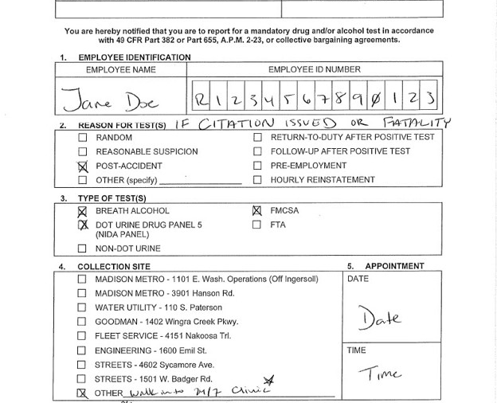
Test Notification
- Citation or Fatality

Slide 23
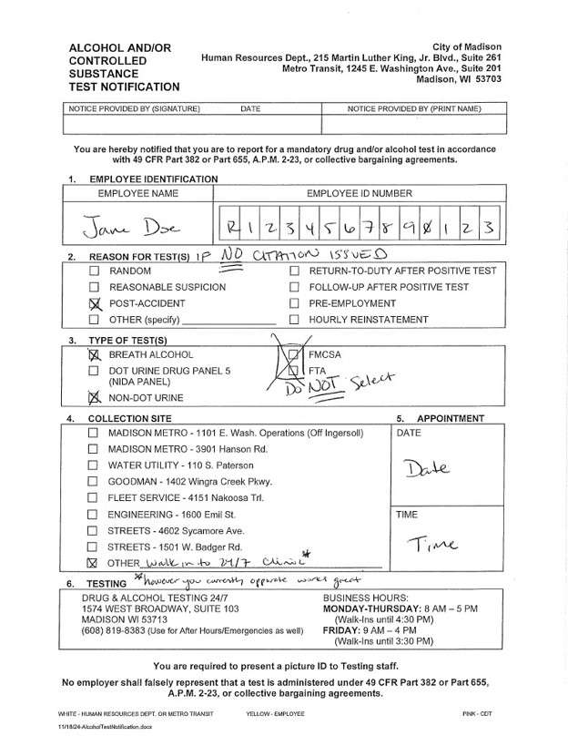
Test Notification – No Citation or Fatality

Slide 24
Random Testing
City tests 50% of the total number of CDL drivers for drugs
City tests 10% of the total number of CDL holders for alcohol
Some test results are provided immediately, but if awaiting results employees can return to work
Notes:
Random Testing is completed for all employees in CDL positions. Please keep in mind, while we test 50% annually, that requires that we test 12.5% quarterly, but each quarter it is the same list that gets randomly sampled. Consequently, you could get tested four quarters in a row, even though each quarter we are testing only 12.5% of employees.
Metro has different testing requirements based on federal transportation regulations. 50% drug, 10 alcohol%
When we test for alcohol – we need to test just prior to the employee performing safety sensitive work. *I have noticed that sometimes supervisor check off the BAT if a driver is not performing safety sensitive functions that day. That is fine. However, if it’s end of the year and I’m notified that we are 2 or 3 BAT tests short to meet our mandatory percentage, I will not ask for new names to be drawn, I’m going to send someone who was initially selected for a BAT earlier in the quarter but ended up not being tested, in for testing to satisfy DOT requirements.

Slide 25
Test Notification Process – 24/7 LLC
1. Tests are entered electronically in the portal
Requires no “Notice Provided by” signature
Will be emailed to the department, no physical pickup
2. Tests are performed, like usual
Will print both results and CCF (Chain of Custody) directly from portal
This will produce an “ePASSPORT” which is the new testing notification form
3. CDR maintains all paperwork
No more inter-d exchange of these forms
No paperwork will need to pass between the collector and supervisor
Notes:
Please let me know any changes to the test dates, or if there are call-in/vacation.

Slide 26
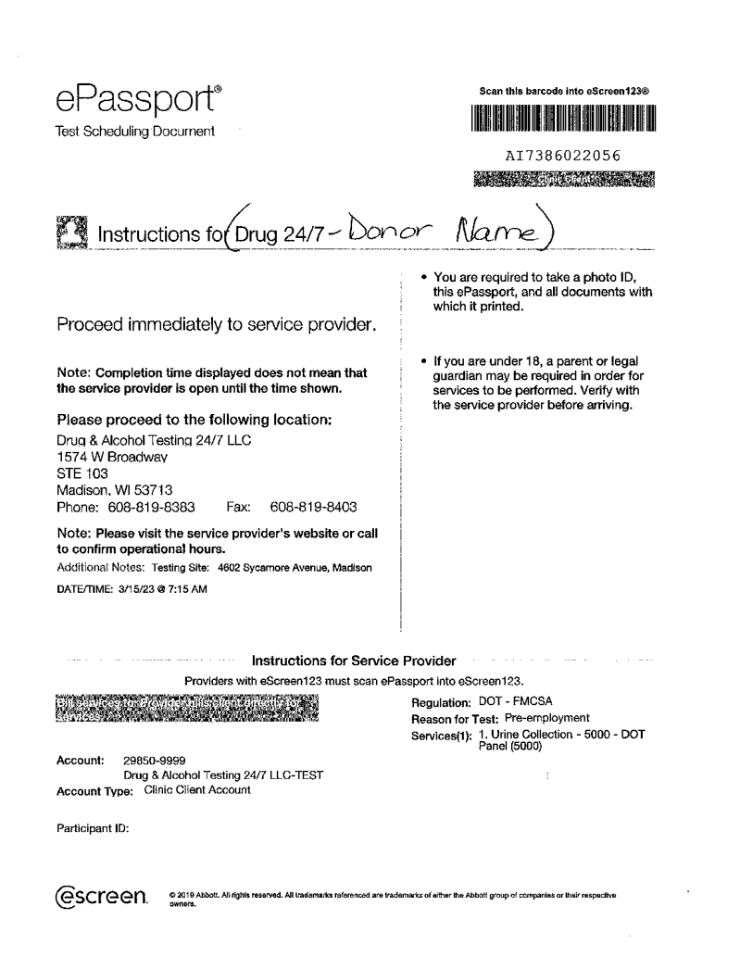
Test Notification – 24/7 LLC
We use 24/7 for most of our random testing. At the beginning of each quarter this is the

Slide 27
Test Notification Process – Badgerland
1. Tests are still filled out on the paper Test Notification Form
For pre-employment BATs or one-off reschedules notification forms will be sent Inter-D
2. Tests are performed, like usual
Primarily used for first day BATs, PM scheduled employees, and rescheduled random tests
3. CDR maintains all paperwork
Requires a “Notice Provided by” signature in the top right corner
For a batch of random tests DER will hand-deliver to department contact
Will get drug test results directly from Badgerland
Supervisors will need to send back the notification form and any materials provided by Badgerland (BAT and
Notes:
Please let me know any changes to the test dates, or if there are call-in/vacation.

Slide 28
Reasonable Suspicion Testing
Suspicious behavior must be directly observed by the supervisor with written record of observations
Alcohol testing must be completed within two hours of observed behavior
Drug and controlled substances testing must be done within 24 hours of reasonable suspicion
Use your reasonable suspicion checklist and supervisor instructions for
conducting reasonable suspicion tests. We also recommend finding another supervisor or manager to be a second witness!!
Notes:
Reasonable suspicion tests applies to all city employees and are the most difficult to decide when to test. Labor Relations makes final decision on testing. Please contact Kurt/Bill.
Suspicious behavior must be directly observed by supervisor. These behaviors have to be occurring in the present, and need to be able to be clearly defined. Some examples include:
Physical, behavioral characteristics like bloodshot eyes, slurred speech
“Changes” in normal behavior of individual, are they extremely agitated or do they have extremely slow speech patterns which are outside of how they normally speak
Written record should be made of observations (checklist, found 2-23, attachment)
Alcohol testing must be within 2 hours of observed behavior, Alcohol May be done up to 8 hours later with documentation as to the reason for not doing sooner
Drug/Controlled substance testing must be done within 24 hours of reasonable suspicion determination

Slide 29
Prescription Drug Use
Employee must notify supervisor when taking any legally prescribed medications or therapeutics in specific cases
Supervisor reports in writing and reviews situation with City Safety Officer/Acc. Specialist
No CDL operations when using any Schedule I drugs
When any prescription or non-prescription drug contains alcohol
When taking any prescription or non-prescription drug that carries a warning label that indicates that mental function, motor skills or judgment may be adversely affected by use of the medication.
LSD
Heroin
Ecstasy
Example: Employees are allowed to take some prescribed opioids even as CDL drivers, provided they are taking those opioids in accordance with prescription
Notes:
Schedule 1 drugs are substances or chemicals that are defined as drugs with no currently accepted medical use and a high potential for abuse

Slide 30
Positive Tests
Employee is off work on accrued leave or AWOP if necessary
Employee is required to see a substance abuse professional (SAP) and complete their required treatment plan at the cost of the employee
Employee is required to complete return to duty test and any required follow-up tests
Violation of the drug and alcohol policy are considered just cause for discipline. Supervisors are required to follow the disciplinary process (a third positive test OR a positive during the follow-up testing period is typically considered cause for discharge)
Please note: A refusal to take required test is considered a positive and is
considered just cause for discipline
Notes:
When there is a positive test, we go through the following steps: (read above)
They can use Flex medical spending for this
The SAP drug tests them (non-DOT) before sending them to back to the city for the RTD test; follow up tests range anywhere from 6 months – 5 years. Once completed, the DER will log into Clearinghouse to notify FMCSA of completion. The supervisor or employee is not notified.

Slide 31
Testing Procedure - Alcohol
Administered by Breath Alcohol Technician (BAT) using Evidential Breath Testing (EBT) device
Conducts initial screening test and confirmation test (if required) within 15 to 20 minutes of initial test
2A. Instant results of initial screening test for all covered employees
If less than .04, employee can return to work
If greater than .04, employee is removed from the work place
2B. Instant results of initial screening test for CDL holders
If 0.00 return to work
If 0.01 to 0.04 the employee cannot perform any safety sensitive functions for 24 hrs and may or may not be given other assigned duties in the department
If greater than 0.04 employee subject to evaluation by SAP and return to duty testing as well as follow up
If over .04, confirmation test 15-20 minutes after screening
3. The BAT notifies Designated Employer Rep (DER) of test results
BAT completes required paperwork and picture ID is required for both employee and BAT
1. Test conducted in confidential place
Notes:
This is effectively a 3 step process. The first step is that we conduct the test in a confidential location. The second step is to review the results. The third step is for DER to be made aware of results

Slide 32
Testing Procedure – Controlled Substances
1. Urine test by certified lab technician
Conducted with defined “chain of custody” process to ensure control over sample
Split specimen sample-a primary and secondary vial are requested
2. Medical Review Officer (MRO) reviews results
MRO notifies employee of positive results, then the City Designated Representative (CDR)
Typically conducted at a City facility
3. Results received by employer/employee
Notes:
The test notification form and chain of custody form for drug and alcohol tests should be received by the collector and forwarded to HR
*employee gone on an extended leave, medical leave or military AWOP, 6 months,

Slide 33
City Testing Sites
Madison Metro 1S Ingersoll or 3901 Hanson Rd (24 hours)
Water Utility 110 South Paterson (near loading docks)
Fleet Services – 4151 Nakoosa Trail
Engineering 1600 Emil Street 1st floor near reception
Streets/Parks East 4602 Sycamore Ave- Office Bathroom
Streets West 1501 Badger Road- Office Bathroom
Traffic Engineering – 1120 Sayle Street
Parks
  Forest Hill Cemetery - 3715 Speedway Rd
  Summit Maintenance Facility - 1902 Freeport Rd
  Mall Concourse Maintenance shop - 120 S. Fairchild
  Goodman Park Maintenance Facility - 1402 Wingra Creek Parkway
  Yahara Hills Maintenance Bldg (Golf)
Notes:
Here is a list of all of the City testing sites. We also do walk in testing at the 24/7 facility located on Broadway. There will be times where an employee calls in sick or is on vacation on their test date and I will try to reschedule those on later scheduled dates per department but if there are no later dates available or it’s the end of quarter I will ask you to take the employee to 24/7.

Slide 34
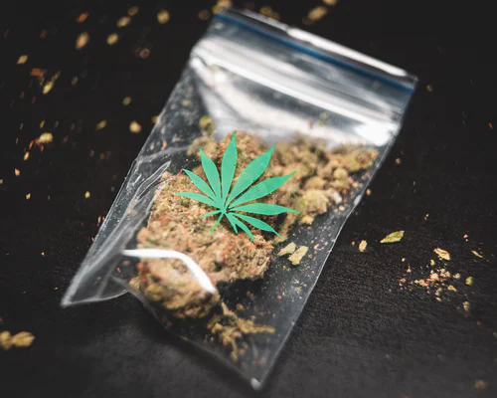
Supervisor Responsibilities
Notes:
Supervisors are responsible for several key aspects of drug and alcohol testing.

Slide 35
Constructive Confrontation
Observe/ Identify
Confirm
Confront
Document

Slide 36
Observe/Identify/and Document
Remain observant to changes in behavior or common characteristics of drug and alcohol use
Write down observations, and get a second supervisor to review
Use the reasonable suspicion check-list where appropriate
Notify Human Resources
Notes:
List what observe means: observations could include bloodshot eyes, heavy eyelids, dilated pupils, mumbled or slurred speech, excited, combative, sleepy, wobbly, stumbling
https://www.cityofmadison.com/mayor/apm/hr/APM2-23ReasSuspicionInstructChecklist.pdf

Slide 37
Confirm
Discuss with Human Resources first
Find confidential location
Do not leave alone
Allow representation/support where requested
Make sure a second supervisor is present
Notes:
4. Association/Union or family, friends

Slide 38
Confront
Ask about alcohol or drug use
Continue to document, noting any inconsistencies in their responses
Test if allowable – Contact HR if you think you need to test
Offer resources including:
Early intervention through recognition; diagnosis; and treatment
Encouragement to self refer
Reach out to EAP to obtain additional support for both the employee and yourself
Internal EAP –Arlyn Gonzalez – 266-6561
External EAP – FEI Behavioral Health - 1-800-236-7905 FEI Workforce Resilience
Notes:
Ask about alcohol or drug use
Continue to document, noting any inconsistencies in their responses
Test if allowable
Offer resources including:
Early intervention through recognition; diagnosis; and treatment
Encouragement to self refer
Reach out to EAP to obtain additional support for both the employee and yourself
Internal EAP – Arlyn Gonzalez, Mary Eldridge – 266-6561
External EAP – FEI Behavioral Health - 1-800-236-7905 FEI Workforce Resilience

Slide 39
Questions?
Feedback
Contact Katherine Roe
kroe@cityofmadison.com
266-4617
Share your feedback on this course – link in chat or scan:
Notes:
Feedback link:

