Slide 1
So You Need to Share Your Data:
Graph Tips Everyone Can Use
Rebecca LeBeau
Public Health Madison & Dane County 2024

Slide 2
All the concepts in this presentation are real
But the data are made up!
Notes:
For the purposes of this presentation, most of the data are made up. If something is real I’ll call it out.

Slide 3
Data viz best practices
≠
“Dumbing it down”
Notes:
The core of data viz and plain language is making things simpler. It intersects a lot with clear communications– some overlap here in the beginning with that training.
You are making changes to your graphs so that people can understand the information in less time. But that doesn’t mean you’re dumbing it down.

Slide 4
Data viz best practices
Smartening up
Notes:
Instead, you’re smartening up your work. You’re meeting our audience’s needs. People don’t want to spend more time than they need trying to dissect data reports– they want the info to be easily accessible and understandable.

Slide 5
Even people with high literacy levels appreciate plain language.
Notes:
Even though this is research on language, it still applies--
There’s also a misconception that only people with low literacy levels appreciate plain language. Not true. Take this study of lawyers and judges:
Researchers surveyed judges and lawyers in four states. They were asked to read a series of two versions of six different paragraphs and say if they preferred A or B. One version was in lain language and the other in traditional legal style. The survey itself and its cover letter did not indicate this was a plain language survey (it said it was evaluating language trends in the legal profession).
1,462 judges and lawyers returned the survey. And in every state, the preferred the plain language versions by margins of 80-86%.

Slide 6
Do you want [this] to feel like homework?
ANN K. EMERY data
visualization
expert
Notes:
But more than anything else, I never want my audiences to feel like the materials I create are boring and hard to follow.
I love how Ann Emery put it on a particularly wordy graph she was redesigning: Do you want this to feel like homework? NO!
The reality is that people don’t want to waste their precious minutes staring at our graphs. They want to immediately get the main point. This is true across all of our audiences.

Slide 7
It is our job to contextualize the data we present
Is there a trend or correlation? Is it significant?
Confounding factors?
Are there historical influences or root causes audiences might not know?
Was a goal met or not met?
What are the similarities or differences between groups?
Notes:
In fact, it’s our job to add context and meaning to data. Describing and highlighting trends and key points in the data, giving context as to why rates may be increasing or decreasing, linking back to upstream causes– this is our role as public health! We should make this clear through the way we present graphs and data too. Graphs should have context and be easy to interpret and understand.

Slide 8
PURPOSE
AUDIENCE
CHANNEL
Notes:
Before you start creating anything, consider:
Purpose – what’s my goal with this product? Is it to increase flu vaccination for kids? Get fewer calls about a common COVID question? Explain a new process for booking appointments?
Audience – who am I trying to speak to? Be specific! Are you trying to reach parents of kids under 5? Restaurant owners and operators? People in the LGBTQ+ community?
Channel – how will this information be shared? Fact sheet? Video? Presentation?

Slide 9
Data viz needs to be accessible to be equitable
Notes:
Analyzing, collecting, visualizing data is a lot of work. But sometimes there can be some elitism in the field. People might feel like “not just anyone can understand this,” or “it takes a lot of expertise to be able to analyze this.” but part of our work is also translation. The data in public health are often about people– and the people in the data deserve to be able to access, understand, and utilize their data for advocacy and action. That means moving data out of dense, 100 page reports and complex graphs and into visuals and formats with which people can engage.

Slide 10
Data isn’t objective
“We 100% agree that the tools of statistics and data science don’t carry inherent biases towards a worldview or group,
but as soon as people get involved, they start making choices that – if unexamined – reinforce their own perspective in a way that affects the data outcomes and by extension the decisions or actions based on them.
It’s how you use the hammer that matters.” –We All Count
Notes:
https://weallcount.com/the-data-process/

Slide 11
Who decides the groups?
Percent of people experiencing XYZ by race and ethnicity
Notes:
The dominant way of denoting race is often decided by whatever system we’re working out of, or the census, or other large datasets. And often, “Asian” is grouped together. For a made up inequity, you might see that numbers are very similar.

Slide 12
Who decides the groups?
Percent of people experiencing XYZ by race and ethnicity
Notes:
But if you broke out “Asian” by different categories and ethnic groups, you might find different data. In this made up example, I’ve pulled out Hmong people and found that there’s a significant difference in experiences. If we didn’t pull this out, how would systems take action on this inequity?

Slide 13
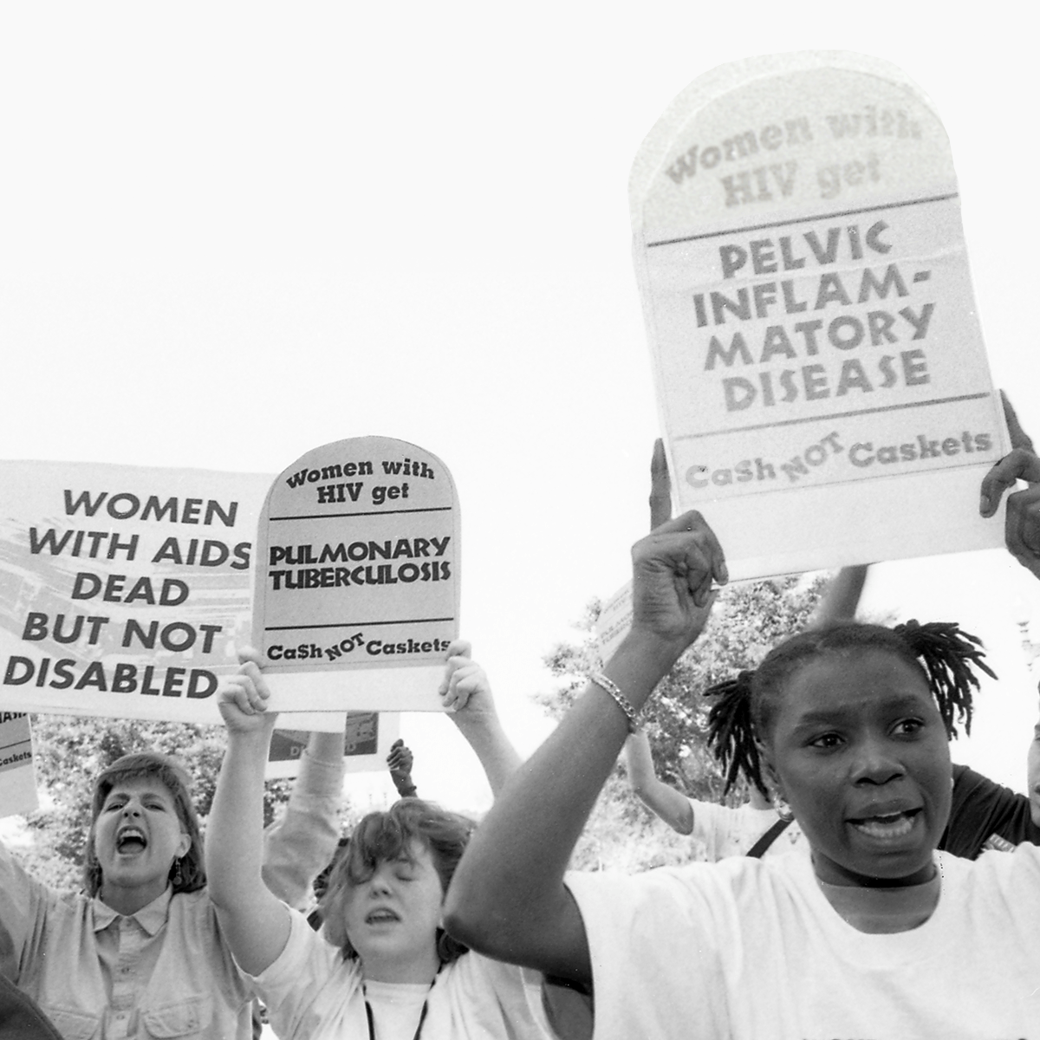
Who makes the definitions?
This is real:
Women diagnosed with AIDS increased 45% after the CDC changed the definition in January 1993 to include more symptoms, including gynecological symptoms.
-- From Reveal News
Notes:
Source: https://revealnews.org/podcast/the-plague-in-the-shadows/

Slide 14
Only 14% of Group A reported attending a neighborhood meeting in the past year.
Are there ways I can make root causes clearer?
Notes:
Sometimes when we present public health data or talk about public health topics, we try to present “just the facts.” So, we just show something like this. “HIV Prevalence among group B is three times that of group A.”
What’s the problem with this? It’s that you’re leaving your audience with more questions– mainly, why? Why is there a difference? If we don’t answer that question, then your readers will find their own answers in their own brain.

Slide 15
Individualism is the assumption that individual outcomes—both positive and negative—are a function of a person’s will, drive, and choice.
This mindset has been foundational in American culture since before the founding of our country, shaping default assumptions about topics as wide-ranging as education, health, poverty, and aging.”
--The Frameworks Institute
Notes:
Americans are individualistic, although systems thinking and acknowledgement of things like racism is increasing. People point to behaviors overwhelmingly as influencing health. In the previous example, how would people interpret the data? How might it perpetuate harm?
Source: https://www.frameworksinstitute.org/wp-content/uploads/2020/05/culture-change-project-highlights.pdf

Slide 16
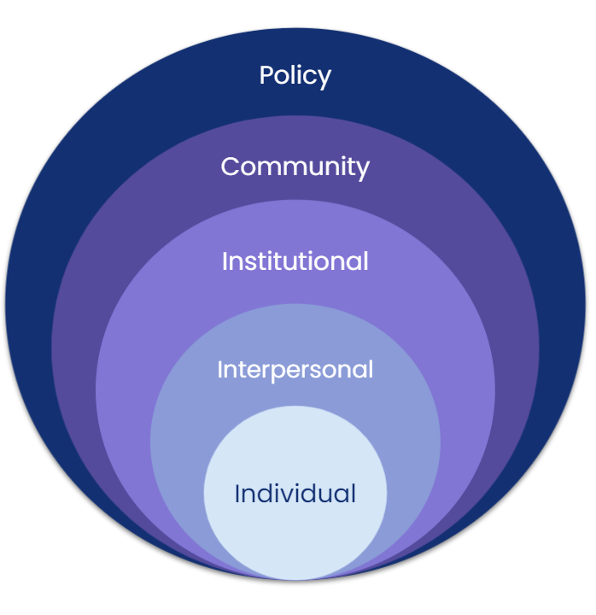
How could
we bring the focus to the rest of the picture?
Tat
Notes:
We know in public health that health inequities are caused, at least in part, by systemic factors, like racism, access to health care, poverty, stigma. But those systemic factors are less visible-- it’s hard to see systemic racism, but it’s easier to see people’s behaviors and individual choices. I saw this over and over again among undergrads when I led a pop health class discussion on campus a few years back. One of the activities was to watch a video about the Pima, a Native American community in the southwest, that experienced high diabetes rates. The video went through historical contexts of racist harms from the government that the Pima people experienced, from being forced to live on reservations to being provided food subsidies that were not cultural foods and nutritionally lacking. But when I asked the students the most important factor influencing diabetes rates, they would often point to “education”– that “people just don’t know what they put in their bodies.” This is the tendency of all of us– to not see the systemic– and takes a lot of training to see the bigger picture.

Slide 17
Because of inequitable access, only 14% of Group A attended a neighborhood meeting in the past year.
Are there ways I can make root causes clearer?
Notes:
Sometimes when we present data, we try to present “just the facts.” So, we just show something like this.
What’s the problem with this? It’s that you’re leaving your audience with more questions– mainly, why? Why is there a difference? If we don’t answer that question, then your readers will find their own answers in their own brain.

Slide 18
Go to the root
Health outcomes (such as injury, heart disease, or overdose)
Social determinants (such as housing, education, or employment)
Underlying systems (such as racism, ableism, poverty, distribution of resources)
Notes:
It’s easy to focus on outcomes, because it’s what we see. It’s harder to focus on social determinants, like housing. It’s even harder to focus on underlying systems. As government, sometimes WE are the underlying system that has historically or currently had unfair policies, distributed resources inequitably, etc. But how can you change the root cause of an issue if you don’t even look at it?
We aren’t going to get there every time. You’re not going to explain the history of racism in the United States in a social media post. Our goal is instead to frame toward systemic root causes and away from individual responsibility.

Slide 19
1 in 4 people in Group A work a job that requires evening or weekend hours, compared to just 3% of Group B.
Are there ways I can make root causes clearer?

Slide 20
What is the root issue these data are talking about? How can I communicate that?
How can I make these data more accessible?

Slide 21
DATA VIZ BEST PRACTICES SPEEDRUN
Notes:
This presentation isn’t going to be an in depth tutorial, but we are going to touch on some data viz best practices so we are all on the same page!

Slide 22
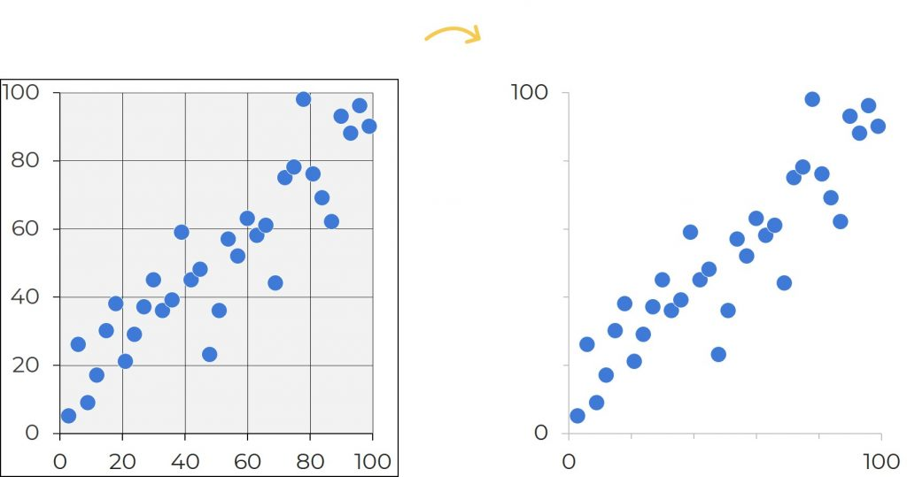
Best practice #1: Declutter
Photo via Ann Emery
Notes:
A key part of making your graphs simpler and easier to interpret is to declutter.
To declutter, you work on removing:
Gridlines (direct label important points)
Excessive axis labels
Legends (again, direct label)
Background colors
3d elements (like shadows, etching, or 3d designs)
Axis titles (if it can be made obvious via chart title)

Slide 23
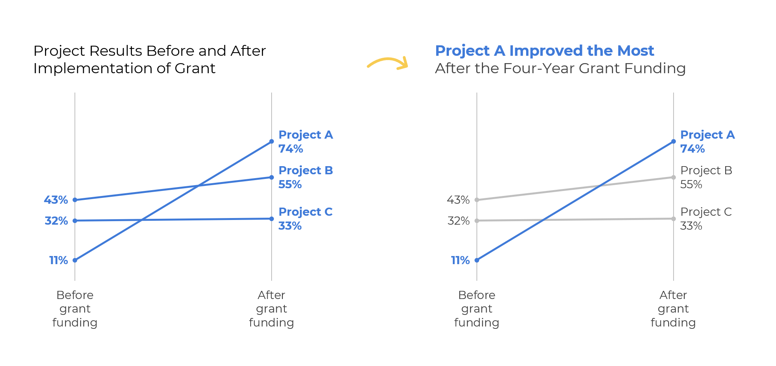
Best Practice #2: Storytelling
Photo via Ann Emery
Notes:
Storytelling graphs help audiences more quickly interpret the information. In the example above, project A is the only project that improved after grant funding. You can see that trend much easier by using both the graph title and the graph color to highlight the interesting portion of the graph. Your eyes are able to much more easily find the main point of the graph using these techniques.

Slide 24
Best practice #3: Branding and design
Notes:
Branding– fonts and colors– add consistency, professionalism, and tie you to your organization.

Slide 25
RED
GREEN

Slide 26
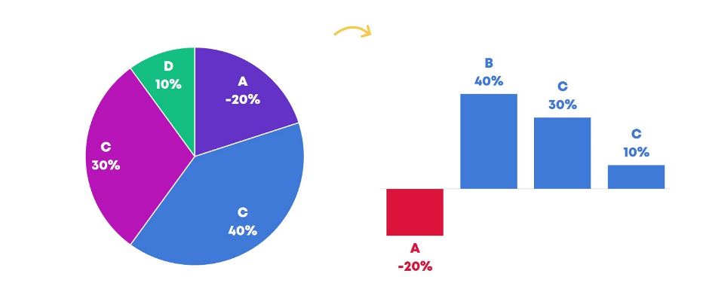
Best practice #4: Chart types
Photo via Ann Emery
Notes:
Sometimes the first graph we pick isn’t the best graph. In this example, there are too many categories for a pie chart, and on category is negative, which isn’t clear from the visual on the left. A bar chart with a negative axis helps present that data more accurately and makes it faster to read.

Slide 27
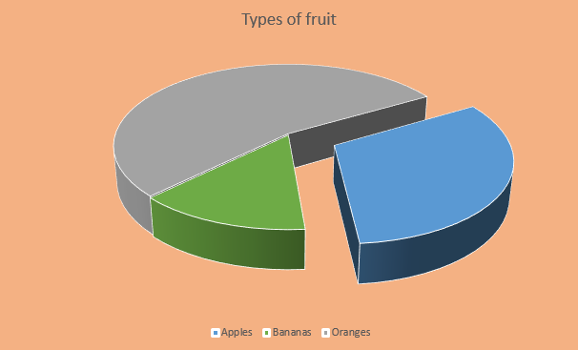
What would you change?
Notes:
So let’s put these practices into practice and dive in first to this 3D pie chart. Let’s say you are making this graph for public health. What would you change?

Slide 28
What would you change?
Notes:
Title: not descriptive, confusing, vague
Chart design: 3d element distorts the angle of pie slices, makes it hard to interpret
Chart design: exploding element further distorts chart interpretation
Colors are not branding colors
Colored background not recommended– hard to read
No data labels, making it even harder to interpret percentages
Legend is impossible to read. Even if it were easy to read, you have to look back and forth– better to directly label when possible

Slide 29
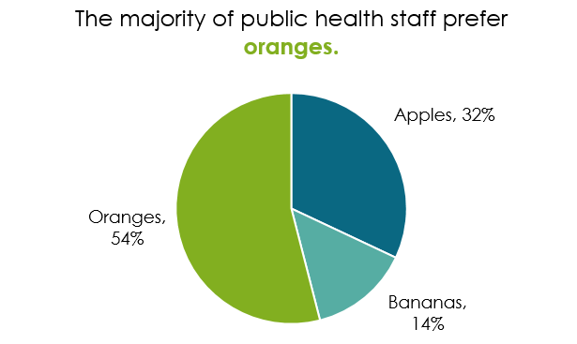
Giving it a remake
Notes:
Redoing it here– we have branding colors, the 2D element is easy to read, things are directly labeled, white background– way cleaner. It takes two seconds thanks to the title and the design to get the main takeaway.
Bonus fact– the white borders between the pie slices look even better and make them pop against each other! Also a very useful element when printing in black and white.
Pie chart resource from Ann Emery: https://depictdatastudio.com/when-pie-charts-are-okay-seriously-guidelines-for-using-pie-and-donut-charts/

Slide 30
Telling a story
Notes:
Adding storytelling makes this example even stronger.

Slide 31
If there were 7 categories
Notes:
It gets kind of overwhelming if you have more than 3 categories in a pie chart. Especially when there are little slices, it’s hard to compare the sizes of the slices and it gets hard to label.

Slide 32
You might switch graphs
Notes:
You might switch graphs to a bar chart or something similar. It’s way easier to compare the proportional sizes because everything is lined up nicely. One downside though is it’s less obvious things add up to 100%. But in this case I think it’s worth the switch.

Slide 33
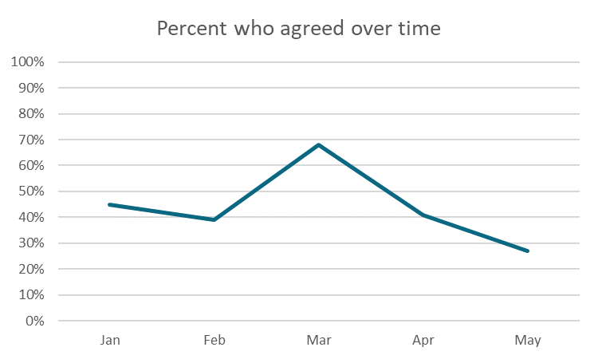
What would you change?
Notes:
Ok, one more really quickly!

Slide 34
What would you change?
Notes:
Bland title
Gridlines not needed
Y-axis not needed (controversial?)
No direct labels

Slide 35
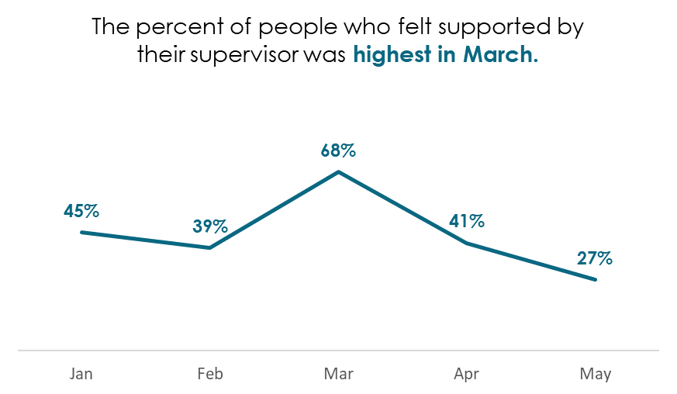
Giving a refresh
Notes:
Added direct labels
Added branding colors
Increased text sizes
Deleted gridlines and y-axis
Added descriptive title (also added context as to who was agreeing with what??)
What could be even better?

Slide 36
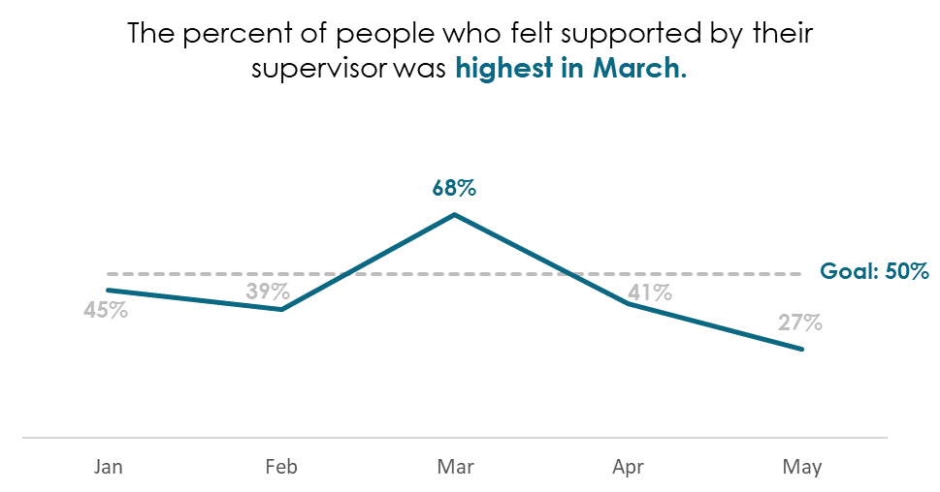
Same graph, different message
Notes:
Maybe you’re not celebrating 81%. Maybe you actually have a goal of 50%, and all but one month was below your goal. There are different ways to get your message across with the same graph.
In epidemiology, you might not have a goal. (might be more common in evaluation if you have a program or project you are evaluating). But still important to describe main points and key takeaways for people in the title. Also could still have goals (like healthy people thresholds) or comparing to state averages. Our jobs to add the important context for audience.

Slide 37
Bar charts

Slide 38
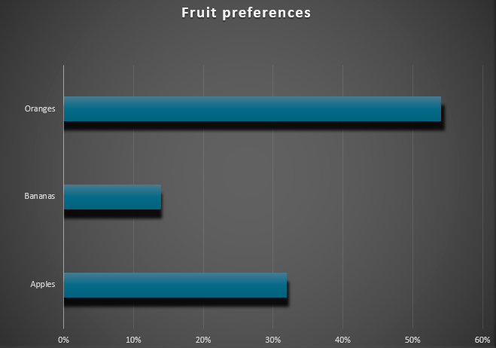
But not this bar chart!
Notes:
Just like the pie chart, we are avoiding all of the 3d elements that Excel offers for bar charts and other charts. They are all bad! This is one of the Excel “suggested” designs and it’s just so busy and hard to look at. We don’t want the design to distract readers from the main point. Avoid colored backgrounds, gradients, 3d shadows– keep it simple and 2d on a white background. Note too that data isn’t directly labeled and instead we are forced to guesstimate percentages using the gridlines and axis at the bottom.

Slide 39
Lollipop charts
Notes:
For some visual variety, a lollipop chart is basically the same as a bar chart. It can look less visually aggressive/intense than a bar chart which is nice if you have lots of categories or the percentages are large. A group of 10 bars together can be a lot

Slide 40
Showing percentages
Notes:
Waffles are a great option for proportions other than pie charts– each square represents 1%. You can do waffles with a couple of categories (but probably not more than about 3-4).

Slide 41
Instead of multiple pie charts
Agree
Disagree
Don't know
Notes:
If you have a situation where data add up to 100% for multiple categories, try a 100% stacked bar

Slide 42
Barbells can show inequities
LGBTQ+
Not
LGBTQ+
Notes:
Barbells are powerful to show differences and inequities between two groups. Here’s an example: https://publichealthmdc.com/documents/2022_Infant_Health_Data_Snapshot.pdf

Slide 43
Icon arrays can humanize
Notes:
Adding icons can add a stronger visual to your graphs and help people interpret what it is about

Slide 44
Show proportions over time
Notes:
Slope graphs are just line graphs with some formatting, but they are a great way to show proportions

Slide 45
If you have confidence intervals
Notes:
If you’re pulling from data that has confidence intervals, you can use a slider plot for a more intuitive visual

Slide 46
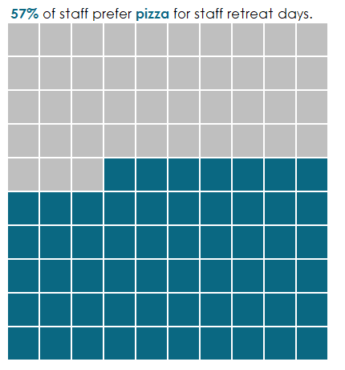
In general, do this
Branding colors and fonts
Direct data and category labeling
Descriptive titles
2D
White background
White borders
Remove clutter (like gridlines, legends, graph borders, unnecessary axes)

Slide 47
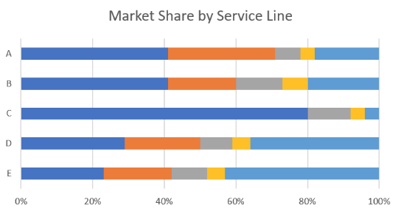
In general, don’t do this
Default Excel colors
Forcing people to guess numbers and percentages
3D, gradient, or shadow elements
Colored backgrounds
Excess design elements
Notes:
Photo via ann emery

Slide 48
PLAIN LANGUAGE
Communication your audience can understand the first time they read or hear it.
Notes:
Plain language is communication your audience can understand the first time they read or hear it.
This is the definition from plainlanguage.gov—the standards used by the federal government.
https://www.plainlanguage.gov/about/definitions/
Today we’re going to be covering plain language tips and tricks, and also something more broad, called “clear communication”, which also includes considerations for not only what we say but how it looks and how that formatting can help us communicate more easily.

Slide 49
WRITE AS YOU WOULD SPEAK
Notes:
With both using pronouns and contractions, the goal is to write as we would speak. This takes practice! We’re so accustomed to formal, flourished writing—we’re trained that way in school. So it takes time to feel more comfortable writing in a less stilted way.

Slide 50
CUT TO THE CHASE
After reviewing this material, the next step is to determine the location of the mobile service base as well as where the mobile food unit will be vending. Once this has been decided, the Operational Plan can be completed and submitted to the department.
Next Steps
Determine where you will be selling food.
Fill out an operational plan and send it to us.
Notes:
Also notice we put in some first and second person pronouns!

Slide 51
USE ACTIVE VOICE
Syndromic messages from seven hospitals were analyzed for ED visits that occurred over a 12-day period.
We analyzed syndromic messages from seven hospitals for ED visits that occurred over a 12-day period.
Notes:
Here syndromic messages is the subject, but it’s not really doing the action. The action is happening to it. So who is doing the action? Who is analyzing? We don’t know. That’s one of the problems with passive voice; it’s vague. To make this active, we would need to add who is doing the analyzing as the subject.

Slide 52
MAKE IT SKIMMABLE
Coffee is tasty. Id, sit, shop seasonal, and, single shot, rich, and cup mug pumpkin spice mazagran. Bar affogato, extraction cinnamon, body cream foam spoon pumpkin spice. Latte, est, trifecta caffeine shop est redeye cream brewed. Foam irish, mazagran shop grounds so arabica french press.
Mochas are coffee with hot chocolate.
Sugar robusta, flavour, breve espresso turkish, robusta turkish cream organic caramelization. Aged to go, cinnamon, pumpkin spice chicory macchiato aroma aftertaste cup cinnamon. Bar aftertaste, saucer.
Notes:
Use headings often to give readers signposts to follow. This is called making it skimmable.
If you wrote great key messages in your project brief, they often work perfectly as your headers.

Slide 53
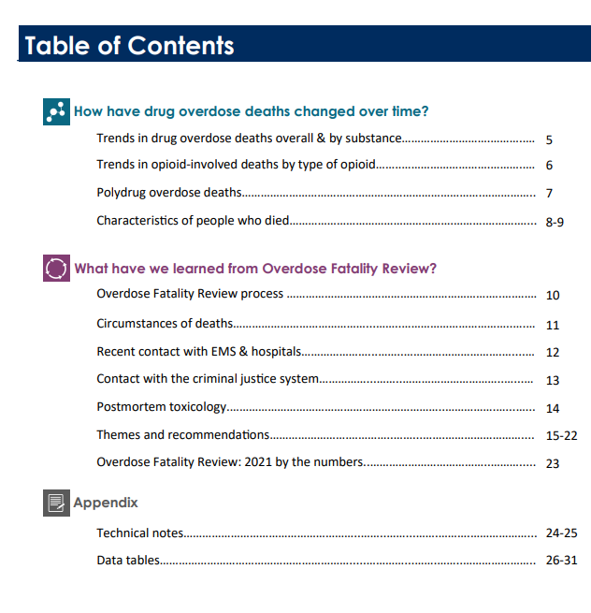
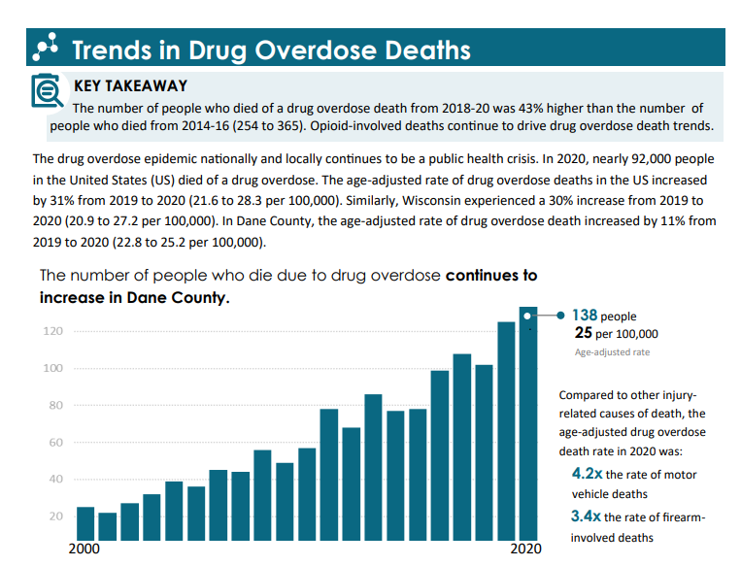
USE COLOR
Notes:
Using color is also helpful. This is particularly useful in longer reports. Here’s a great example of how data sections are color coded in the overdose fatality review report.

Slide 54
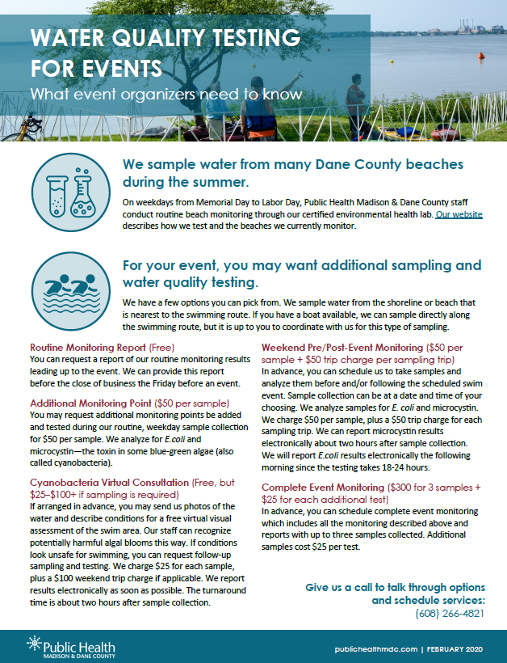
USE ICONS AND PICTURES
Draws in reader
Helps readers tell what this is about
Helps establish tone and emotion
Helps with recall
Adds visual interest
Notes:
Use icons and pictures.
Pictures add visual interest and help give the reader a sense of what this is about and can help establish tone and emotion.
Icons are fantastic because they help make things skimmable too, as well as more memorable. And if your audience might have people with limited English skills, these pictures can help guide them.

Slide 55
Thank you!

