Slide 1
PowerPoint Accessibility Demo

Slide 2
Agenda
Document Properties
Document Structure
Images
Links
Tables
Check Accessibility Tool
Notes:
Now let’s discuss how to make your PowerPoint slide decks accessible. In this section we will be following the exact same path that we did in Word. We will cover…

Slide 3
Document Properties
Environment Setup
Document Title
Language
Built-in Styles (Design)
Color Contrast
Notes:
Just like in Word, we want to start with setting up our environment and document. This will allow us to be efficient and affective from the start.
Let’s begin with Environment Setup. Let’s activate the “View Tab” in the top nav of PowerPoint. Locate and activate the Outline View option at the far-left side of the Ribbon Menu. When you do this you will notice that you are provided with a similar experience to what we had in Word where we see the outline of the presentation.
Next, let’s investigate the Document Title. Let’s locate and activate the File Tab in the Top Navigation. This will now present you with a left navigation area with an several options. Locate and activate the Info control and that pane will open. In the Properties area, update the Title to make more it more appropriate. You can also review the advanced properties here and update as many properties as your administration requires. To return back to your presentation, locate and activate the arrow button. Visually, it is located at the top-left corner of the screen, or at the beginning of the tab order.
Continuing on - let’s evaluate the Language settings for your slide. Let’s Display the slides like normal. Select a slide in the left pane area. At the bottom of the screen below is a place to select the language. You can change it for the slide or for the entire deck.
Lastly let’s discuss layout and spacing. Remember, spacing helps People with Dyslexia and Cognitive disabilities. I like set up my environment every time so I can keep things consistent. I like to start off with guides. Let’s right click in an area of the screen that has nothing in it. In the dialog you will be presented with an option for “Grids and Guides”. Locate and activate the right arrow button, then you can turn on guides if it is unselected, and you can add vertical and horizontal guides to help keep things lined up.
Every element that is multiple lines can be adjusted. Just be sure to do it throughout.

Slide 4
Document Structure and Styles
Headings
Lists
Notes:
Now let’s talk about Document Structure in PowerPoint. Remember headings help provide navigation elements for screen reader users.
Your headings come automatically from the layouts that are applied to your slide. If you delete a heading, then you will need to reapply the layout to bring it back.
As for lists, remember these types of elements help screen reader users understand how many elements are in the list, and what type of list is in use.
List are easy to apply. Select the item on the slide, locate and activate the list button in the Home Tab ribbon.

Slide 5

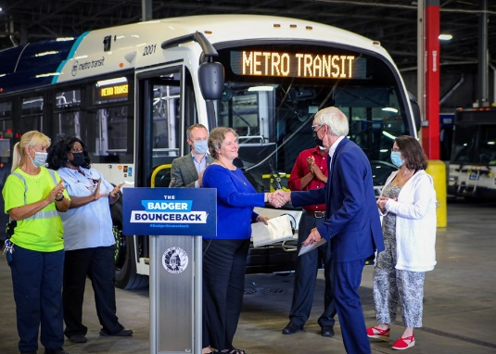
Images
Notes:
Next, let’s revisit images. As before, we want to make sure we are applying our accessibility lessons here in PowerPoint as well. Each image should have alternative text applied, and context of the image matters.
Let’s check the alt text on each of these images. One way to accomplish this is to select the image. Right click on the image, locate and activate the View Alt Text element on the dialog. It will open a pane on the left of your screen. With that image select you can enter alt text for it in the form in the Alt Text pane.

Slide 6
Links
Let’s browse the http://www.google.com website to locate more information.
Or you could go to the Bing website if you are desperate.
Notes:
Now let’s discuss links in PowerPoint. Like we described before, adding the URL here is not supportive of all people. You’ll want to adjust it to read the link description, not the URL.
To perform this action two ways – with the URL and with just the word that you want to become a link. First select the text of the google link. Right click on the word selected, locate and activate the Edit link button in the dialog. This will open a new dialog labelled “Edit Hyperlink”. Enter the proper link text that you want to show on your slide in “Text to display” field. Always check the link and activate the OK button.
Let’s do it again and change the link to be on the words Bing website. Select those words and perform the same steps. Now you will need the link in the Address field to be entered.

Slide 7
Tables
Date | Event | Venue
12 February | Waltz with Strauss | Main Hall
24 March | The Obelisks | West Wing
14 April | The What | Main Hall
Notes:
Alright, we are back to tables. Remember, tables are complex to navigate and we can support screen reader users by turning on a few out of the box features in PowerPoint.
Let’s select the table and find Table Design in the Top Navigation Tabs. Select the Header Row and First Column in the Table style options area.

Slide 8
Check Accessibility Tool
Locate the tool under the Review Tab.
Run the tool
Fix Alt Text
Check and fix reading order
Check for hard to read contrast
Provide table headers

