Slide 1


Supervisor Orientation Learner Workbook
Page 1 of 8

Slide 2
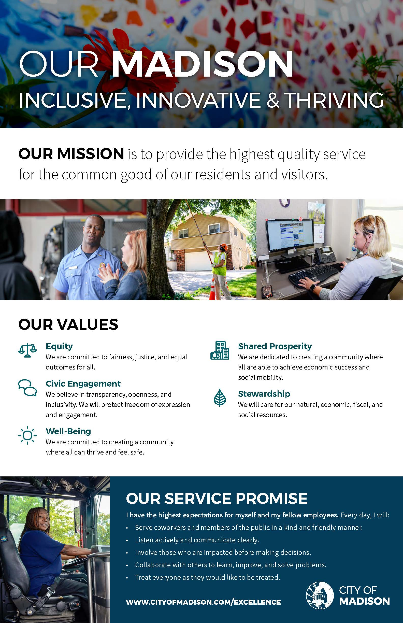
Page 2 of 8

Slide 3





From Values to Action Learner Activity
How can we imagine the City of Madison’s Values guiding our daily work? What might these values look, sound, and/or feel like for you in your new role? If you need guidance, read through the list of questions beneath each value below – consider your position description and what efforts you might be working on in your new role.
Equity: We are committed to fairness, justice, and equal outcomes for all.
How will you consider who will benefit or burden from the service you provide to our community?
How will you involve those who stand to be impacted by your decisions?
Consider the privileges you bring to the table, and who else may need to be represented?
Example: Equity looks like considering all in your decision making, including those who are different from you.
Notes:
Civic Engagement: We believe in transparency, openness, and inclusivity. We will protect freedom of expression and engagement.
How will you ensure you include stakeholder engagement and public participation?
In what ways will you hold yourself accountable to taking action on stakeholder input?
Name 3-5 ways you could report out to stakeholders (internal and external)?
Notes:
Well-Being: We are committed to creating a community where all can thrive and feel safe.
What does it look like, sound like, and feel like to commit to your wellbeing in the workplace?
In what ways can you imagine contributing to a safe work environment for all?
Notes:
Shared Prosperity: We are dedicated to creating a community where all are able to achieve economic success and social mobility.
How will you know if anyone in our community is better off as a result of the service you provide?
In what ways can you tell the story of how your service impacted folks in the community? Consider qualitative and quantitative information.
Notes:
Stewardship: We will care about our natural, economic, fiscal, and social resources.
How can you imagine doing your job in the most sustainable way?
How will you hold yourself accountable to stay on track – both in time and budget – for the service you provide?
Notes:
Page 3 of 8

Slide 4
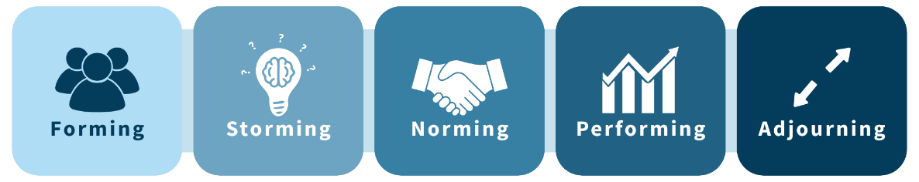
Team Development Toolkit: Forming
Definition | The team meets and learns about the challenges and opportunities and agrees on goals and processes. The team members behave independently. The team gets to know one another and starts to establish working patterns.
Current State & Future Stage Goals | Build relationships, establish clarity, and set expectations.
Looks, Sounds, Feels Like | Anxiety Politeness Slower productivity Many questions Messy | Impatient Excitement Eagerness Cautious
Tips | Create a space where people feel safe to be themselves and don’t have to worry about without judgement. Facilitate exercises that can help the team get to know each other, clarify roles and expectations and build relationships that will help the team succeed.
Actions by Stage | Team Meeting Agenda Template Use this to facilitate your team discussions and increase meeting effectiveness. Create Team Agreements DISC, MBTI, StrengthsFinder Learn and appreciate your own strengths and how to help the team.
Notes

Slide 5
Team Development Toolkit: Storming
Definition | Interpersonal conflicts can arise as the team grows accustomed to how everyone works. Members start to communicate feelings but still view themselves as individuals rather than part of the team. They may resist control by group leaders.
Current State & Future Stage Goals | Navigate conflict, improve communication, and build trust.
Looks, Sounds, Feels Like | Conflict Competition Disagreements Frustration Tension | Doubt Arguments Power struggles Gossip
Tips | Agree on how to handle conflict productively as a team, focusing on the problem and not the person. Surface issues, create solutions and learn from different ways of doing things. Accept personal differences in working style as part of being in a team.
Actions by Stage | Team Agreements Anchor to the team agreements you completed in the Forming Stage to surface and resolve issues completely and quickly. Remind team members by keeping the agreement visible. 15-Minute Team Huddle Guide Participate in and/or conduct a weekly team huddle to align on progress and blockers. Participate in Employee Check-Ins Raise challenges and celebrate wins not only with your supervisor, but also your team! Work Culture Discussion Guide Remember to connect teams around public service common goals.
Notes

Slide 6
Team Development Toolkit: Norming
Definition | The team begins to settle into a productive workflow and the new normal is established. Teams learn to work together without constant conflict. Members begin to grow closer. Trust and comfort develop.
Current State & Future Stage Goals | Strengthen teamwork, refine processes, and boost engagement.
Looks, Sounds, Feels Like | Resolve conflicts Trust Collaboration & cooperation | Effective Developing respect Goal clarity
Tips | Define priorities and refine work processes so the group can do their best work. Give space to grow and work on what most excites them. Facilitate 1:1s to develop and empower your team members Engage in thoughtful group discussion around priorities and tasks.
Actions by Stage | Project Charter Template Minimize misunderstandings and increase your team’s success. Standard Operating Procedures SOPs Use & update SOPs for your work unit. Individual Work Plans For each team member; those plans will strengthen and inform the Team Work Plans in the next stage. Customer Service Framework Center the team around to the Customer Service Framework approach to customer service—to each other and the city.
Notes

Slide 7
Team Development Toolkit: Performing
Definition | Conflicts have been resolved, processes are in place, and the team is working at peak performance. The team works in a trusting atmosphere where flexibility is key and hierarchy matters very little.
Current State & Future Stage Goals | Sustain high performance, optimize workflows, and encourage growth.
Looks, Sounds, Feels Like | Peak Performance Collaboration Toward Common Goals High Productivity | Achievements Independence within the Team
Tips | Empower members to do work that engages them individually as well as a group. Remember that a group is strengthened as its individual members do more of what matters to them and are engaged in creating the change they want to see.
Actions by Stage | Team Work Plans & Agency Work Plans Use these to set and achieve interdependent goals. Set goals and keep track of key metrics in your agency. Plan, Do, Check, Act (PDCA) cycle Keep growing and stretching as a team with Continuous Improvement. Eisenhower Box Optimize your team performance by prioritizing work.
Notes

Slide 8
Team Development Toolkit: Adjourning
Definition | The project or team ends, or a member exits, and the group is disbanded or returns to the forming stage as new members join.
Current State & Future Stage Goals | Celebrate team accomplishments and individual transitions.
Looks, Sounds, Feels Like | Fulfillment Sadness Grief or loss | Gratitude Recognition Closure
Tips | Ensure everyone is well positioned for whatever they do next. Share learning points through reflection and then document them effectively.
Actions by Stage | Plan and host an inclusive celebration acknowledging team and individual contributions. M365 Viva Insights: Boosting Recognition & Wellbeing at Work
Notes

Slide 9
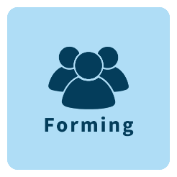




Self-Assessment
Team Stages | Team Behaviors | I agree | I disagree
 | Team members are still getting to know each other.
 | We rely heavily on a leader to provide direction and structure.
 | Goals and roles within the team are not yet fully clear.
 | We avoid conflict and focus on being polite.
 | Decision making is slow as we are unsure of processes.
Totals:
 | Disagreements or personal conflict often arise within the team.
 | Team members challenge authority or question leadership decisions.
 | There is competition or tension regarding roles and responsibilities.
 | Miscommunication or frustration is common.
 | The team sometimes struggles with trust and cohesion.
Totals:
 | Team members collaborate effectively and support one another.
 | Roles and responsibilities are clearly defined and accepted.
 | Conflicts are resolved constructively without major disruption.
 | There is a growing sense of trust and team spirit.
 | Team members are open to feedback and willing to improve.
Totals:
 | The team operates efficiently with minimal supervision.
 | We consistently achieve or exceed our goals.
 | Each members feels valued and contributes to the team’s success.
 | We adapt easily to challenges and problem-solve effectively.
 | There is a strong sense of trust, respect, and shared purpose.
Totals:
 | Team members are focused on wrapping up tasks, documenting outcomes, or handing off responsibilities.
 | Team members are beginning to disengage or reflect on their experience together.
 | Discussions have shifted toward recognition, closure, or next steps beyond the current team.
 | There is a sense of accomplishment, loss, or transition as the team disbands.
Totals:

Slide 10



Employee Experience
Notes:
Relationship Building
Get to know your team
Be accessible
Lead by example
Recognize and appreciate
Transparent communication
Communication Practices
Written
Verbal
Decision-Making
Team Dynamics
Schedules
Group Agreements
Expectations
Clarity
Alignment
Engagement
Trust
Satisfaction
Retention
Page 5 of 8

Slide 11
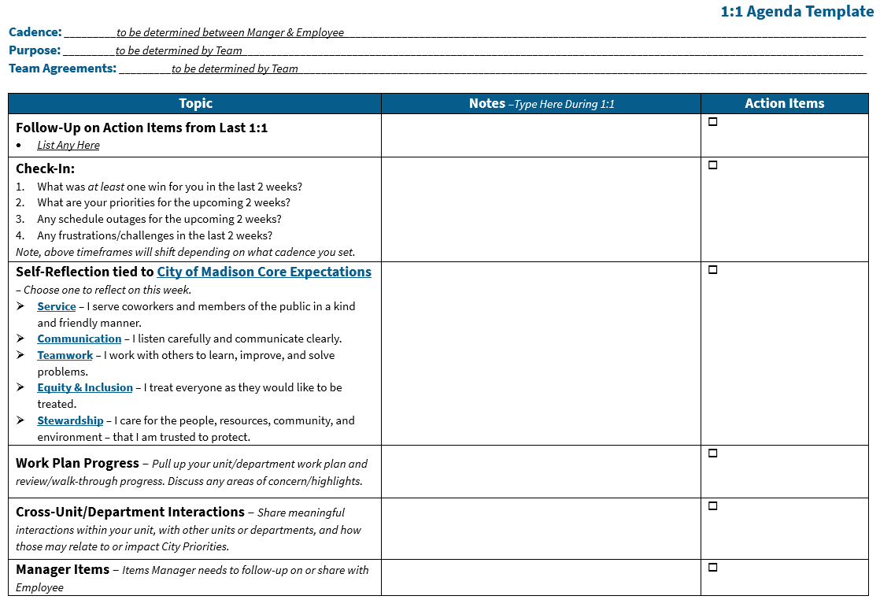

Employee Experience (continued)
1:1 Agenda Template
Notes:
Notes:
Learning & Development
Prioritize your development
Support your team’s development
On-the-job learning
Continuous improvement
Page 6 of 8

Slide 12


Resources & Support
Utilize this table to locate additional information and resources shared with you in your Supervisor Orientation session. The slide number column coincides with the deck you’ll receive after attending orientation.
Category | Topic Title (hyperlinked) | Category | Topic Title (hyperlinked)
Supervisory | Supervisor Resources – Main Page | Learning & Development | Individual Development Plan
Employee & Labor Relations | Employee & Labor Relations |  | Mandatory Supervisor Courses
 | Employee Accommodations | P.E. | Performance Excellence
 | Trauma-Informed Supervision | Performance Management | Performance Management
 | Leave Administration |  | Employee Check-In Process
 | Drug & Alcohol Testing |  | Setting Expectations and Goals
 | Paperless Drug Testing Process |  | Position Descriptions
 | Misconduct Investigations |  | Reclassification Process
 | Disciplinary Process | Policies & Procedures | Policies & Procedures
 | Supervising Represented Employees |  | Administrative Procedure Memoranda (APM)
 | Grievance Process |  | Affinity Groups & Guidelines
EAP | Employee Assistance Program |  | Equity & Inclusion Resources and Tools
Hiring | Hiring |  | Hiring & Onboarding
 | Welcome & Onboarding New Employees |  | Payroll Clerk Resources
General | Organizational Development Toolkit
 | Affinity & Identity-Based Croups
 | Day One Employee Orientation Resource Links Document
Additional Supervisor Development Resources | Ask A Manager - Website and Podcast
 | From Values to Action by Harry Kraemer Jr.
 | The First 90 Days by Michael Watkins
 | “The Inclusive Enterprise” with Brian and Charlotte Hughes
Page 7 of 8

Slide 13
Frequent City Contacts
IT Department
IT Help Desk: 608-266-4193
IT Service Center: https://cityofmadison.teamdynamix.com/TDClient/2427/Portal/Home/
Employee Assistance Program
Internal Phone Number: 608-266-6561
External Phone Number: 1-800-236-7905
Email: eap@cityofmadison.com
Central Payroll
Payroll Number: Call the HR main number and they will transfer you.
Payroll Fax: 608-261-4241
Email: payroll@cityofmadison.com
Finance Department
Main Number: 608-266-4671
Human Resources Department
Main Number: 608-266-4615
Fax Number: 608-267-1115
Email: HR@cityofmadison.com
Benefits:
Benefits: Call the HR main number and they will transfer you.
Benefits Email: Benefits@cityofmadison.com
Employee Handbooks and Labor Relations: Call the HR main number and they will transfer you.
Family Medical Leave Act (FMLA): FMLA@cityofmadison.com
Accommodations & Access: Accommodations@cityofmadison.com
Organizational Development: OrganizationalDevelopment@cityofmadison.com
Page 8 of 8

