Slide 1



Welcome to Supervisor Orientation
1. Please rename yourself on Zoom
    Name
    Agency
    Pronouns
2. Answer our check-in question in the chat:
“If you had a time machine, where would you go?”

Slide 2







Tech
Check
Rename Yourself
  Participants > Hoover over your name > 3 dots > Rename. Type your Name, Pronouns, and Department.
Mic & Video Test
  Select the microphone button to unmute yourself & say hello! Select the video button to go on/off camera.
Locate the Chat Feature
  Select the three dots > Chat to open up the chat box.
Raise Hand or Use Reactions
  Select the three dots > Reactions > Raise Hand to raise your hand.
Turn on Closed Captioning
  Select Show Captions button, select your preferred language, click Save.
Turn off your VPN
Grab a Copy of the Learner Workbook / Handouts
  Found in Chat from your facilitator!
Disruption? Try logging out and logging back in again.

Slide 3
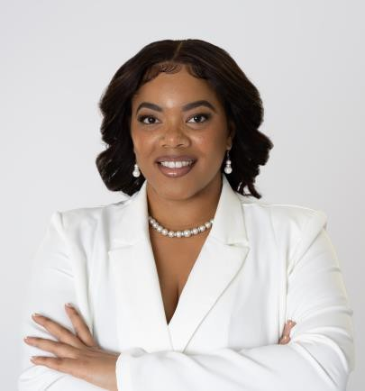




Jay Winston, M.S.
(She/her/hers)
Badger Alumna
World Traveler
Thalassophile
Foodie

Slide 4

Group Agreements
Be Present
Take Space
Make Space
Take Notes
Be Curious
Ask Questions
Additions?

Slide 5
Supervisor Orientation

Slide 6
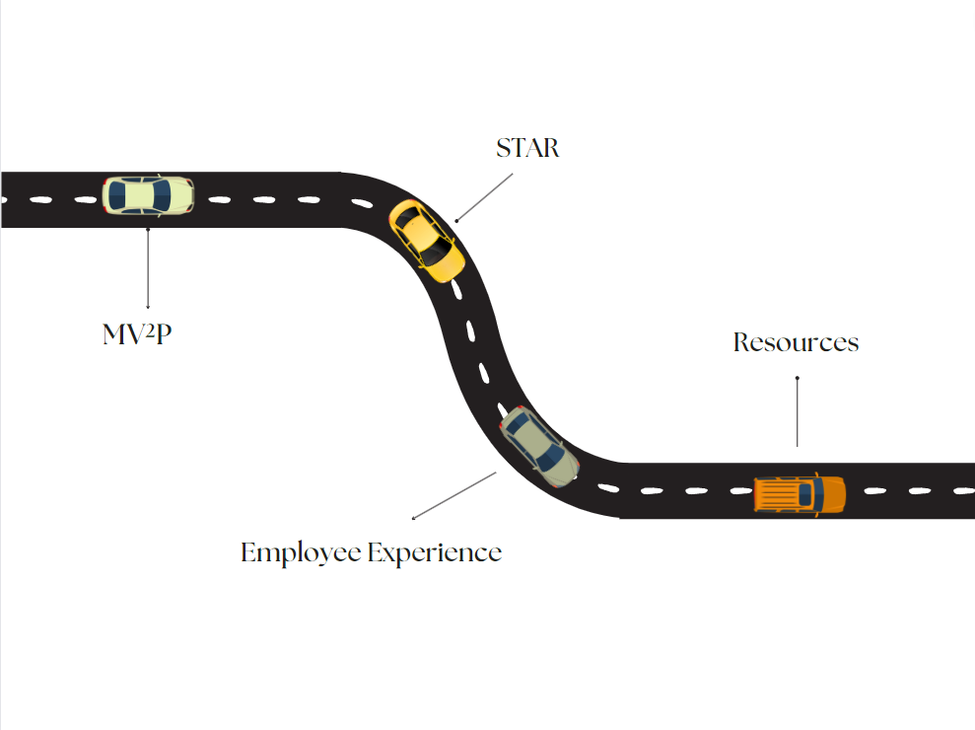
Team Development & Self-Assessment
MV^2P
Resources & Support
Employee Experience

Slide 7
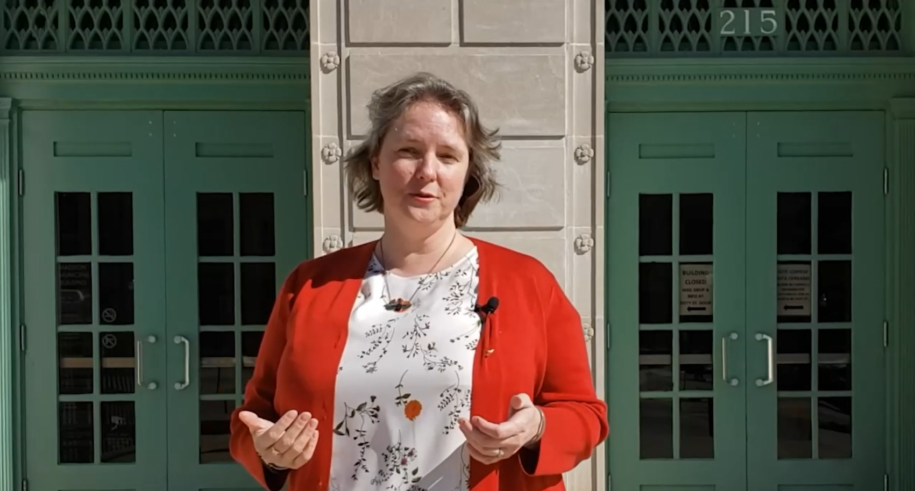

Welcome Video from the Mayor
Notes:
Shortened Video Link: https://media.cityofmadison.com/Mediasite/Play/421b918030c54dcb96560cacddc237f11d

Slide 8


Our Mission

Slide 9
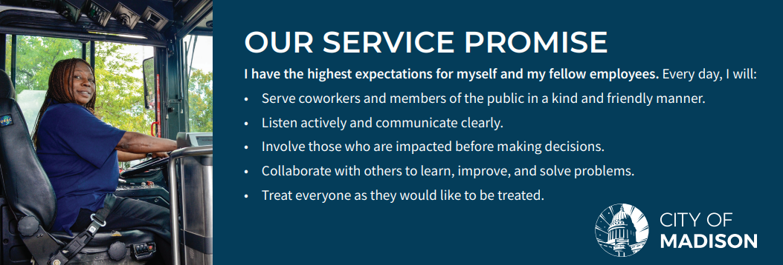
Our Service Promise

Slide 10
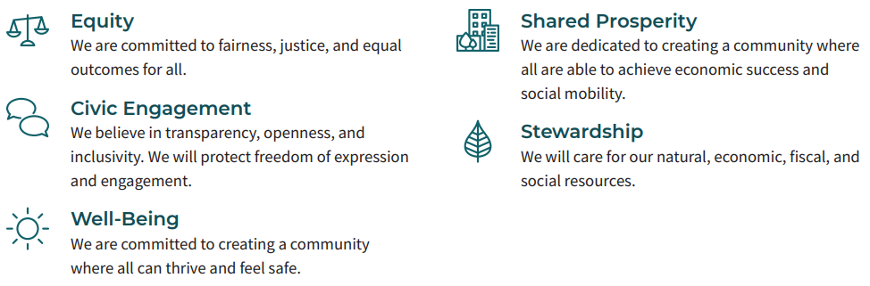
Our Values

Slide 11
Breakout Activity

Slide 12
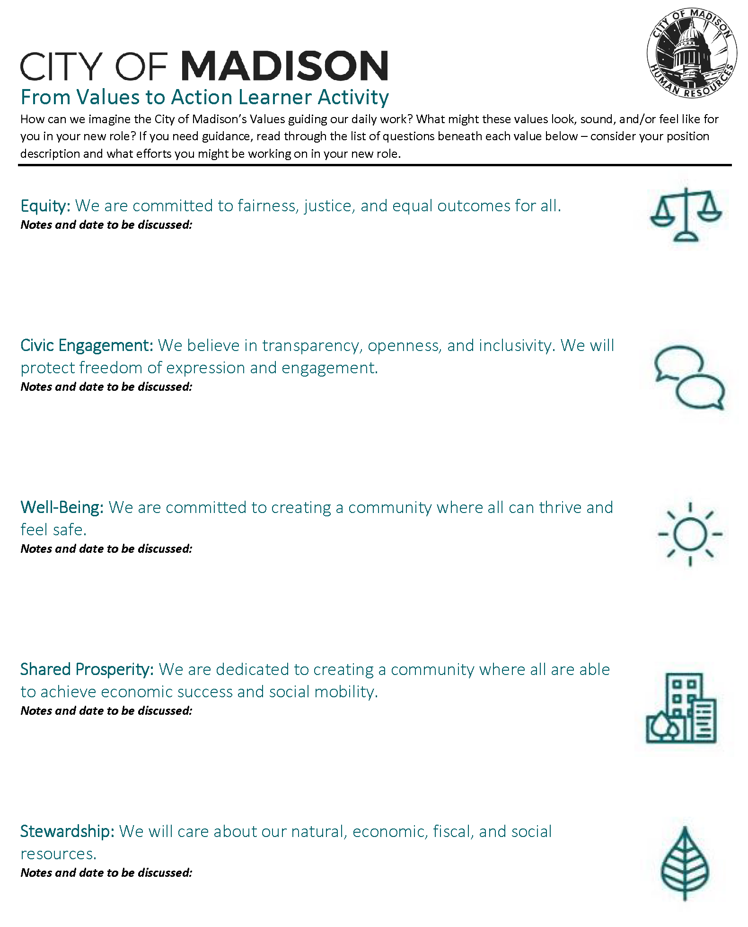
From Values → Action

Slide 13
Share Out

Slide 14
Team Development

Slide 15
What is a Team?
A team is defined as a group of people who perform interdependent tasks to work toward accomplishing a common mission or specific objective.*
*ASQ – American Society of Quality

Slide 16
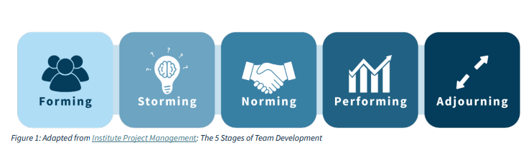
5 Stages of Team Development

Slide 17
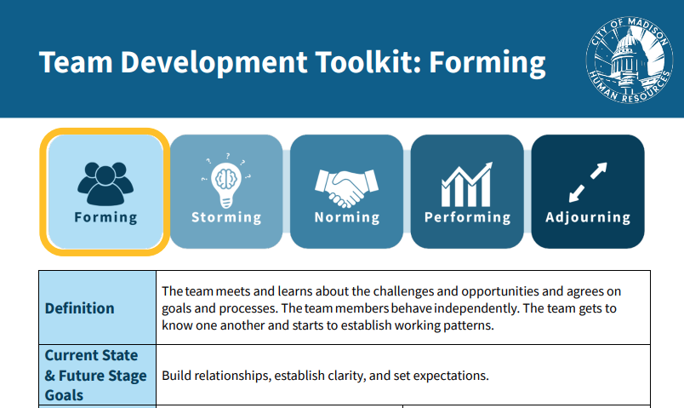
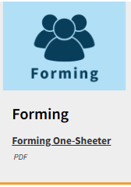
Team Stage: Forming

Slide 18
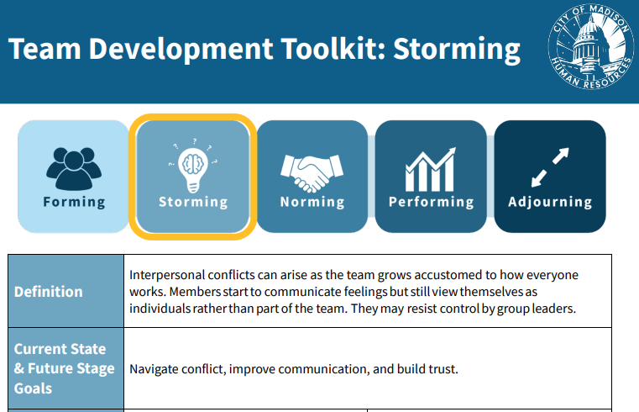

Team Stage: Storming

Slide 19
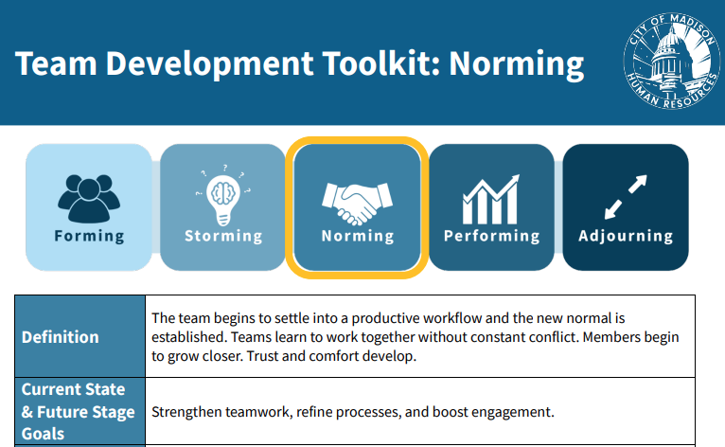
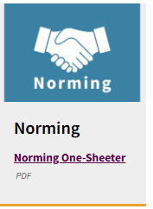
Team Stage: Norming

Slide 20
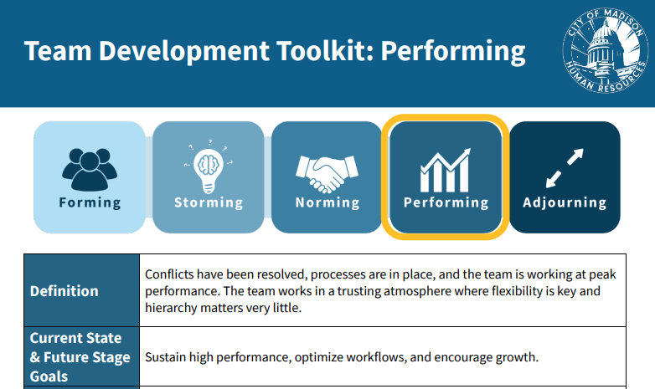
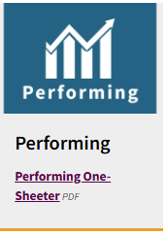
Team Stage: Performing

Slide 21
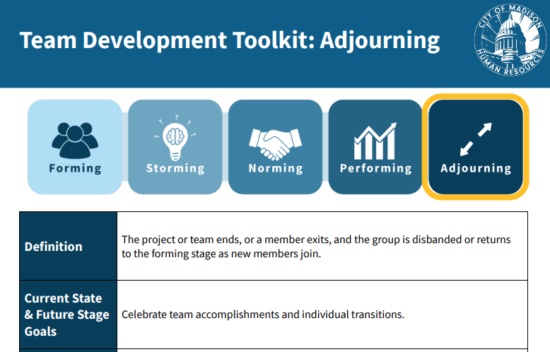
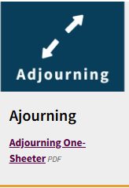
Team Stage: Adjourning

Slide 22
Self-Assessment

Slide 23
Team Stage Self Assessment
Add snapshot of assessment on this page

Slide 24
Break-Out Discussion

Slide 25
Stage Breakout Discussions
Individually complete steps 1 - 3.
  Locate your stage in your workbook.
  For more details, reference the Team Stage Development Toolkit.
  Read and decide at least one strategy you’ll use to advance the team’s performance.
As a Break Out Group, each person shares their scenario and strategy in approximately 3-5 minutes.
  Listen to each other’s ideas and provide encouragement or advice on what they might try.
  Rotate through everyone.
  Wait for the facilitator to stop into your room or to call you back.

Slide 26
Breakout Wrap-Up

Slide 27
Your Homework Leaving Supervisor Orientation
In your next team meeting, introduce the Stages of Team Development.
Contact organizationaldevelopment@cityofmadison.com for a Team Development Stage Assessment customized for your Team.
As part of your Individual Development Plan, IDP, share your findings and goals with your leader.
Contact me with any questions.

Slide 28
STARS- Situational Analysis
Notes:
https://www.cityofmadison.com/human-resources/documents/STARS_Framework.pdf

Slide 29
What’s the Situation?
S
Start-Up
T
Turnaround
A
Accelerating Growth
R
Realignment
S
Sustaining Success

Slide 30
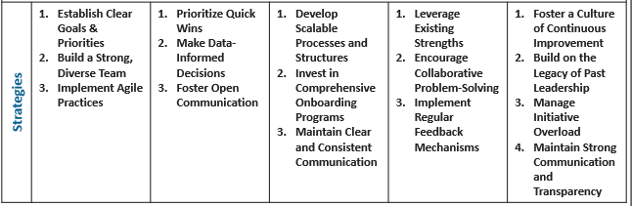
STARS Strategies
Start Up
Turnaround
Accelerating Growth
Realignment
Sustaining Success

Slide 31
Break-Out Discussion

Slide 32
Employee Experience

Slide 33

Relationship Building
Get to know your team
Be accessible
Lead by example
Recognize and appreciate
Transparent communication

Slide 34
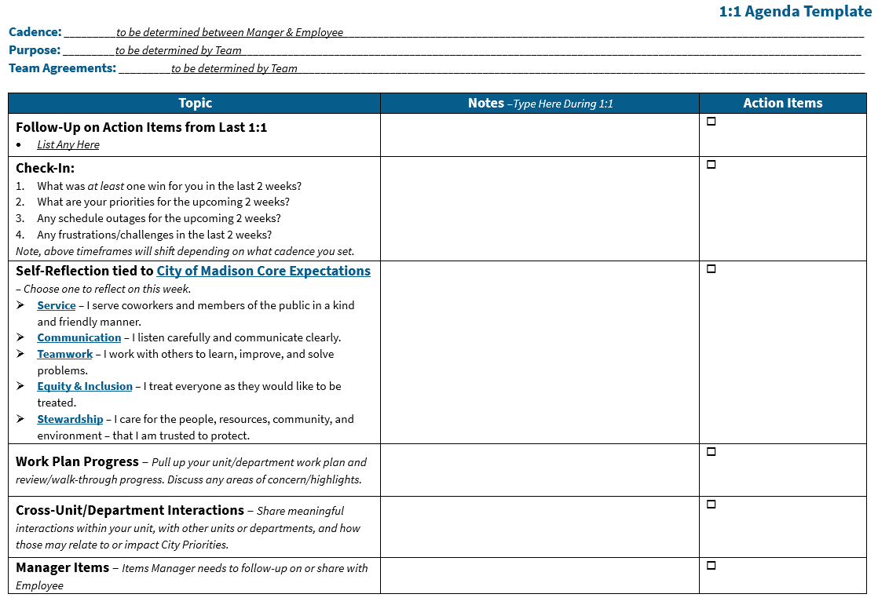
Employee Experience

Slide 35

Communication Practices
Written
Verbal
Decision-Making
Team Dynamics
Schedules
Group Agreements

Slide 36


Acknowledge & Validate

Slide 37


  Possible Approaches for Acknowledging
What you’re saying is…
Let me see if I get this…
I’m hearing you say…
Let me give that back to you so we can make sure I got it.
In other words…

Slide 38

  Possible Approaches for Validating
You have every right to feel “X” because…
That’s perfectly natural (normal). It can be very upsetting when “X” happens.
It’s understandable that you feel [feeling/emotion] because/given…

Slide 39

  Putting it All Together
You feel you’ve been hurt and you’re angry (Acknowledging), no wonder you are feeling resentment (Validating).

Slide 40

Expectations
Clarity
Alignment
Engagement
Trust
Satisfaction
Retention

Slide 41

Learning & Development
Prioritize your development
Support your team’s development
On-the-job learning
Continuous improvement

Slide 42

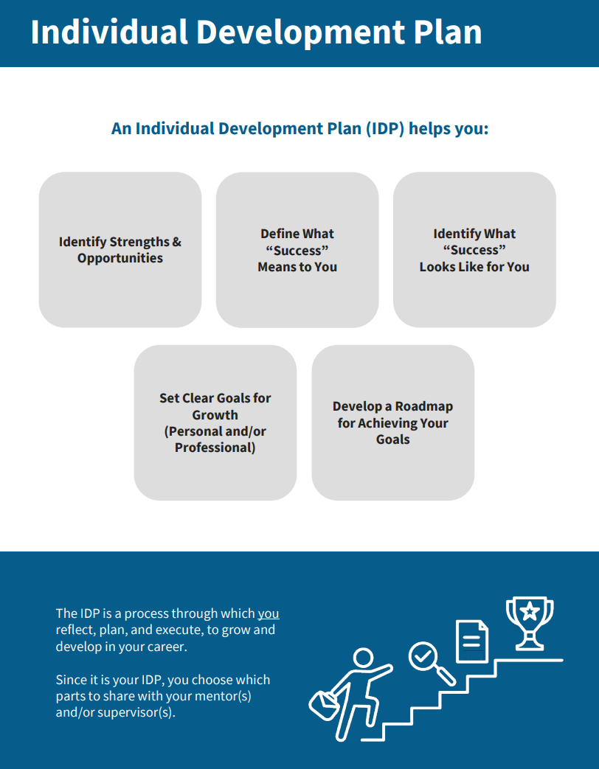
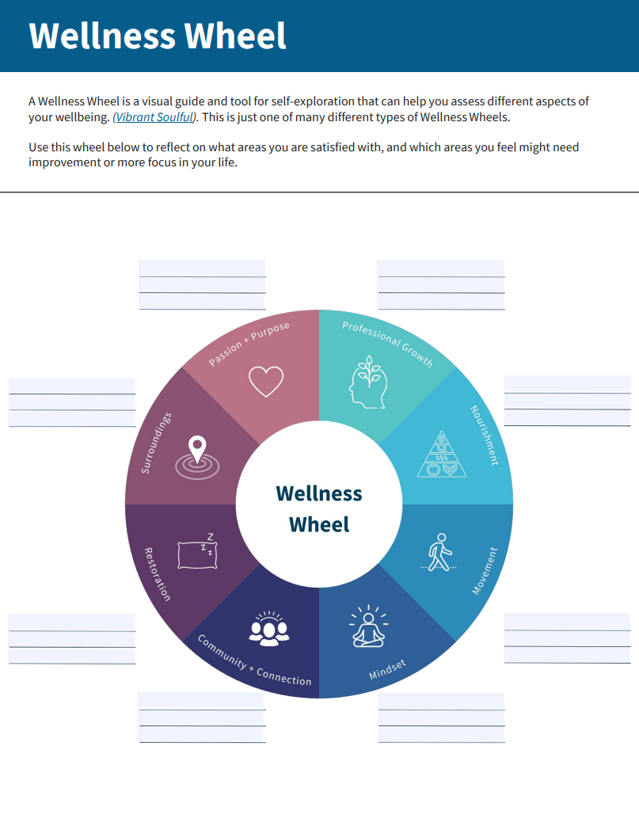
Learning & Development

Slide 43
Resources & Support

Slide 44
Wrap Up

Slide 45
Recap
Lead with your values
Prioritize relationships
Clearly communicate expectations
Own your development

Slide 46
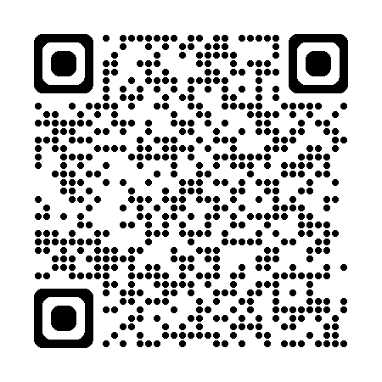

We Want Your Feedback!
Notes:
https://www.surveymonkey.com/r/2025LeadershipCourseFeedback

