Slide 1
E. Mifflin Bicycle Boulevard Improvements
City of Madison Traffic Engineering
Transportation Commission Presentation – 12/11/2024

Slide 2
E. Mifflin Bicycle Boulevard Improvements
$125,000 Improvement Budget
Toole Design: Review of potential improvements
Public Information Meeting Held on 6/3/2024
Project Website created with Link to Survey
  https://www.cityofmadison.com/traffic-engineering/traffic-safety/safe-streets-madison/safe-streets-projects/e-mifflin-bicycle

Slide 3
E. Mifflin/N. Paterson Diverter Test
Timeline
  Before Data Collected (9/6/2024 – 9/23/2024)
  Diverter Test Installed on 10/14/2024
  Diverter Test Data Collected (10/18/2024 – 11/5/2024)
  Diverter Test Removed for Winter (12/2/2024)

Slide 4
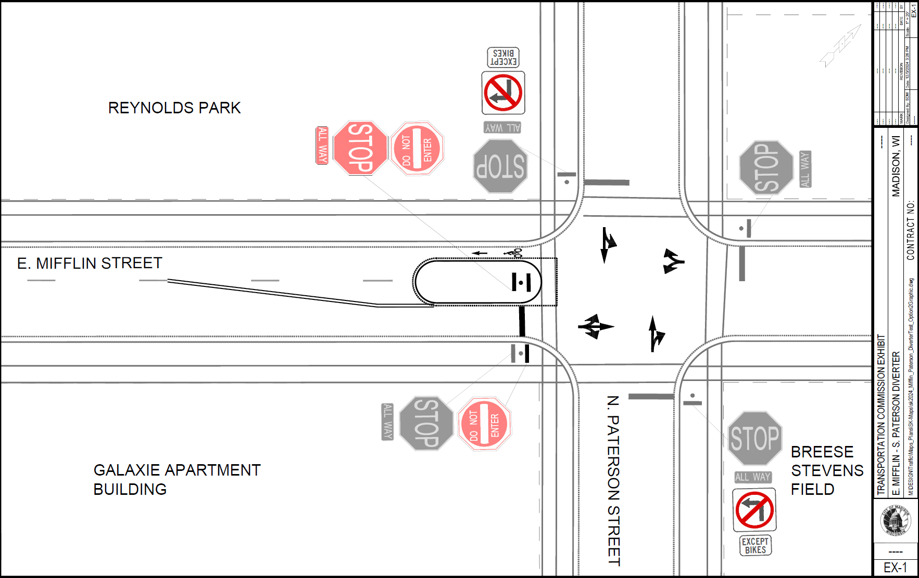
E. Mifflin/N. Paterson Diverter Test

Slide 5
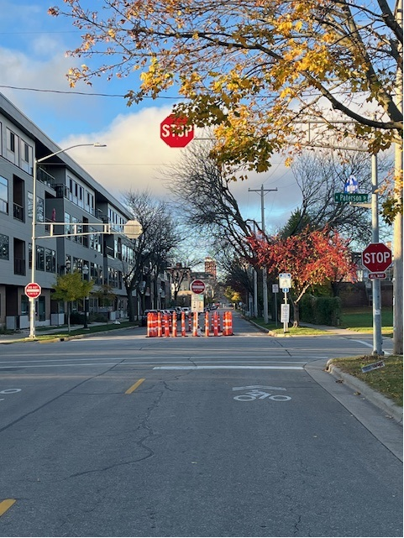
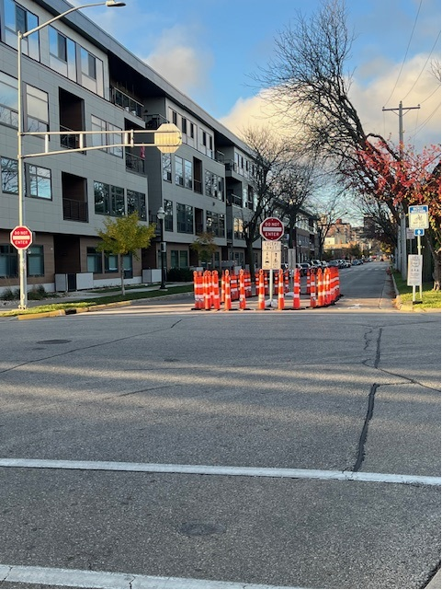
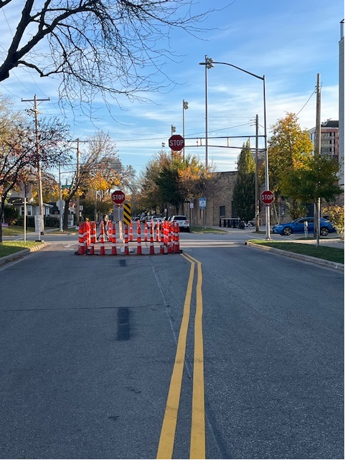
E. Mifflin/N. Paterson Diverter Test

Slide 6
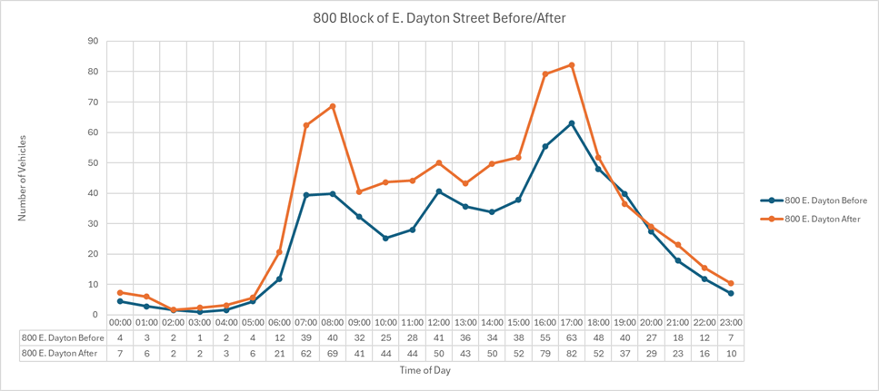
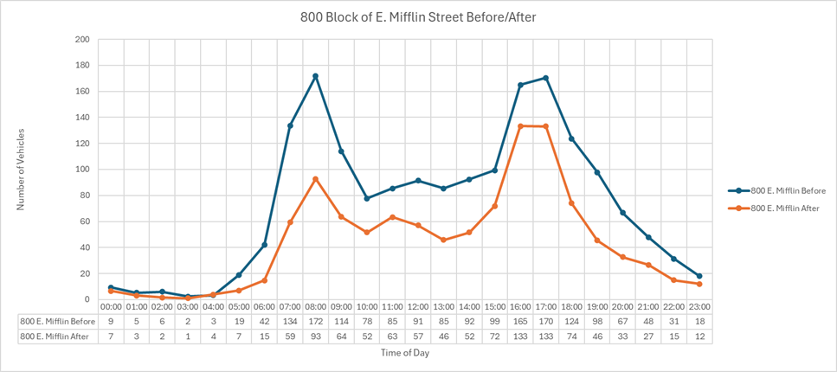
Before/After Data

Slide 7
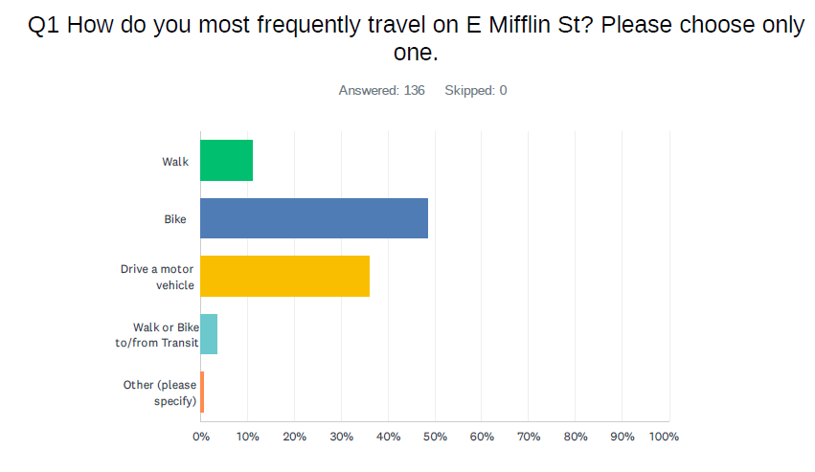
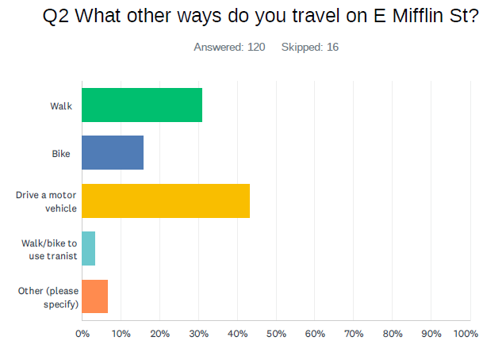
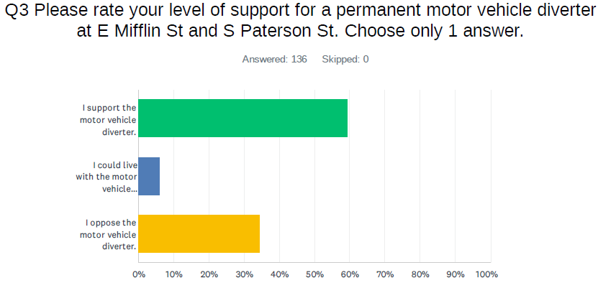
Survey Results

Slide 8
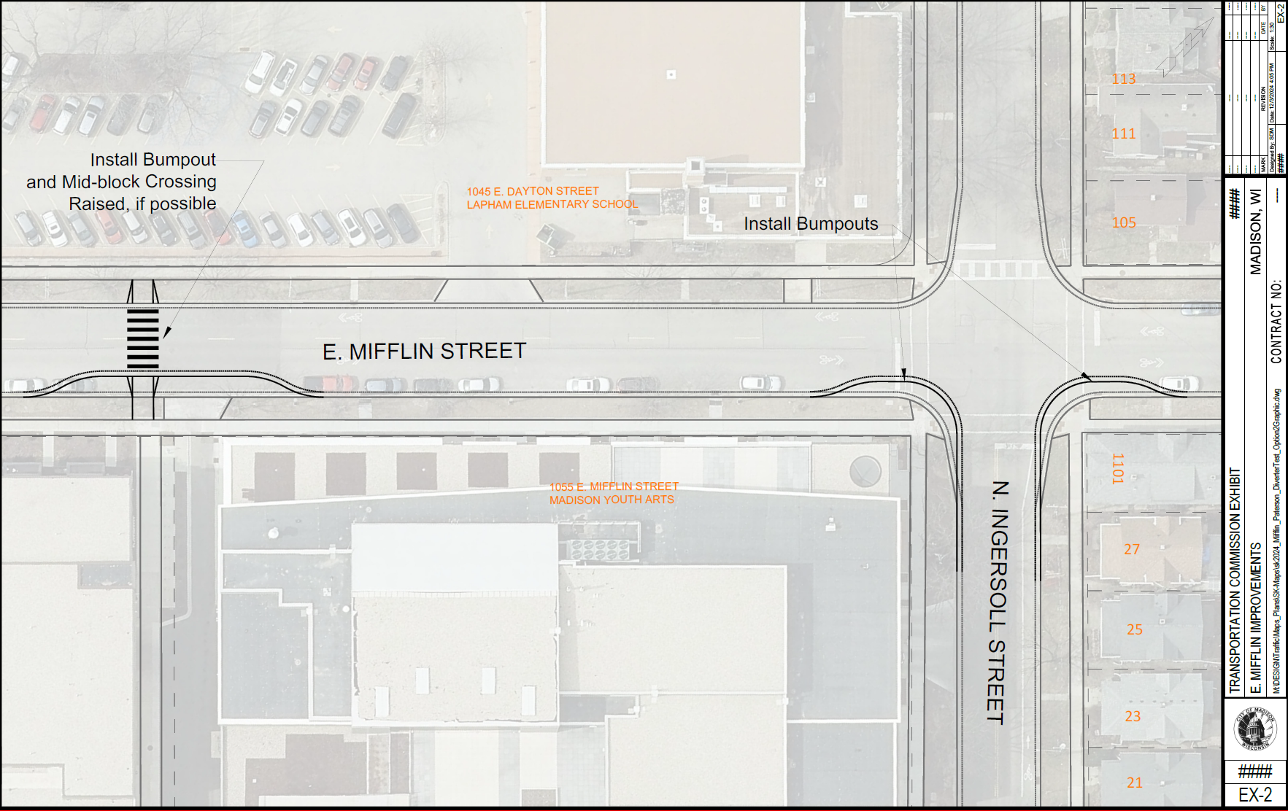
Other Recommended Improvements

Slide 9
Other Recommended Improvements
Add Bicycle Wayfinding signage
Add stop sign on Dickinson at E Mifflin
Review E Mifflin at Brearly for stop sign

