Slide 1

Public Information Meeting
City of Madison Transportation Division
October 22nd, 2025
6:00 PM
Perry St Connection
-Planning Study

Slide 2
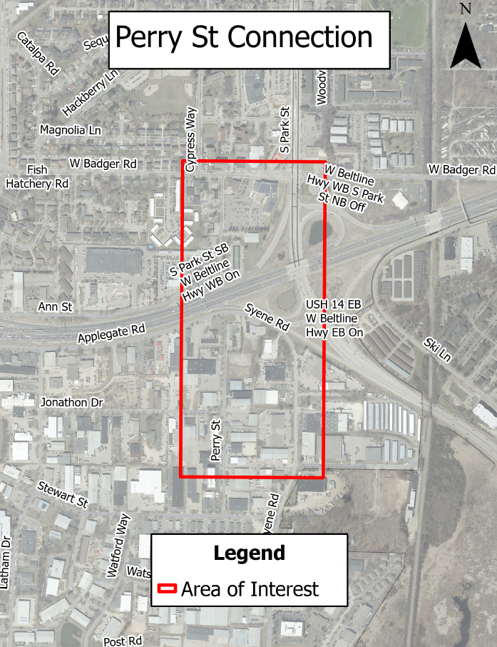
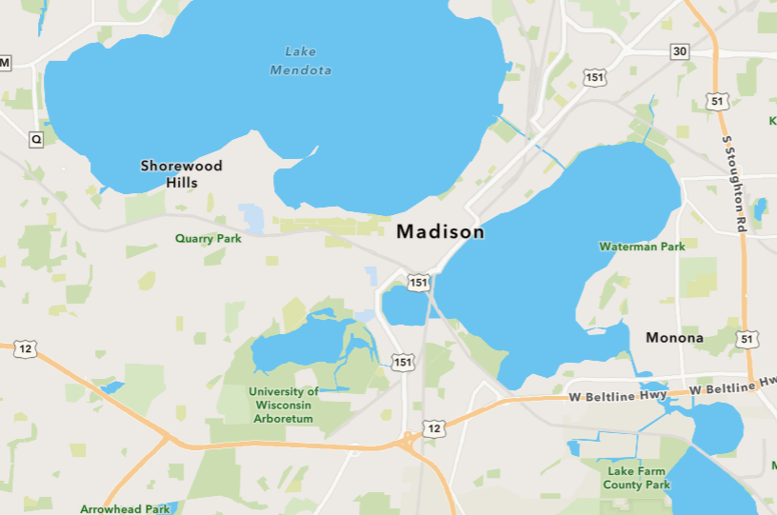
Area of interest location

Slide 3
Study Purpose
Explore ways to better connect neighborhoods on the north and south of the Beltline (US 12/18)
Improve travel for people going to homes, businesses, and other amenities making it safer and easier for multi-modal access
This connection was identified in the 2022 South Madison Area Plan

Slide 4









Study Development Process
Meeting Purpose (Big Picture)
  Staff presents to Board of Public Works
  Staff presents to Transportation Commission
  Consultant Selected / Study Start
  Final Reports
WE ARE HERE
  First Public
  Involvement Meeting
  Second Public
  Involvement Meeting
  Future Steps
  Gather team, data, and existing conditions
  Design options developed based on data and public feedback
  Design further developed and refined

Slide 5
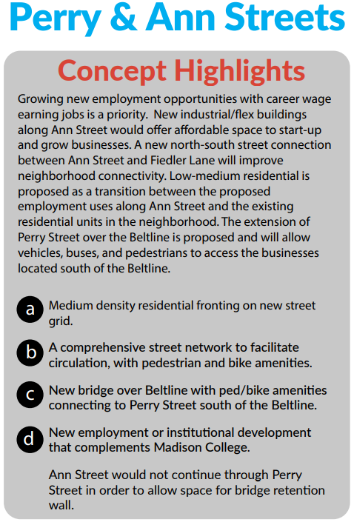
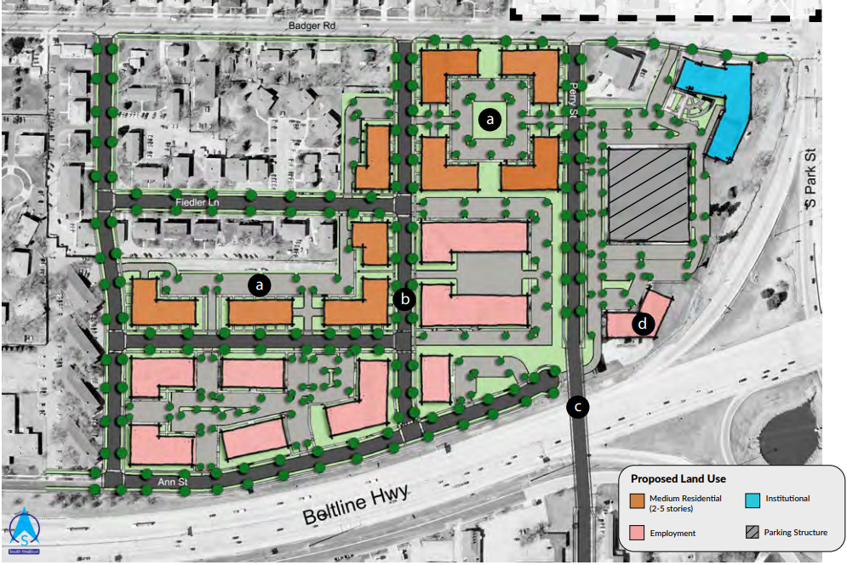
South Madison Area Plan
Initial Concept
Page 45 of South Madison Area Plan
https://www.cityofmadison.com/dpced/planning/documents/SMP_Plan_PDF_Version_FINAL.pdf

Slide 6
Study Scope
Identify Design Alternatives
  Data Collection
  Gain public feedback
  Identify Alternatives and Feasibility
  Report Findings
Overall Goal
  Study to be complete by summer 2026
  60% Design
    An overpass/underpass design that has gone through project partners opinion’s, design staff, and the City’s approval system
  Apply for Implementation Grant for construction opportunity

Slide 7
Meeting Purpose
Hear thoughts and feedback about the study
Understand your concerns about transportation in this area
Learn how you get around in this area
Use your input to develop street design for future meetings
Remind you to fill out the survey

Slide 8
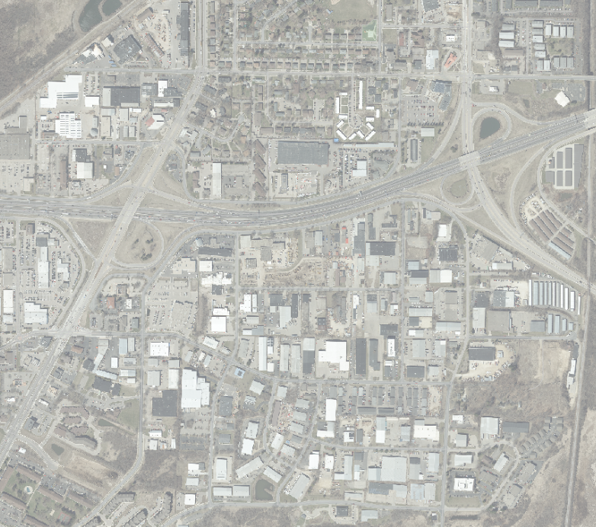
Why This Area?
Park St
Badger Rd
Connectivity and Access
  Only one way into the area southside through Greenway Cross
One Way Direction Currently
Proposed Connection
Beltline (US 12/18)
Perry St
Fish Hatchery Rd
Greenway Cross

Slide 9
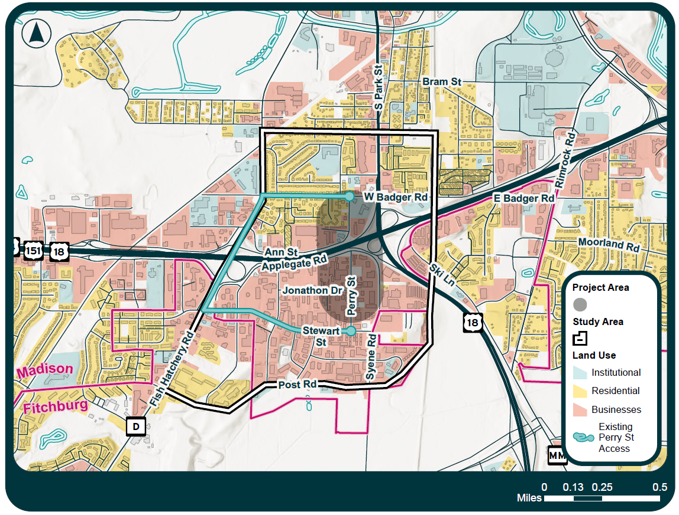
Area Needs
Getting more access to jobs
  2873 households in the study area
  1886 (65%) households are located north of the beltline
  5040 jobs in the study area
  3669 (72%) are located south of the beltline

Slide 10
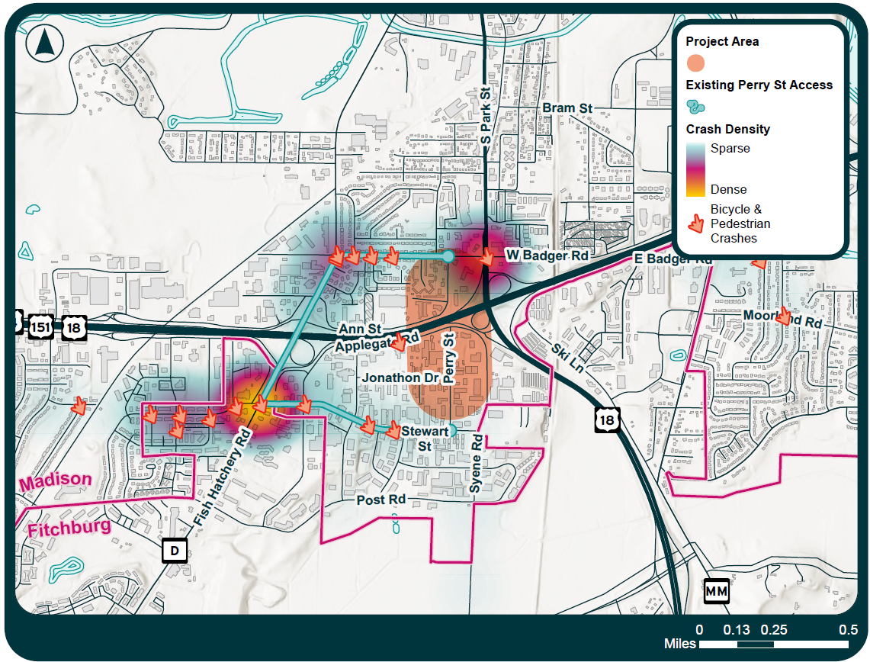
Area Needs
If you were to travel (Currently)
  Would need to go through Badger Rd through Fish Hatchery Rd to access the southern area
  Safety would be a concern traveling through high crash density areas

Slide 11
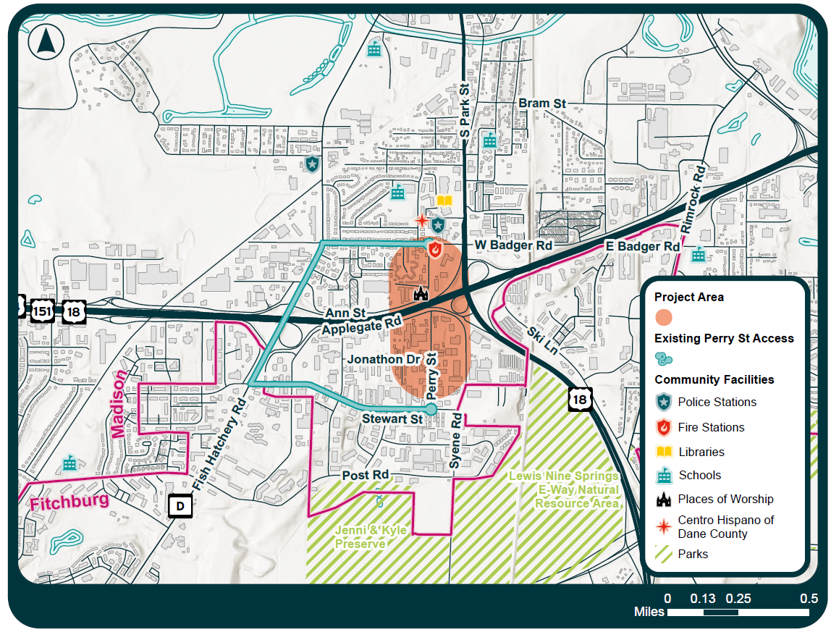
Area Needs
If an emergency would occur (Currently)
  Would need to go through Badger Rd through Fish Hatchery Rd to access the southern area
  A direct connection would provide a direct route to the area providing faster emergency routing

Slide 12
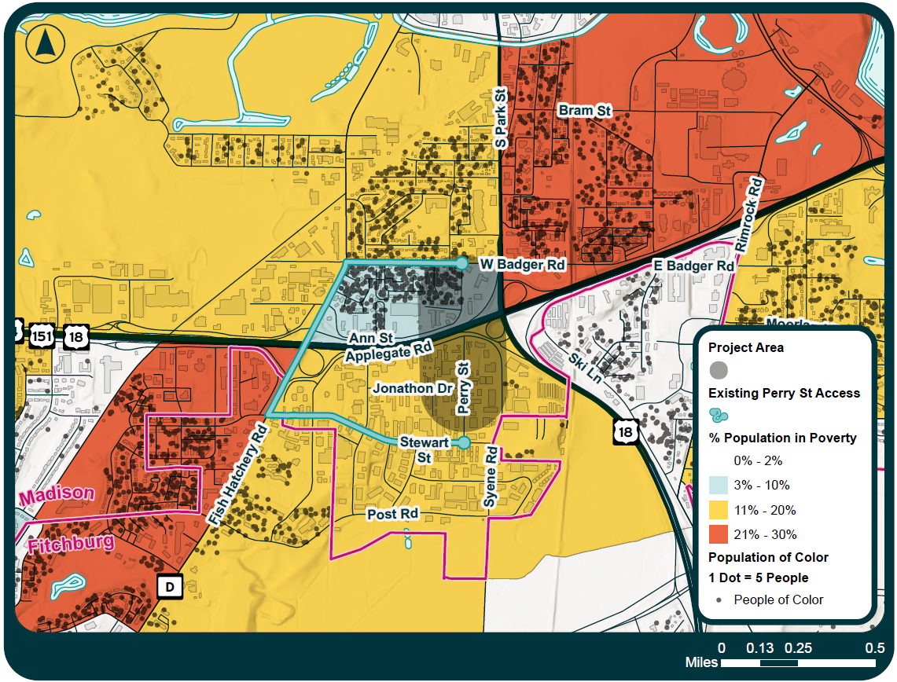
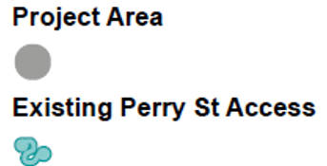
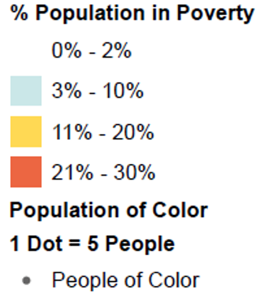
Area Needs
Who lives in this area?
  Connection would better serve residents living at or below the median income looking for job opportunities
% Population living at or below median income

Slide 13
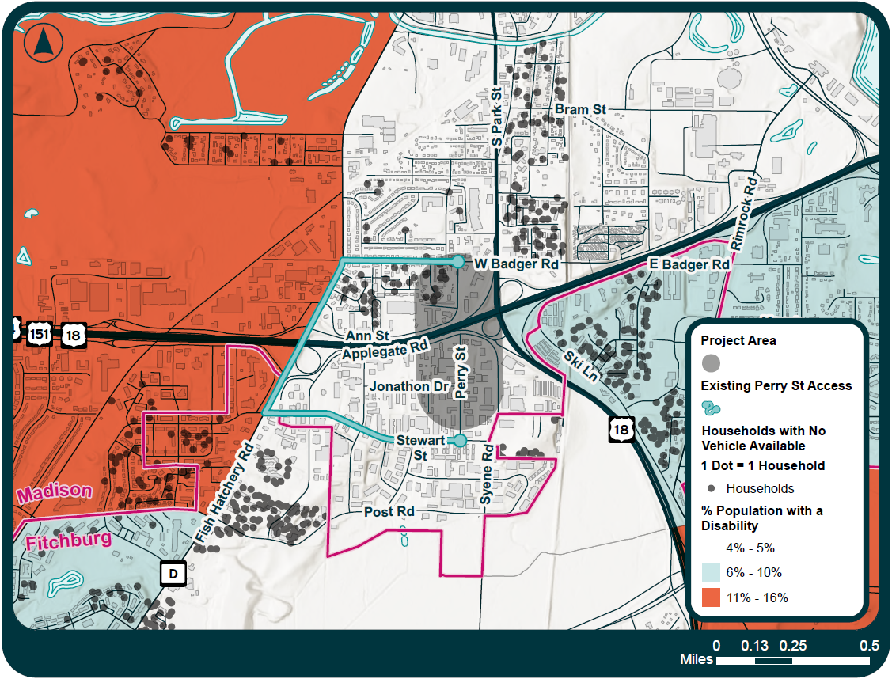
Area Needs
Who lives in this area?
  Connection would better serve those who do not have access to a vehicle

Slide 14
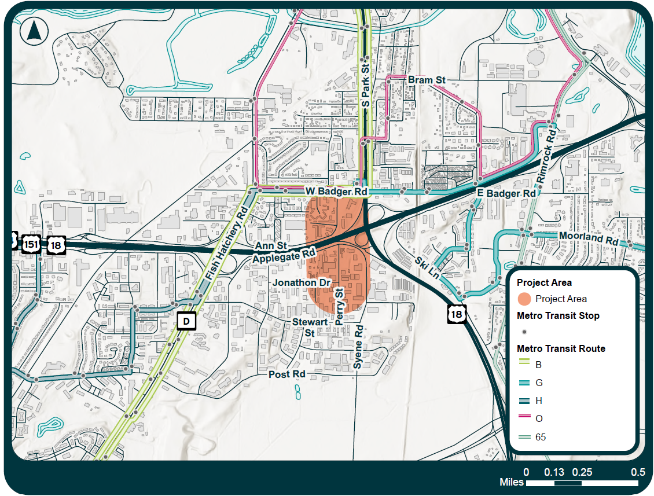
Area Needs
How would it better serve accessible transportation?
  Connection could potentially expand transit system to go into the southern area
  Currently the B and H bus share a route on the same road
  H route could split off in the future

Slide 15
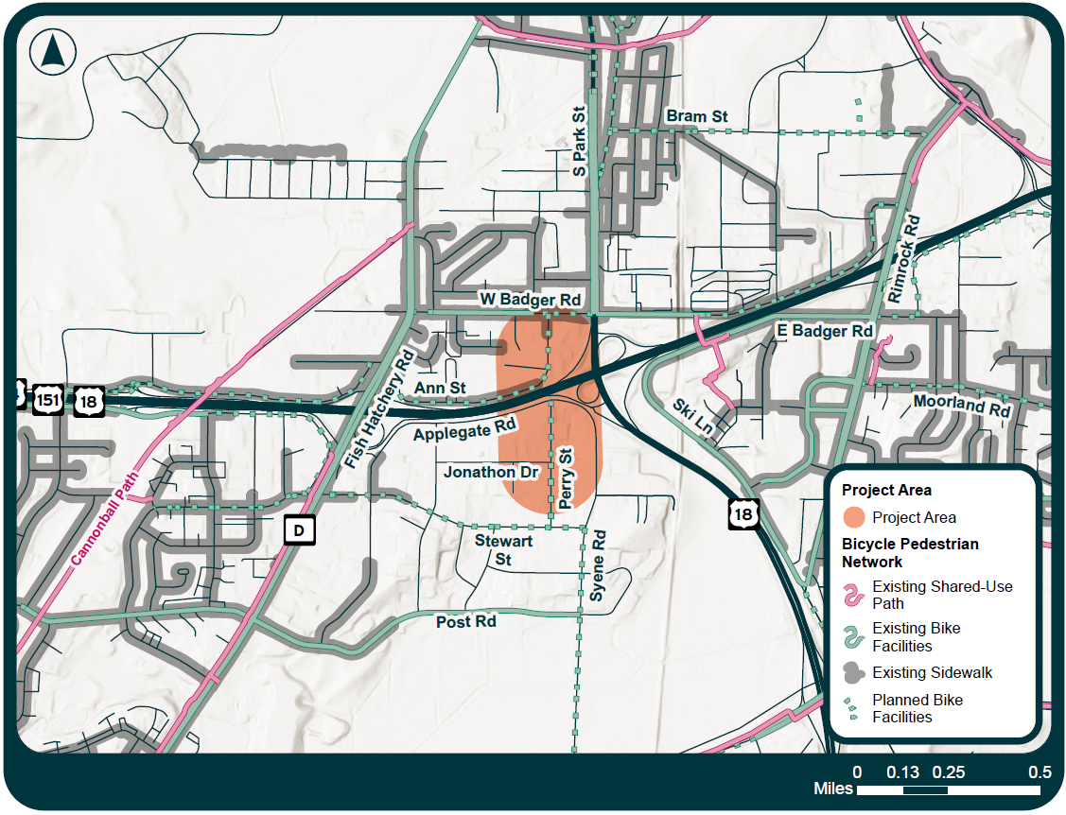
Area Needs
How would it better serve accessible transportation?
  Connection could expand the Bicycle and Pedestrian Network
  Could allow users to not travel through W Badger Rd and Fish Hatchery Rd to access the southern area
  Proposed bike facility here in all ages and abilities network

Slide 16
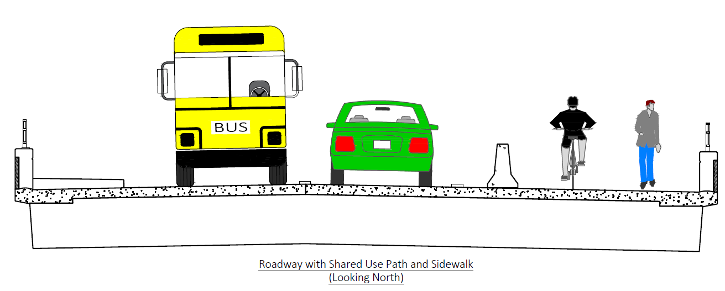
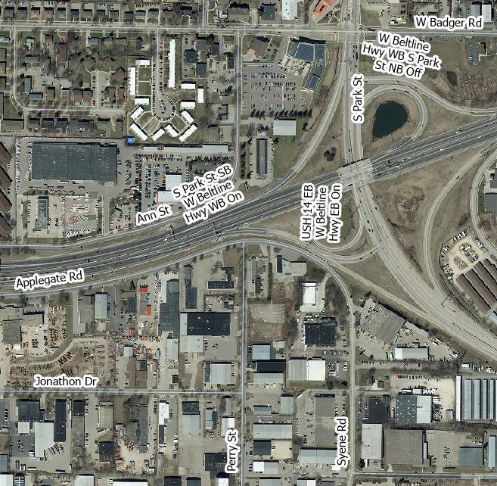
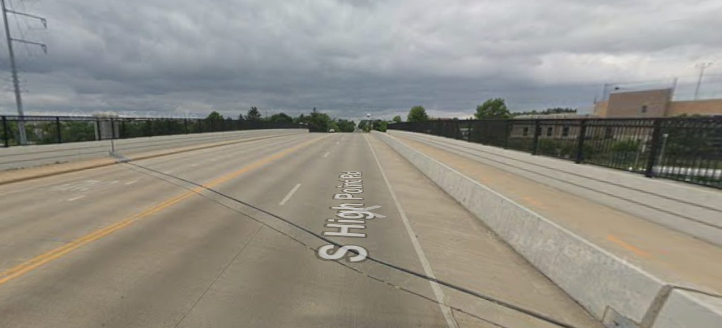
Possible Alternatives – Overpass
An overpass option would provide multi-modal transportation options

Slide 17
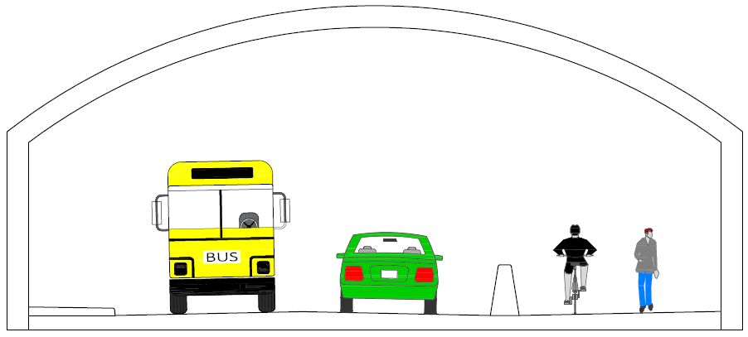
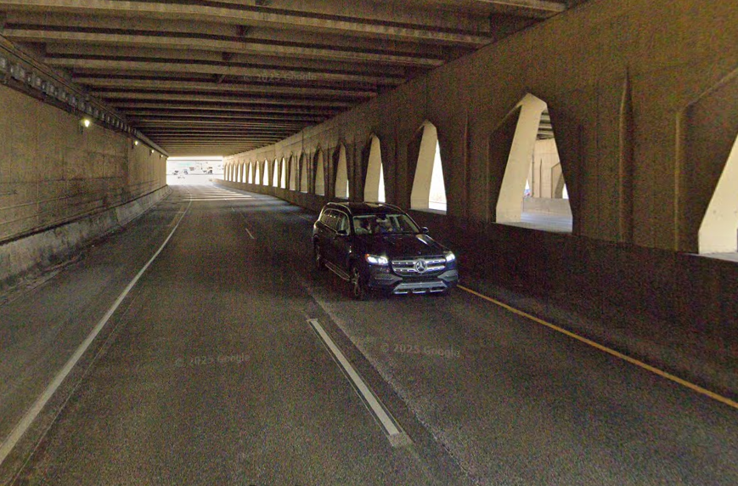
Possible Alternatives – Underpass
An underground tunnel could also be an alternative

Slide 18
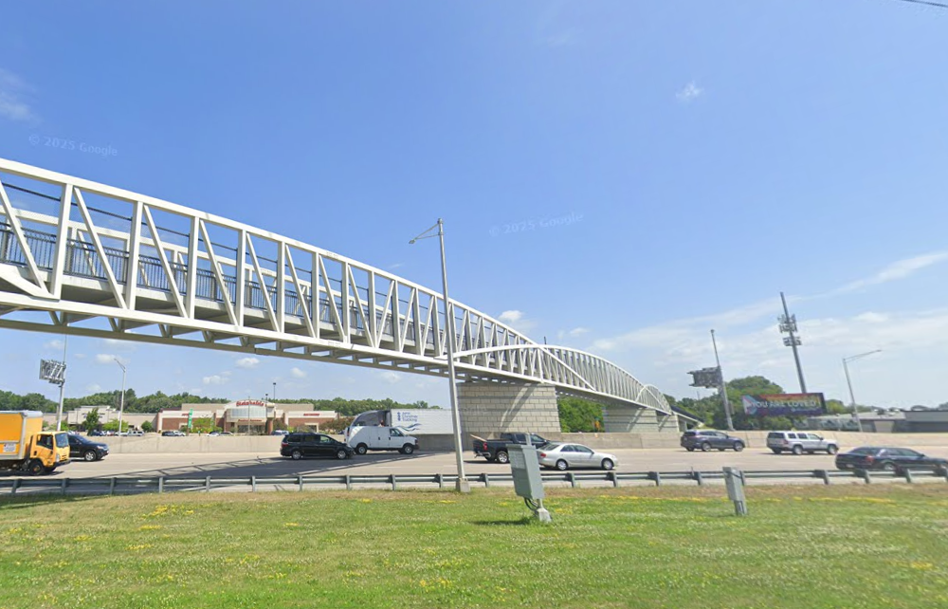
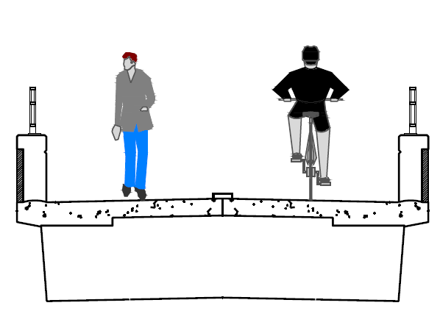
Possible Alternatives – Bike/Pedestrian Only
A Bike/Pedestrian only bridge

Slide 19
Alternative Selection
Looking for initial feedback on general alternatives
City will determine alternatives based on criteria and public feedback
Selected alternatives will be developed in detail for further review by the public and City approval process

Slide 20
Next Steps
Collect feedback / Survey end
  Survey to end November 5th, 5pm
Designing alternatives will start
Preliminary alternatives will go to Transportation commission for initial review
  December 3rd – Tentative date
  Project page will be updated prior to Transportation commission meeting
New survey Prior to second public information meeting
  Will include detailed design alternatives
Second public information meeting will be held Winter 2026

Slide 21
Contact Information & Resources
City of Madison
  Engineer, Jose Navarro, (608) 267-1148, jnavarro@cityofmadison.com
  Engineer, Aaron Canton, (608)242-4763, acanton@cityofmadison.com
  Planner, Breana Collins, (608) 243-0179, bcollins@cityofmadison.com
  Public Information Officer, Kristin Brodowsky, (608) 264-9272, kbrodowsky@cityofmadison.com
  Traffic Engineer, Sean Malloy, (608) 266-5987, SMalloy@cityofmadison.com
  Pedestrian & Bicycle Administrator, Kevin Luecke, (608) 266-6225, kluecke@cityofmadison.com
Project Website:
https://www.cityofmadison.com/transportation/initiatives/perry-street-connection-study
Sign-up for project email updates on the website
  Updates on work progress will be posted to the project website
  Recording of this presentation will be posted on the project website

